Slide 1
Safety and Operational Procedures
Basic Maintenance Tools and Techniques
Personal and Electrical Safety
Environmental Safety and Materials Handling
Professionalism and Communication
Organizational Policies and Procedures
Troubleshooting Theory

Slide 2

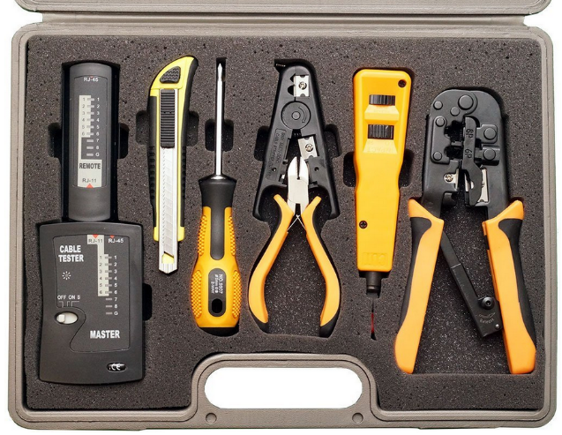
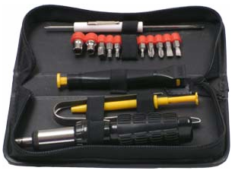
Types of Hardware Toolkits
Basic toolkit
Extended toolkit
Network toolkit

Slide 3
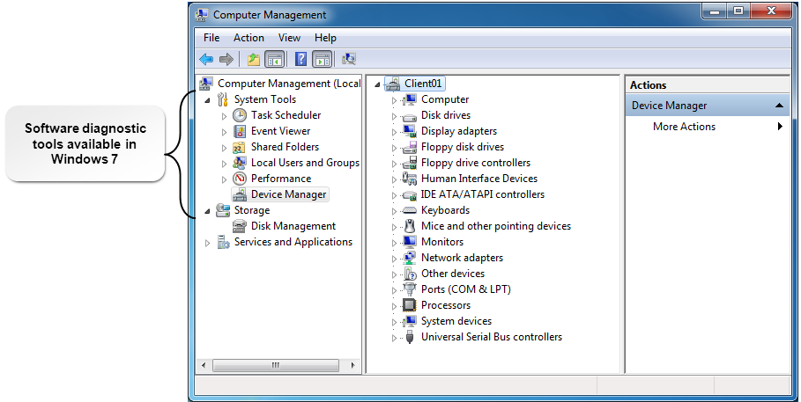
Software Diagnostic Tools
Software diagnostic tools available in Windows

Slide 4
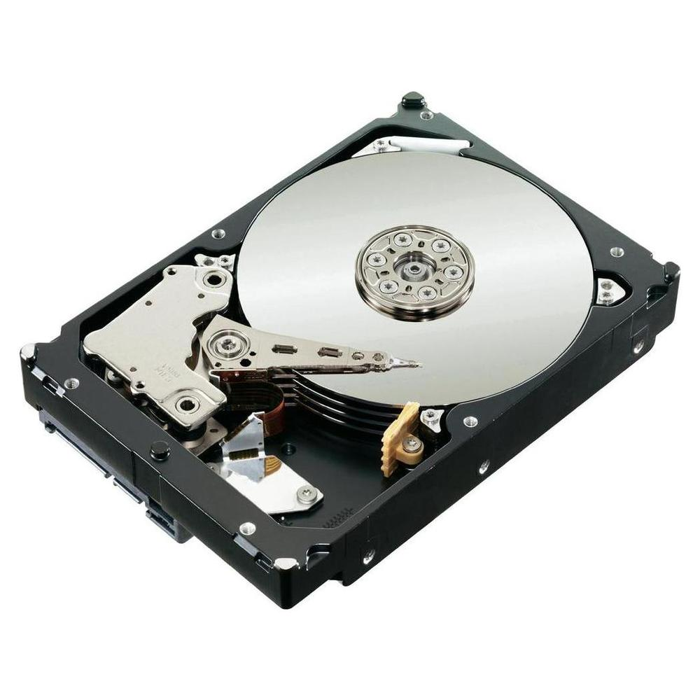
Hard Drive Self-Tests
Diagnostic tool that enables a hard disk drive to test itself when the PC starts.
Can be built into drive’s firmware.
Can be a separate utility available from the drive manufacturer.

Slide 5

Software Diagnostic Tests
Detecting problems
Repairing problems
Preventing problems

Slide 6
Maintenance Techniques for Computer
Components
Technique | Description
Use proper power devices | Use a surge protector or UPS to protect the device from power surges, spikes, brownouts, and power failures.
Clean peripheral components | Cleaning prevents problems with the computer’s peripherals resulting from dust buildup.
Clean internal system components | Cleaning internal components prevents problems resulting from dust buildup.

Slide 7

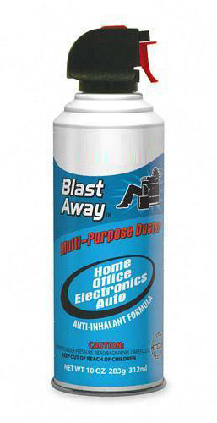
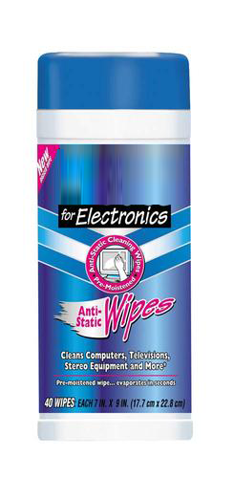
Cleaning Materials
Wipes and cloths
Cleaning solutions
Cleaning tools
Compressed air canister
Computer or electronics vacuum
Mask and gloves

Slide 8




Documentation and Resources
Resource | Description
User and installation manuals | Provide basic guidance for installing, configuring, and troubleshooting hardware and software.
Internet and web-based resources | Provide detailed guidance for installing, configuring, and troubleshooting hardware and software. Knowledge bases and wikis.
Training materials | Provide instructions on how to install and use hardware and software products.

Slide 9
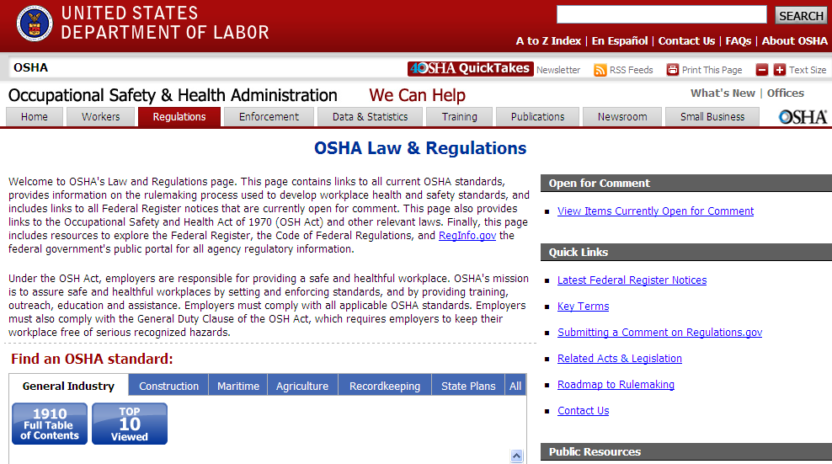
Compliance and Governmental Regulations

Slide 10
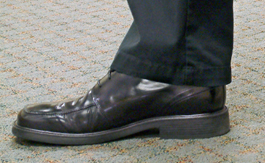

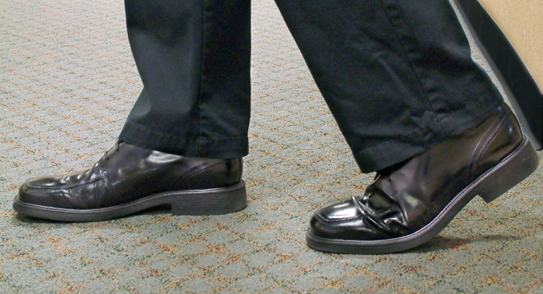
Static Electricity
Object 1
Object 2
Object 1
Object 2

Slide 11
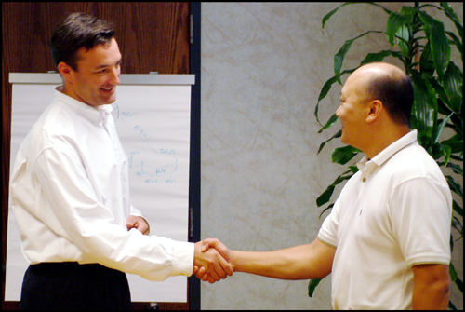
ESD

Slide 12
ESD Prevention Techniques
Eliminate activities and tasks that create static charges.
Use self grounding methods before touching electronic equipment.
Use equipment grounding methods.
  Anti-static vacuums for cleaning
  ESD mats and materials
  Anti-static bags for storing components like RAM and power supplies
Maintain air quality.
  Air ionizer for neutralizing positively charged particles
  Humidifier to maintain 50% to 60% relative humidity

Slide 13
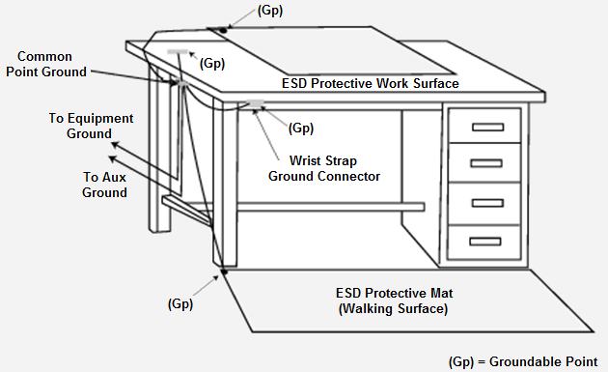
ESD Tools
Wrist or ankle strap
Grounded floor mat or grounded work-surface mat
Anti-static bags
ESD smock

Slide 14
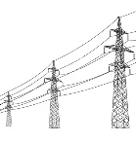






EMI

Slide 15

Electrical Hazards
Electric shock
Electrocution (fatal shock)
Burns
Collateral injuries

Slide 16
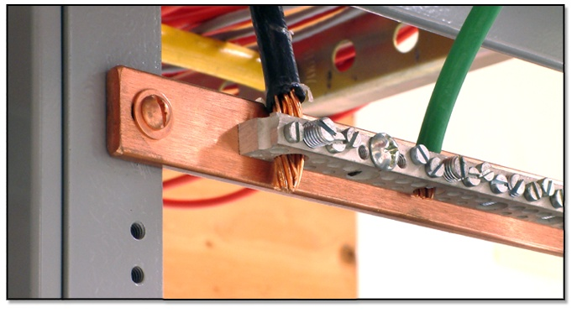
Equipment Grounding
Shelf frame connects to the ground
Ground
point
Conductor

Slide 17
Personal and Electrical Safety Precautions
Be aware of personal safety measures.
Be aware of the environmental conditions you are working in.
Prevent static electricity from damaging components by using anti-static equipment.
Use safety guidelines when disassembling computer equipment.
Use caution when working with power supplies.
Be aware of the electrical fire safety procedures.

Slide 18
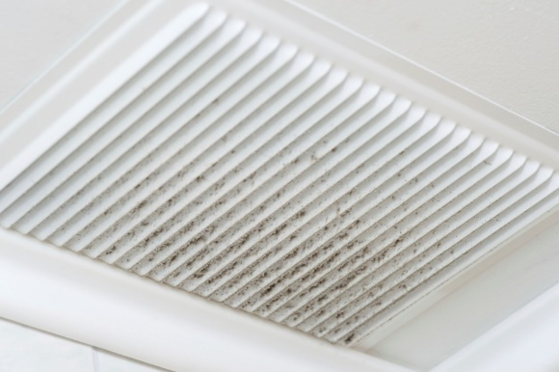
Environmental Considerations
Consideration | Description and Controls
Ozone gas | Caused by laser printers. Ensure proper ventilation around printers.
Temperature and humidity | Extremes in temperature and humidity can damage equipment and hinder performance. Maintain moderate temperature and humidity in areas were PCs are used.
Dust and debris | Dust buildup can cause resistance or heat retention. Clean equipment periodically.
Airborne particles | Contaminants such as ozone, particulates, or organic emissions can damage computer equipment by corrosion and overheating. Install protective enclosures for PCs, or install air filters designed to remove airborne particles as they flow through the HVAC system.

Slide 19
Workplace Safety Issues
Safety Issue | Description
Falling and tripping | Keep in mind the location of hardware, cables, and devices. Use cord protectors to cover cords and cables that run across the floor. Implement cable management techniques.
Equipment storage | Don’t stack PCs and other hardware. Make sure equipment is secure.
Component handling and protection | Follow proper handling guidelines. Use anti-static bags.
Lasers | Used in printers and optical drives. Can cause damage to human eyes and skin. Never point a laser at anyone, never look into the laser source, and never disable safety mechanisms on devices with embedded lasers.
RSI | Injury due to repetitive motion. Rest, medication, therapy, and even surgery might be prescribed for sufferers. Prevent by providing an ergonomic arrangement of computer equipment.
Eye strain | Blurred vision, difficulty focusing, double vision, tiredness, headaches, and burning, sore, or itchy eyes. Dry eyes Take frequent breaks, get eye exams, and use eye drops or artificial tears.

Slide 20
Workplace Safety Issues (Cont.)
Safety Issue | Description
Noise | Most noise associated with normal computer use is not damaging. Loud noise might indicate an equipment problem. Industrial high-speed printers might require sound-suppression equipment or should be placed away from operators.
Hot components | Can cause burns. Avoid prolonged exposure to hot components.
Food and drink | Can cause hardware malfunction. Follow internal policies regarding food and drink around PCs.
Moving equipment | Lifting and moving computer equipment can cause back injuries. Be aware of what you can lift. Ask for help when necessary. Lift with your knees. Plan ahead.

Slide 21
General Power Issues
Power Problem | Description
Blackout | Complete loss of power.
Brownout | A temporary power reduction that is often used by electrical power companies to deal with high power demands.
Sag | A momentary low-voltage power failure.
Spike | A short-term increase in the electrical supply voltage or current carried on a wire.
Surge | A sudden sharp increase in voltage or current that can last up to 50 microseconds.

Slide 22
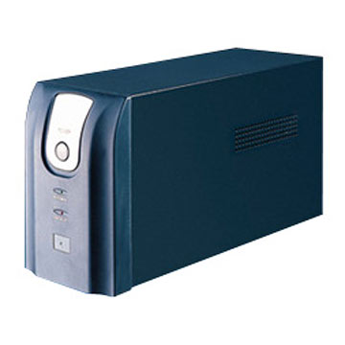

Power Protection Systems
UPS or battery backup
Generators
Surge suppressor

Slide 23
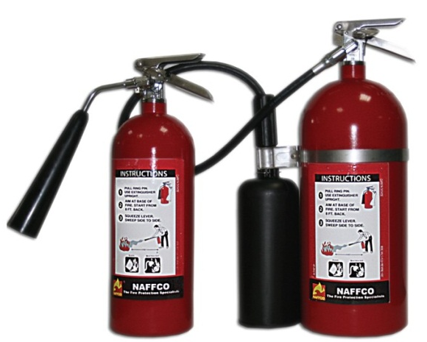

Liquid Hazards
Hazardous liquids are commonly encountered in many workplaces.
Compounds are used to clean or condition equipment.
Read the labels and follow instructions carefully when disposing of hazardous liquids.

Slide 24
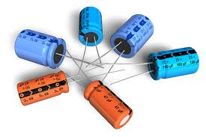
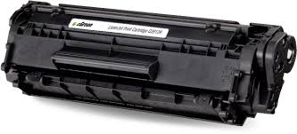
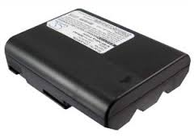
Chemical Hazards
Laser printer toner
Batteries
Capacitors

Slide 25
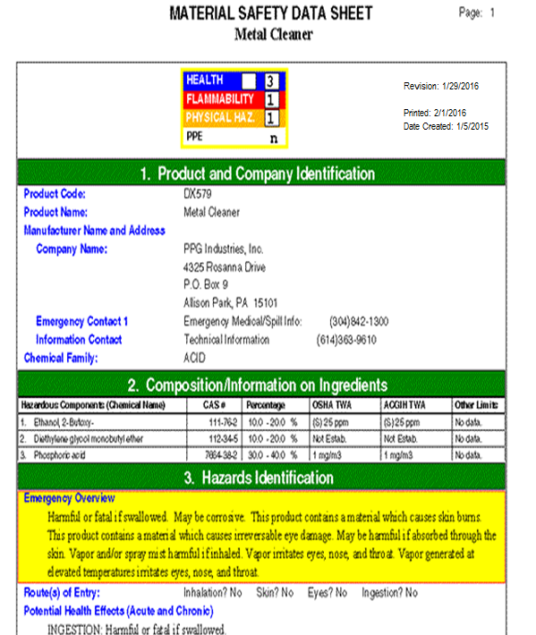
MSDS Documentation

Slide 26
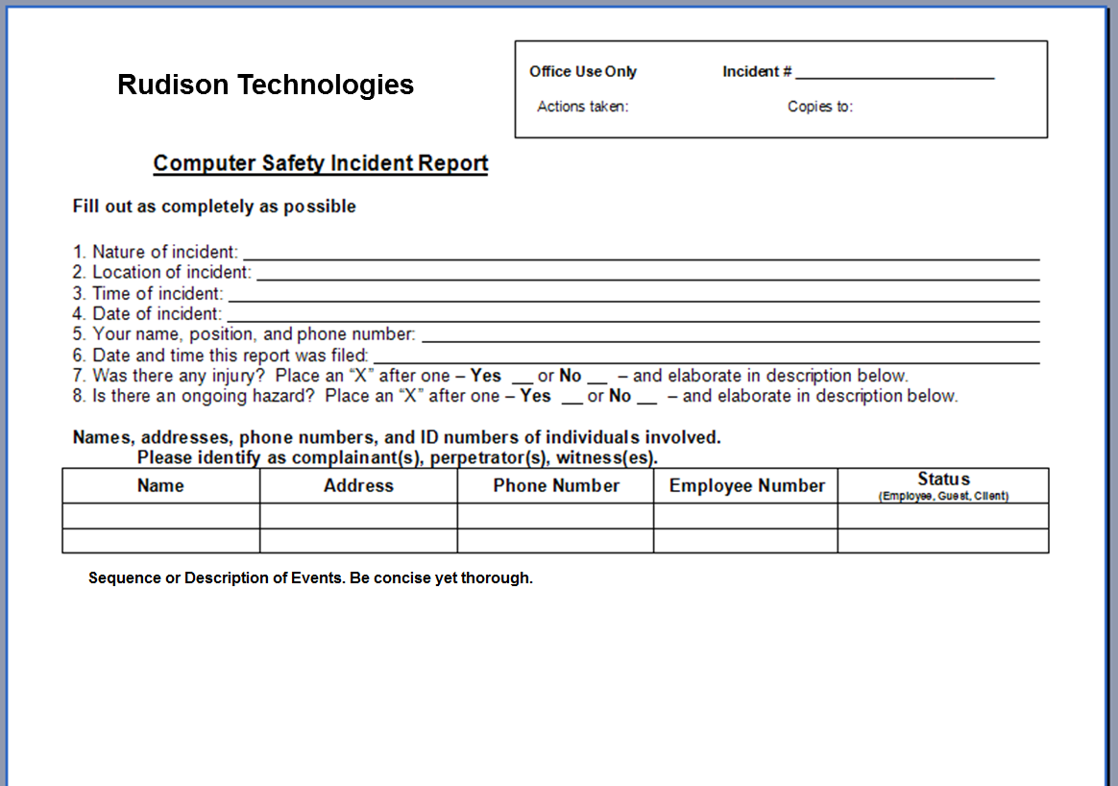
Incident Reports

Slide 27

Hazardous Materials Handling and Disposal
Liquid cleaners and empty containers
Toner
Display devices
Ozone filter
Batteries

Slide 28
Communication Skills
Use proper language.
  Avoid jargon, acronyms, and slang.
Maintain a positive attitude and project confidence.
Actively listen to the customer.
  Take notes.
  Avoid interruptions.
Be culturally sensitive.
  Use professional titles.
  Maintain personal space.
Be on time.
  Contact the customer if you are detained.
  You might need to reschedule.
Avoid distractions.
Deal appropriately with confidential and private materials.
Set and meet expectations and timelines.
  Communicate status with the customer.
Use discretion and tact to deal with difficult situations.

Slide 29
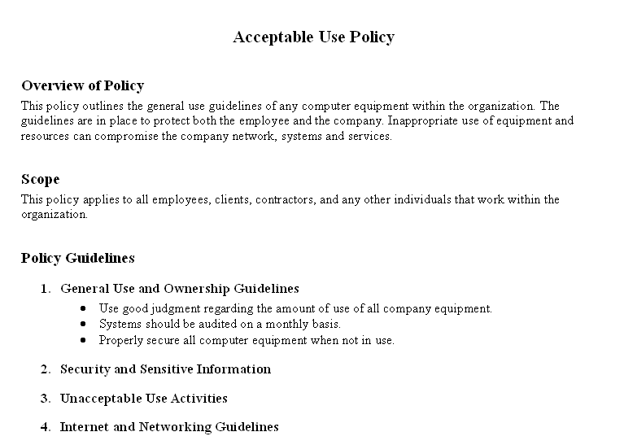
AUP

Slide 30
Prohibited Content and Activities
Prohibited activities
  Viewing forbidden web pages
Prohibited content
  Distasteful
  Inappropriate
  Illegal
Social networking sites
Reporting

Slide 31
Guidelines for Dealing with Prohibited
Content and Activities
First response
  Identification of data and/or hardware.
  Reporting the details of a discovery and evidence through proper channels.
  Preserving the data and/or device as evidence.
Chain of custody
  Record tracking of evidence from collection to presentation in court.
Documentation
  An organization’s documented procedures should always be followed.

Slide 32

Computer Forensics
  Basic forensic response procedures for IT include:
  Capture system image
  Examine network traffic and logs
  Capture video
  Record time offset
  Take hashes
  Take screenshots
  Identify witnesses
  Track man hours and expense

Slide 33
Privacy
Affected Party | Legal Considerations
Employees | Who is liable for misuse of email and Internet resources—the organization, the employee, or both? What is the extent of liability for an organization for criminal acts committed by its employees? What rights to privacy do employees have regarding electronic communications?
Customers | What customer data is considered private and what is considered public? How will a company protect the privacy and confidentiality of customer information?
Business partners | Who is liable if the data resides in one location and processing takes place in another location? Who is responsible for the security and privacy of the information transmitted between an organization and a business partner—the sender or the receiver?

Slide 34

Software Licensing
  Single or multiple installations
  DRM and EULA
    Digital rights management
    End user license agreement
  Open source software
  Commercial licensing
  Personal licensing
  Enterprise licensing

Slide 35

Troubleshooting Theory
Identify the problem.
Establish a theory of probable cause.
Test the theory to determine the cause.
Establish a plan of action to resolve the problem and implement the solution.
Verify full system functionality and implement preventive measures when applicable.
Document your findings, actions, and outcomes.

Slide 36



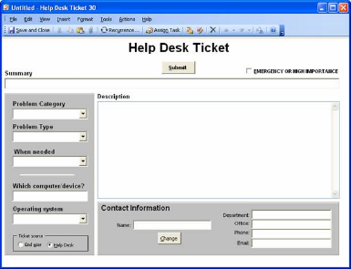
Troubleshooting Software Tools
OS installation media
Antimalware software
Commonly used device drivers
Other software
Call-tracking database

Slide 37
Reflective Questions
1. Which of the best practices discussed in this lesson apply in
your workplace?
2. Have you ever been in a situation where you uncovered inappropriate
conduct or prohibited activity?

