Slide 1
Optimizing and Maintaining
Microsoft Windows
Optimize Microsoft Windows
Back Up and Restore System Data
Perform Disk Maintenance
Update Software

Slide 2
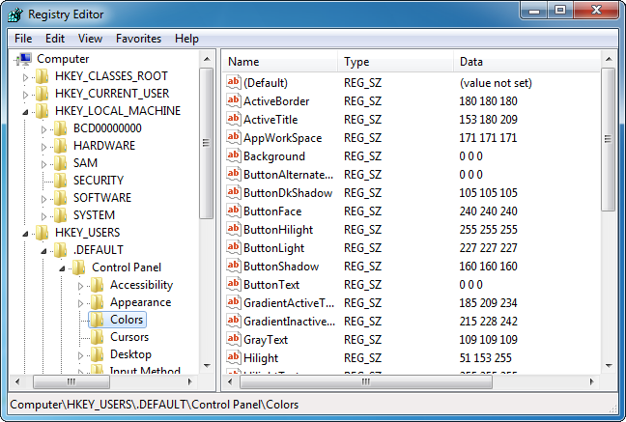
The Registry
Value entries
Subtrees
Keys

Slide 3
Registry Subtrees
Subtree | Contents
HKEY_CURRENT_USER | User-specific configuration information for the user currently logged into Windows.
HKEY_USERS | User-specific configuration information for any user who has ever logged into Windows.
HKEY_LOCAL_MACHINE | Configuration information for the PC’s hardware.
HKEY_CURRENT_CONFIG | Current configuration for the PC’s hardware, including Plug and Play configurations.
HKEY_CLASSES_ROOT | File association information.

Slide 4
Registry Editing
View and manually edit in the Registry Editor.
Automatic changes:
  OS
  Hardware devices
  Applications
Always back up the Registry before opening the Registry Editor.

Slide 5




Virtual Memory
Physical memory
4 GB
Virtual memory addresses
Virtual memory manager
pagefile.sys

Slide 6

The Virtual Memory Process
Storing virtual memory data
1
4
5
Virtual memory manager
Physical memory
2
pagefile.sys
3
Memory page
4 GB
Virtual memory addresses

Slide 7

The Virtual Memory Process (Cont.)
Retrieving virtual memory data
2
4
4
Virtual memory manager
Physical memory
3
4
2
4
pagefile.sys
1
5
Memory page
4 GB
Page fault
Virtual memory addresses

Slide 8
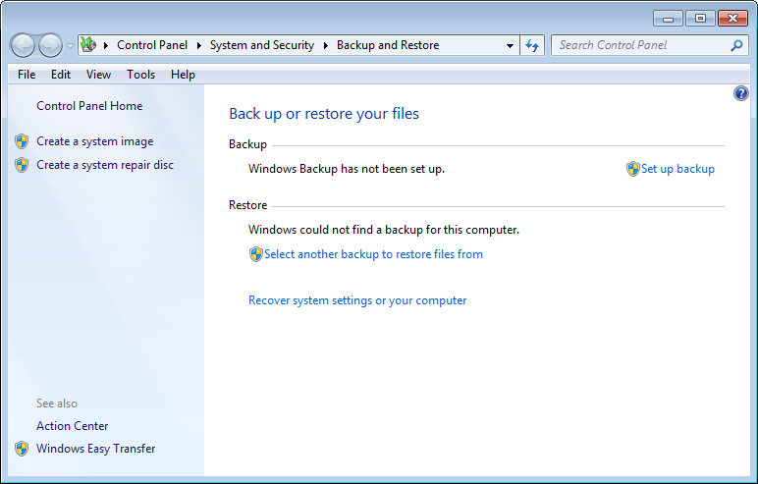
Data Backup and Restoration

Slide 9


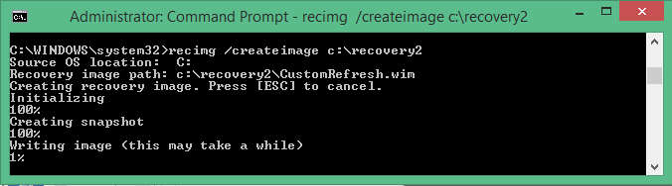
Recovery Images
Refreshes a Windows computer
Default image created when installing Windows 8 or 8.1:
  Post-installation configuration information not included
  Updates not included
Custom images created with RECIMG.EXE:
  All desktop applications
  Current state of all Windows files
  CustomRefresh.wim
  Multiple custom images possible
Image does not affect:
  Windows Store apps
  Documents
  User profiles
  Personal settings

Slide 10
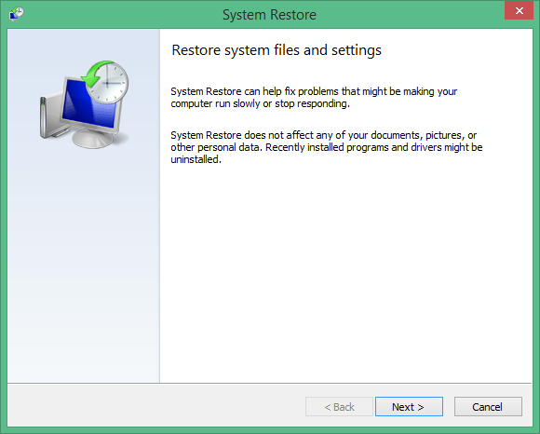
System Restore

Slide 11




Scheduled Tasks
Schedule preventive maintenance tasks for maximum safety and optimal performance.
Organizational policies might require scheduling of maintenance tasks.
Backups are the most common scheduled tasks.

Slide 12

Disk Maintenance
Monitoring and adjusting the configuration of HDDs and the file systems contained on HDDs.
Prevent and solve:
  File system errors
  Bad sectors on the disk platters
  Corrupted files
  Disk fragmentation

Slide 13
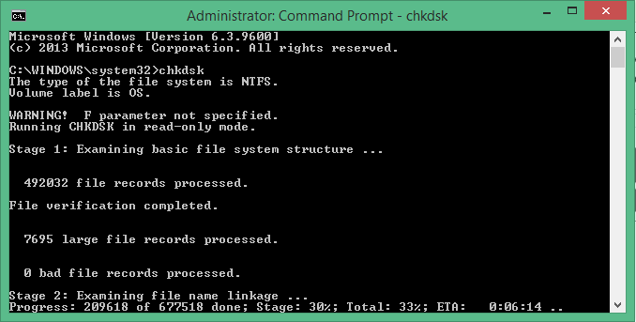
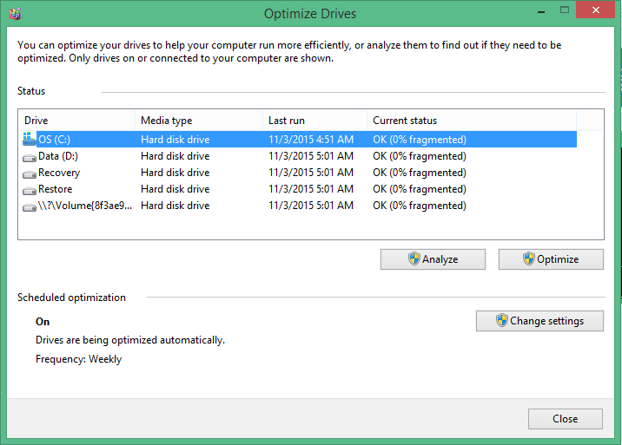
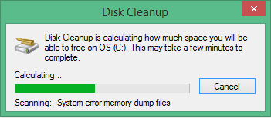
Disk Maintenance Tools

Slide 14

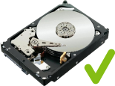
Scheduled Disk Maintenance
Check Disk
Disk defragmentation

Slide 15



Patch Management
Monitoring for, obtaining, evaluating, testing, and deploying integral fixes and updates for programs or applications.
Not all patches should be automatically applied.
  Evaluate for appropriateness.
  Test for compatibility on isolated PCs.
A patch management program may include:
  An individual who subscribes and reviews patched and newsletters.
  Regular review and triage of updates.
  Offline patch test environment.
  Administrative push of both immediate and weekly patches.
  Periodic evaluation of non-critical updates.
Patch management policies adopted by many organizations.

Slide 16

Driver and Firmware Updates
Created by manufacturers to address specific functionality issues.
Updates are downloadable from the web:
  Can be burned to optical disc.
  Can be copied to a flash drive.

Slide 17
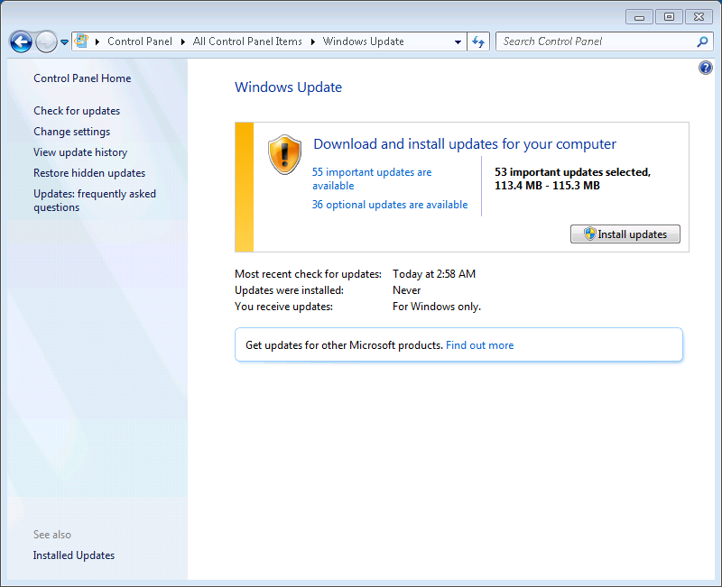
Windows Updates

Slide 18
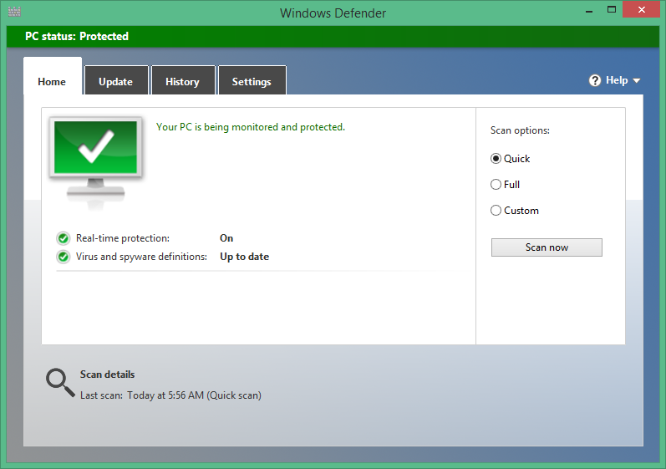
Antivirus and Antimalware Software

Slide 19
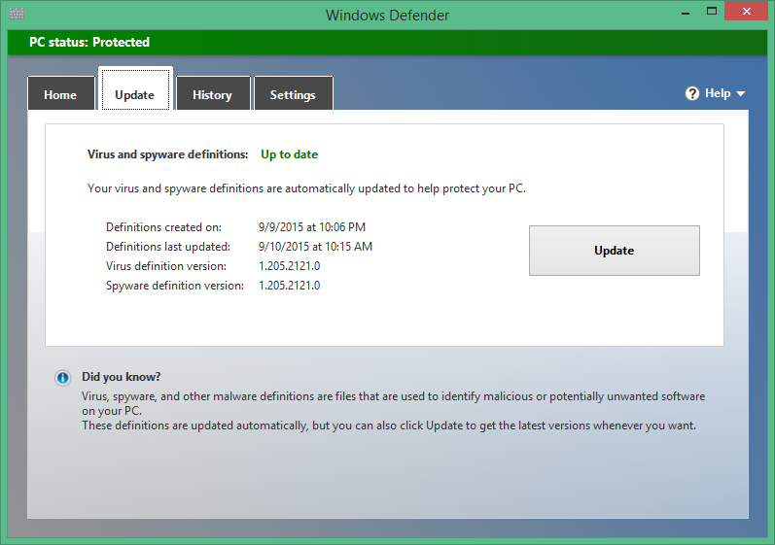
Antivirus and Antimalware Updates

Slide 20
Guidelines for Managing Software Updates
Consider developing a formal patch management process and identifying an update manager.
Always test software updates before rolling them out to all users.
Identify and use an antimalware solution in addition to Windows Defender.

Slide 21
Reflective Questions
Which of the tools and concepts presented in this lesson have you used to optimize and maintain Windows operating systems? Which ones do you think you will use most often in the future?
Have you ever needed to restore settings from a restore point? If so, what happened that caused you to need to do a restore? Were you able to successfully restore the settings?

