Slide 1
Implementing Security Controls
Secure Operating Systems
Secure Workstations
Secure SOHO Networks
Secure Mobile Devices

Slide 2
Types of Users
User Account | Description
Administrator | Complete administrative access to a computer,
Power User | A legacy user type that had fewer access privileges than administrators, but more than standard users.
Standard user | Can use most software on a computer.
Guest | Limited access only.

Slide 3
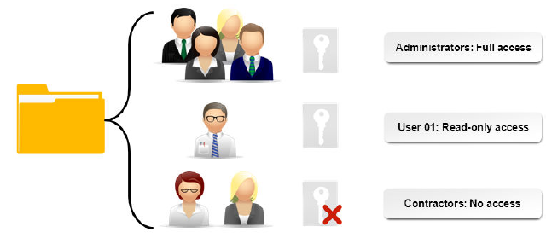
Permissions

Slide 4
NTFS File and Folder Permissions
Standard NTFS file permissions:
  Read
  Write
  Read & Execute
  Modify
  Full Control
Standard NTFS folder permissions:
  List Folder Contents
  Read
  Write
  Read & Execute
  Modify
  Full Control
Special permissions are the individual components of standard permissions.
File compression and encryption.

Slide 5


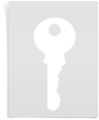
Shared Files and Folders
Shares include:
  Folders
  Printers
  Drives
Allow access from remote computers.

Slide 6
Share Permissions
Permission | Description
Read | View file and subfolder names, contents, attributes Run program files Granted to Everyone by default
Change | Perform all Read permission tasks Add, change, delete files and subfolders
Full Control | Perform all Read and Change tasks Change permissions

Slide 7


NTFS vs. Share Permissions
NTFS permissions apply to actions users can take on files and folders on locally or on the network.
Share permissions apply to folders, subfolders, and files that have been shared with other users and are accessed from the network.
Both NTFS and share permissions can be applied to the same file or folder.
The most restrictive permission will apply.
NTFS permissions
Share permissions

Slide 8
File System Security
Consideration | Description
Allow or Deny? | When choosing whether to allow or deny an action using permissions, choose carefully between the two. Deny is more restrictive than Allow. If the Deny property is applied on either a file or a folder, it will override any Allow permissions that may have been granted to the user.
Move or copy files and folders? | When permissions have been applied, moving a file or folder and copying that file or folder will have different results. It is important to consider those results when choosing whether to move or to copy your files or folders. On the same partition: Move: retains permissions from old location. Copy: inherits permissions from new location
File attributes | You can set file attributes on files and folders, and these attributes can affect the actions a user can have on that specific file or folder, regardless of the permissions that have already been set.

Slide 9



Security for Shared Files and Folders
Administrative shares and local shares.
In Windows, edit folder properties to share the folder.
Inheritance.
Propagation.

Slide 10

Security for System Files and Folders
Read Only.
Hidden.
Meant to protect system files and folders from deletion or modification.
If modification or deletion is necessary, remove the Read Only permission.

Slide 11
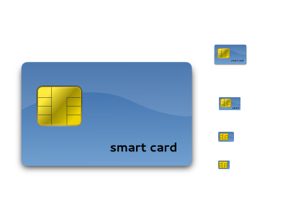
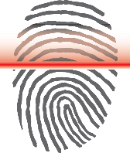
User Authentication
Proving your identity to gain access to network resources.
Methods.
Factors:
  What you know
  What you have
  What you are
SSO.

Slide 12
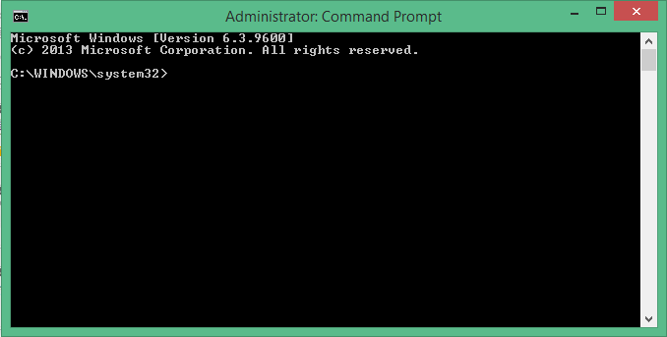
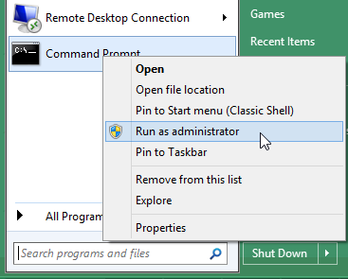
Run as Administrator

Slide 13
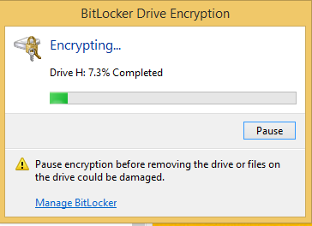
BitLocker
Provides full disk encryption for the OS volume.
BitLocker To Go encrypts removable storage devices.
Recovery key backup.

Slide 14
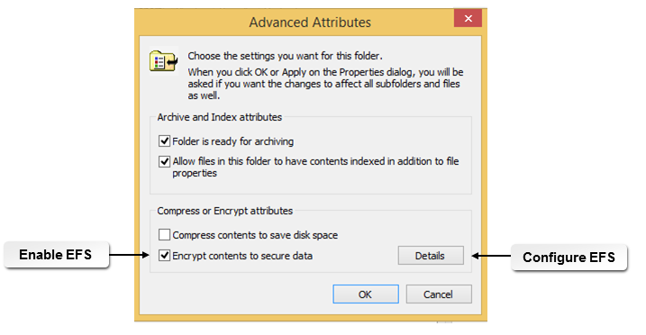
EFS
Encrypting File System.
Available on any NTFS partition.
Uses digital certificates to encrypt files.

Slide 15
Guidelines for Securing Microsoft Windows
Log in as a standard user.
Use Run as Administrator when you need administrative access.
Provide the minimum permissions to achieve your access goals
Verify that the combination of NTFS and share permissions provide the expected results:
  No excessive rights assignment
  No removal of needed rights
Use multifactor authentication.
Consider encrypting file systems.

Slide 16
Password Best Practices
Best Practice | Description
Configuring password expiration | For most organizations, every two to three months is adequate. Some organizations might require more frequent changes.
Changing default user names and passwords | Devices like wireless routers come configured with default user names and passwords, which can be found by a simple Internet search. When you are adding these devices to your environment, change the user name and password to protect against unauthorized access.
Require screensaver passwords | When a user steps away from the computer, they should lock the computer. If they forget to do so, having a screensaver that comes on after one minute and requires a password to unlock the system has the same effect.
Require BIOS or UEFI passwords | Setting a BIOS or UEFI password will help prevent unauthorized users from accessing and changing firmware settings. If users make unauthorized changes to these settings, it might make their system stop working, make it work less efficiently, or make it out of compliance with organizational policies.
Require passwords | On most modern systems, you have to set a password in order to set up the computer. If you are working with older systems, or other devices that don't have passwords by default, you should configure the device to use a password. Smart phones and tablets might not be configured to require a password. Printers and routers might also not require a password to change settings. All of these devices should require passwords whenever possible.

Slide 17
Account Management
Task | Description
Restrict user permissions | Follow the principle of least privilege.
Configure login time restrictions | Limit the days and hours that users can log in.
Disable the guest account | Windows guest accounts are disabled by default.
Configure failed login attempts lockout | Select a threshold for entering the wrong password before locking the account, and the amount of time the account should be locked.
Configure a timeout screen lock | Select a timeout interval for idle computers and mobile devices, and require that the password or another method be used to unlock the device.

Slide 18
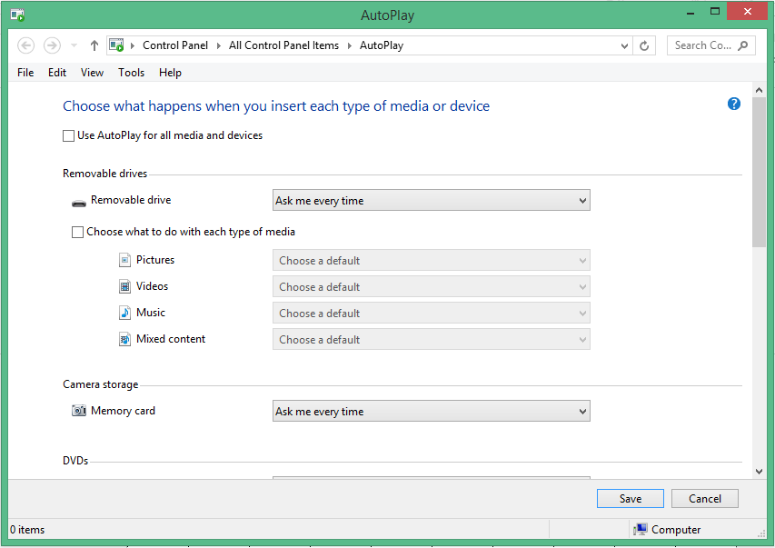
Autorun
Disable AutoRun (AutoPlay) on storage media:
  Optical disc
  USB drive
Prevent embedded malware from self-installing.

Slide 19
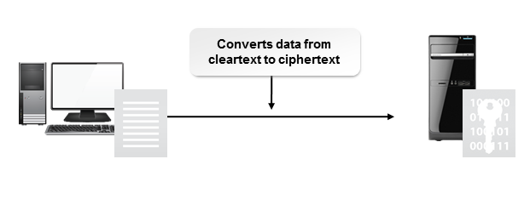
Data Encryption

Slide 20

Patch Management
Monitoring for, obtaining, evaluating, testing, and deploying integral fixes and updates for operating systems or applications.
Organized patch management system:
  A person responsible for reviewing vendor patches, security patches, and other updates.
  A process for reviewing and categorizing updates (urgent, important, and non-critical).
  An offline environment where urgent and important patches can be tested for functionality and impact.
  Immediate administrative push delivery of approved urgent patches.
  Weekly administrative push delivery of approved important patches.
  Periodic review, testing, and rollout of non-critical patches.

Slide 21
Guidelines for Securing Workstations
Manage user authentication:
  Default user name and password
  Strong passwords
  Multifactor authentication
Install updates and patches:
  OS and security updates
  Application patches for OS utilities, web browsers, and application software
Manage user accounts:
  Disable guest and unnecessary accounts
  User permissions
Educate users.
Apply workstation security measures:
  Antimalware software
  Pop-up blocker
  Firewall
  Warnings and banners at login
  AutoRun and AutoPlay
  Screensaver lock
  Automatic OS updates
  Shared resources

Slide 22
SOHO Security Methods
Change default user name and password.
Enable MAC filtering.
Assign static IP addresses.
Disable ports.
Configure firewall settings.
Configure port forwarding and mapping.
Use content filtering and parental controls.
Apply firmware updates.
Apply physical security controls.
Perform security assessments.

Slide 23

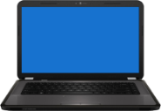



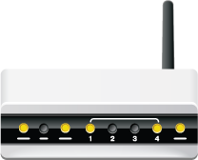




Wireless Security
Wireless eavesdropper
Secured wireless network
10001101110000111110000011010101
10001101110000111110000011010101010111001000011111110101010001111
10001101110000111110000011010101
Prevents data access and wireless intrusions

Slide 24
SOHO Wireless Security Methods
Configure the network settings.
Configure the SSID.
Enable encryption.
Properly place the antenna and access point.
Secure the WAP.
Adjust radio power levels.
Adjust or disable WPS.
Configure the workstation.

Slide 25
Guidelines for Securing SOHO Networks
Implement over-the-air data encryption.
Install antivirus and antimalware protection.
Update clients with software security patches.

Slide 26
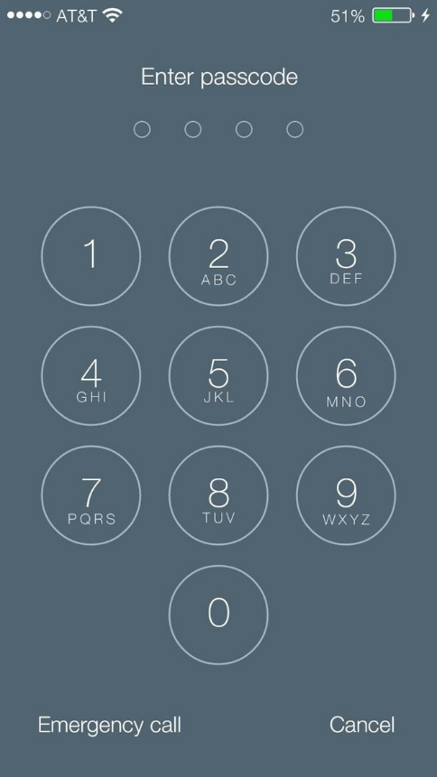
Screen Locks
Enable with a passcode, a fingerprint, facial recognition, or a swipe pattern.
Configure idle time before screen lock is activated.
Organizational security policies.
Swipe passcodes or PIN/password?

Slide 27
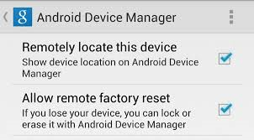
Remote Wipe
Removes sensitive data from mobile devices.
Useful if device is lost or stolen.
Organizational security policies.
Administrative rights for remote wipe.

Slide 28

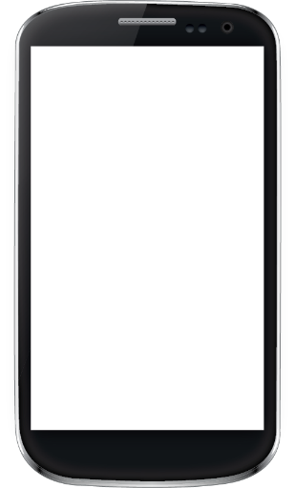

Locator Applications
GPS tracking.
Useful if device is lost or stolen.
Third-party apps.
Enable camera to help catch thief.

Slide 29
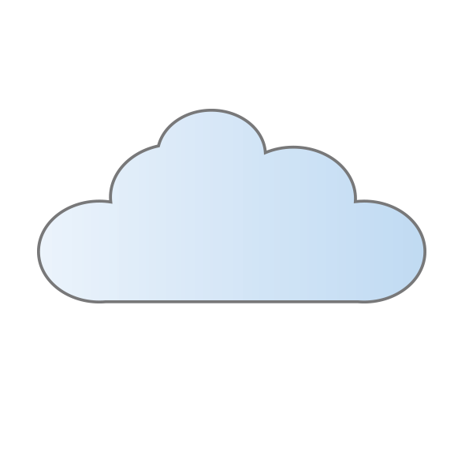


Remote Backup Applications
OS-based:
  iCloud
  Google Drive
Help with recovering data when a device is lost or stolen.
Backed-up data
Lost or stolen phone
Replacement phone

Slide 30
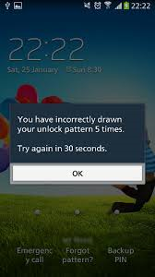
Failed Logon Attempts Restrictions
iOS device: disable after X failures to log on:
  Up to 5: usually no action.
  5 to 10: disabled for 1 to 60 minutes.
  More than 10: data deleted.
Android device: disable after X failures to log on:
  Unlocking the device will require the Google account details used to set up the device.

Slide 31



Antivirus and Antimalware Applications
BullGuard Mobile Security
Kaspersky Mobile Security
ESET Mobile Security
Lookout Premium
Trend Micro Mobile Security
Webroot Secure Anywhere Mobile

Slide 32
Mobile OS Patches and Updates
Similar to updates for other computing devices.
Configure devices to update automatically.

Slide 33
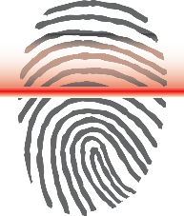
Biometric Authentication
Camera for face recognition
Fingerprint scanner

Slide 34
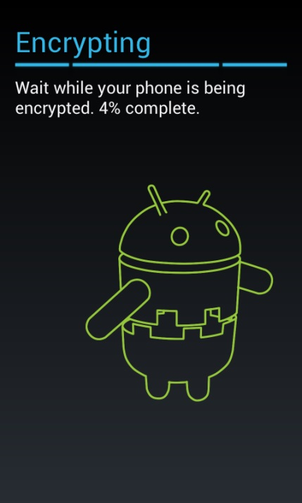
Full Device Encryption
Device encryption
Data encryption
Organizational security policies

Slide 35
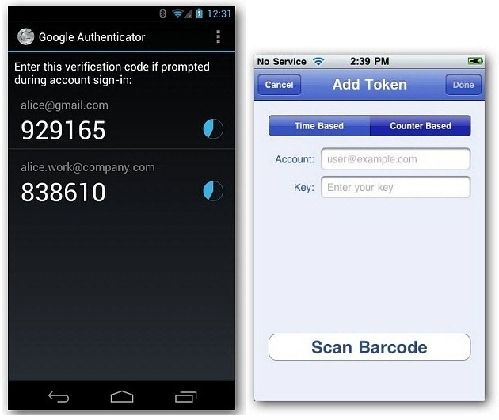
Multifactor Authentication
Combination of PIN and swipe pattern
Combination of biometrics and password
Authenticator app
  Two-step authentication

Slide 36


Trusted and Untrusted Sources
Apps
Wireless networks

Slide 37

Firewalls
Mobile device firewall hardware
Mobile device firewall software

Slide 38
Policies and Procedures
Security profiles
  Policies
  Procedures
  Standards
  Baselines
  Guidelines

Slide 39

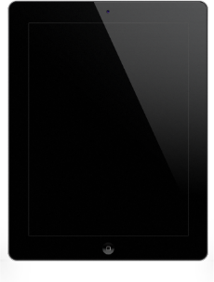
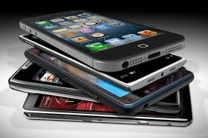
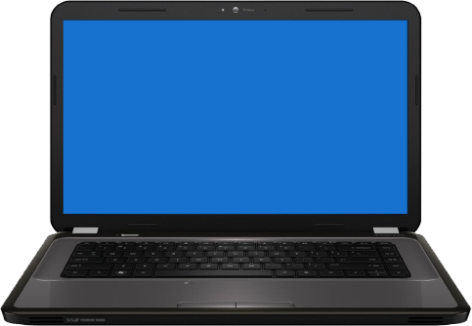
Policies and Procedures (Cont.)
BYOD
  Bring your own device
  User-owned devices in the workplace
  Data protection is critical
COPE
  Corporate Owned, Personally Enabled
  Organization-owned devices that employees can use for personal reasons
  Developed to address BYOD concerns

Slide 40
Guidelines for Securing Mobile Devices
Require screen locks, and configure a short inactivity duration.
Configure remote wipe capabilities.
Leverage locator apps when devices are lost or stolen.
Back up mobile data.
Configure failed login attempt restrictions.
Use antivirus or antimalware software.
Install mobile OS updates.
Use biometric authentication when available.
Use full device encryption.
Use multifactor authentication.
Use trusted apps and networks.
Configure mobile firewalls when available.
Consider BYOD and COPE policies.

Slide 41
Reflective Questions
Which security measures do you feel are the most important? Which are the minimum measures that should be taken? Does your organization implement good security practices?
What physical security controls have you had experience with? What controls do you think are the most common?

