Slide 1
Troubleshooting System-Wide Issues
Troubleshoot PC Operating Systems
Troubleshoot Mobile Device Operating Systems
Troubleshoot Wired and Wireless Networks
Troubleshoot Common Security Issues

Slide 2

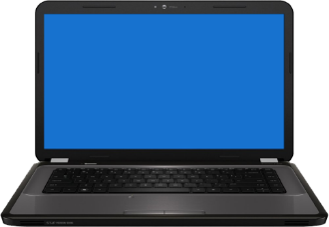




The Windows Boot Process
Pre-boot
Boot
Kernel load
Kernel initialization
Logon

Slide 3
The Linux Boot Process
Processor checks for BIOS and runs it.
BIOS checks for peripherals and a valid boot device.
BIOS loads primary boot loader into memory.
User is prompted to select an OS to boot to.
Boot loader finds the kernel binary, uploads the initrd image into memory, and transfers control to the kernel.
Kernel configures hardware.
Kernel mounts the root partition, releases unused memory, and runs init
init searches for inittab, sets the environment past, checks the filesystem, initializes ports, and runs background processes for the runlevel.
For graphical mode, xdm or kdm starts and displays the login window.
Use enters login name and password.
System authenticates the user credentials, runs scripts, and starts the shell.

Slide 4
The OS X Boot Process
Firmware initialization
  POST test and hardware initialization
  Booter found and started
  Startup chime and single flash of power light
Booter initialization
  System kernel loaded
  KEXTs loaded into memory
  Kernel takes control
  Apple logo displayed on screen
Kernel initialization
  Additional drivers loaded
  Core BSD UNIX system loaded
  Busy wheel or progress bar displayed on screen
System launchd initialization
  launchd starts and loads the rest of the system files
  Login screen or Finder displayed on screen

Slide 5
Operating System Troubleshooting Tools
Tool | Description
WinRE | Use Windows Recovery Environment (WinRE) to troubleshoot and manage system errors that occur within the Windows operating system.
Bootrec.exe | Found in WinRE, use this tool to troubleshoot and resolve MBR issues, boot sector problems, and BCD issues. fixmbr fixboot
sfc | Use System File Checker (sfc) to scan for corrupted files during startup.
System repair disc | You can create a repair disk to access system recovery options when the Windows installation media is unavailable.
Pre-installation environments | Windows PE is commonly used by large manufacturing companies to load a pre-installed version of Windows to provide to end users. It can also be used for troubleshooting and file system recovery by allowing administrators to run forensic and disk imaging tools.
Refresh | If you have attempted to resolve a Windows 8/8.1 problem and have had no success, you can refresh the system.
MSCONFIG | MSCONFIG is frequently used to test various configurations for diagnostic purposes, rather than to permanently make configuration changes.

Slide 6
Operating System Troubleshooting
Tools (Cont.)
Tool | Description
DEFRAG | When systems are running slow and performance is suffering, then you may want to run the DEFRAG utility to reduce fragmentation on the hard disk by reorganizing stored data. This can affect disk performance.
REGSVR32 | This utility registers OLE controls such as DLL and ActiveX files. If you are having issues with Windows or IE, you can use REGSVR32 to unregister and reregister controls.
REGEDIT | Use the REGEDIT utility to make changes to infected or corrupted files within the Registry. Use caution when viewing or modifying these files in the Registry.
EXPAND | Use the EXPAND tool to pull one or more update files from a compressed product update package..
Event Viewer | Use the Event Viewer to look at a system's event logs, which may contain specific information about system errors or significant events on the computer. This can be helpful in troubleshooting various system issues.
Safe Mode | Use this Windows system startup method that loads only a minimal set of drivers and services. When a non-critical driver or service causes severe errors, start the system in Safe Mode, and load additional drivers, services, and applications one at a time until you recreate the error.
Command prompt | Use the command prompt to troubleshoot a variety of issues.
Remote Desktop and Remote Assistance | Use Remote Desktop and Remote Assistance to access a user’s computer and provide assistance with various issues. They must be configured and enabled prior to use.

Slide 7
BIOS/UEFI as a Troubleshooting Tool
Change boot order
Configure hardware ports
Configure CPU and GPU settings
Configure peripherals such as fans and cooling systems
Configure memory settings
Configure power management settings

Slide 8
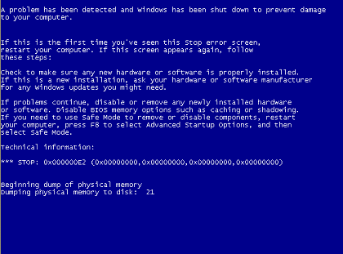
BSOD
System shutdown
Summary
Memory data
All blue background

Slide 9
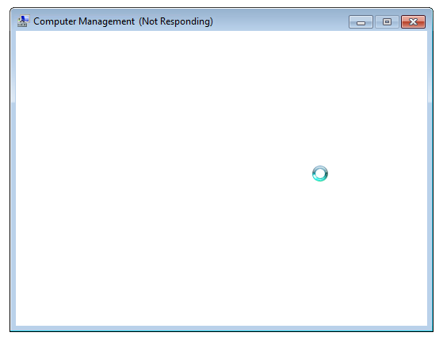
System Lockup Errors
Not responding message
Application hanging

Slide 10



I/O Device Issues
Missing or loose mouse or keyboard connection.
Blocked signals for wireless devices.
Missing or incorrect driver for specialty device.
Misconfigured monitor settings.

Slide 11


Application Errors
Cannot install application.
Installed application will not start or load.
The application cannot be found.
GPF is causing issues.
Illegal operations is attempted and forces application shutdown.
An invalid working directory issue.
Windows Store app not working.

Slide 12
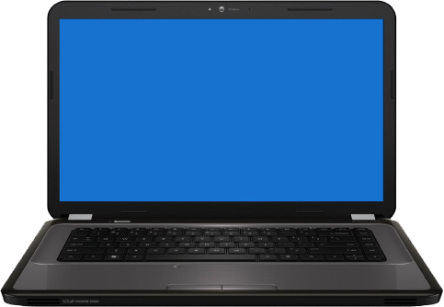
Boot Issues
POST errors.
Invalid boot disk.
Failure to boot.
Missing OS.
Continuous reboot.
Missing NTLDR.
Missing dll message.
System files fail to open or are missing.
Device or service failed during startup.
Boots to safe mode.
Device or program in registry not found.

Slide 13
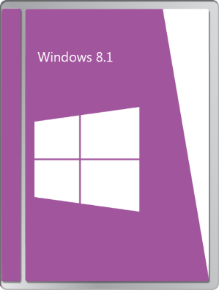
Common Operating System Symptoms
General issues.
Memory issues.
Low system performance and disk issues.
CPU issues.
Kernel panic.
Shutdown issues.
RAID not detected.

Slide 14
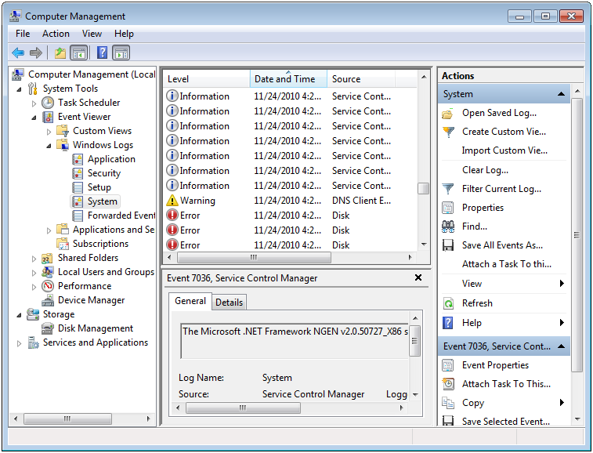
Error and Warning Messages in Event Viewer
Source of messages
Warning icon and message

Slide 15
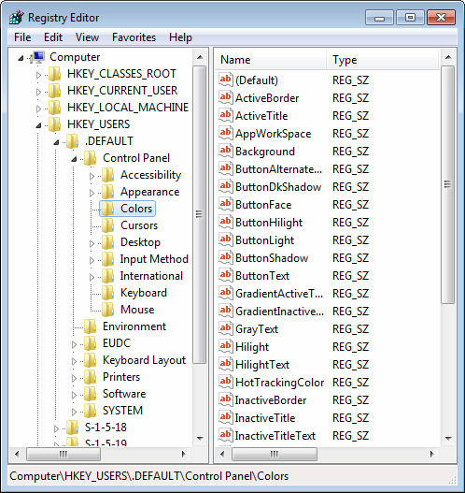
Registry Error Messages
Stop errors or other errors.
Registry access, value entries, or files.
Maintain registry backups.
Find errors in KnowledgeBase.

Slide 16

Common Mobile OS and
Application Symptoms
Mobile OS issues
  Dim display
  Nonresponsive touch screen or inaccurate response
  No or spotty network connectivity
  GPS malfunction
  Cannot broadcast to external monitor
  Slow performance
  Short battery life
  Frozen system
  System lockout
App issues
  Apps not loading
  Cannot decrypt email
  Overheating
  No sound from speakers

Slide 17

Mobile OS and Application Tools
Performing a hard reset.
Performing a soft reset.
Performing a factory default reset.
Closing running applications.
Forcing applications to stop.
Uninstalling and reinstalling applications.
Adjusting device configuration and settings.

Slide 18
Guidelines for Troubleshooting Mobile Device
OSs and Applications
Troubleshoot password problems:
  Develop a way to remember or safely record the mobile password.
  Do not exceed the allowable number of failed password attempts.
  Use a recovery password instead of restoring the device.
  Refer to the user manual for device-specific restore methods.
  If you are restoring a device using a PC, turn off the device, connect the USB cable to the PC and the device, and then turn on the power for the device.
  Check for third-party Bluetooth Unlocker programs.
  Be sure to back up or synchronize data regularly.
Create secure passwords
  While setting a password, use a passphrase with special characters and keep it as unique as possible.
  Make sure the password is of a length to make it strong but still be remembered easily.
  Do not share password information with anyone.
  Regularly change device passwords.
  Avoid using the same password for a mobile device and other accounts.

Slide 19
Guidelines for Troubleshooting Mobile Device
OSs and Applications (Cont.)
Troubleshoot hardware crashes
  Identify when the issue first started.
  Check for recent hardware changes.
  Check if the battery has enough power or any physical damage.
  Check if the device is getting charged properly. A brand new device should be charged for at least 4 hours.
  Check if the device is low on resources.
  After the exact issue is identified, perform resolution steps in a sequential order.
    Back up data before making any changes to the device.
    Visit the manufacturer's website to check for device-specific troubleshooting steps.
    Log resolution steps to take preventive measures to eliminate further issues.
Troubleshoot software crashes:
  Check for recent software changes.
  Determine if the device crashes while running a specific application or all applications.
  Check if the issue persists in safe mode.
  Identify conflicting applications and uninstall them.
  Remove unnecessary background applications.
  Check if the firewall is properly configured.
  Ensure that security software is working fine and does not conflict with firewall or other programs.
  After the exact issue is identified, perform resolution steps in a sequential order.

Slide 20
Guidelines for Troubleshooting Mobile Device
OSs and Applications (Cont.)
Troubleshoot OS and application upgrade issues:
  Make sure the device is connected to the Internet.
  Ensure that you have enough available bandwidth or sufficient remaining megabytes or gigabytes on your data plan.
  Check the manufacturer or app store website for known issues with different platform versions.
Troubleshoot authentication and authorization issues:
  Verify you are using the correct password.
  Make sure Caps Lock is not enabled.
Troubleshoot signal loss:
  Verify that the signal strength is sufficient to ensure good connectivity.
  A loss in signal can be due to roaming out of a coverage area or during a handover from one cell tower to another congested cell tower.
  Any physical damage to the device will impact radio reception, resulting in poor quality.

Slide 21
Guidelines for Troubleshooting Mobile Device
OSs and Applications (Cont.)
Troubleshoot network problems:
  Verify you are connected to a WAP.
  Verify you have an IP address after connecting to the WAP.
  The service over a network will either be unavailable or deteriorate during busy traffic times.
  The network performance will deteriorate due to attacks such as DoS, network jamming, or scanning.
  If connecting using 2G/3G, remember that you could connect to a cell tower and get an IP address, but not have sufficient download capability left on your data plan, or the provider's broadband network is too congested.
Troubleshoot roaming issues:
  Ensure that the mobile subscription includes roaming either to partner networks or international roaming.
  Check your pre-paid balance while roaming, since roaming charges tend to be higher than other connectivity. You might have run out of minutes or data.
Troubleshoot cellular activation and authorization:
  Services to a mobile device will start only after the service is activated.
  If the devices are grey listed or black listed, services will be blocked. Devices that are grey listed or black listed when devices are stolen, bills aren't paid, mobile services are used illegally, etc.

Slide 22
Guidelines for Troubleshooting Mobile Device
OSs and Applications (Cont.)
Troubleshoot email issues:
  Ensure that the email settings, such as protocol (SMTP, POP3, or IMAP), server addresses, ports, and security settings, are set properly.
  Ensure that the email password is accurate.
Troubleshoot VPN issues:
  Ensure that you are connected to the Internet.
  Ensure that the VPN client is running on the device.
  Ensure that the credentials being provided to access the VPN are correct.
  Ensure that you are not behind an older wireless access point (WAP) or router that disallows certain types of VPNs.

Slide 23
Common Network Issues
No connectivity or connection lost.
Slow transfer speeds.
Local connectivity but no Internet connection.
Limited connectivity.
IP conflict.
Intermittent connectivity.
Low RF signals.
APIPA/link local address issues.
SSID not found.

Slide 24
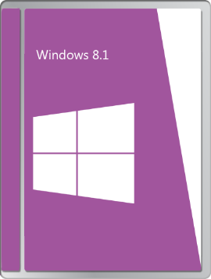
Network Troubleshooting Utilities
Windows command-line tools:
  IPCONFIG
  PING
  NSLOOKUP
  TRACERT
  NETSTAT
  NBTSTAT
  NET
  NETDOM
Software
  Network troubleshooters
  Wi-Fi locators

Slide 25


Linux and OS X Network Troubleshooting
Utilities
Utility | Description
traceroute | Tracks the route that data takes to get to its destination.
ping | Verifies that a system can be reached on a network. It checks the hostname, the IP address, and whether the remote system can be reached.
arp | Displays information about the ARP cache, including hardware address, host name, and network interfaces.
ifconfig | Display the local system’s network interface information, including IP address, hostname, and subnet mask. This tool also allows you to configure these parameters.

Slide 26
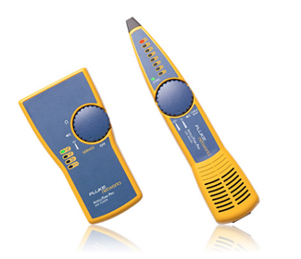
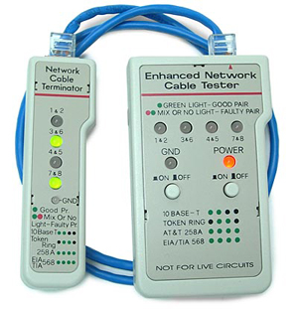


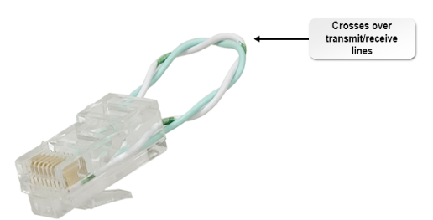
Network Troubleshooting Tools
Cable tester
Loopback plug
Punch down tool
Tone generator and probe
Crimpers
Wire strippers
Wireless locator

Slide 27
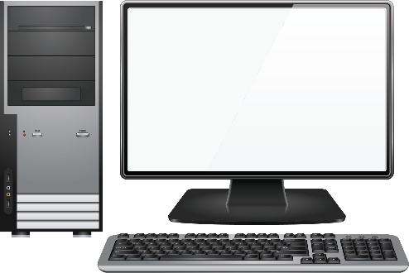

Common PC Security Issues
Pop-ups
Browser redirection
Security alerts
Internet connectivity issues
Slow performance
PC locks up
Applications crash
Windows update fails
Rogue antivirus
Email issues
Access denied
Malware infestation
File system issues
Invalid certificate
Data access issues
Backup security

Slide 28
Security Troubleshooting Tools
Tool | Description
Anti-malware/ antivirus software | This software scans a potentially infected system for malware and identifies any file signatures it recognizes as malicious. Most anti-malware solutions also provide quarantine and deletion functionality.
Recovery Console | An operating system’s recovery console provides an interface with which you can execute a limited set of actions that may help you resolve boot issues. Common recovery options include repairing master boot records, formatting drive volumes, and repairing disk corruption.
MSCONFIG/safe boot option | MSCONFIG is a System Configuration utility that can also help you troubleshoot boot and system startup issues. The utility allows you to select and deselect certain services and device drivers you do or do not want to boot with. Likewise, safe boot loads the operating system with only non-essential functionality, making it easier to isolate and remove a malware infection.
Refresh/restore options | Newer versions of Windows offer certain recovery scenarios that may resolve system slowness or corruption. Recovery scenarios include reinstalling the operating system but keeping all other files; rolling back to a previous build of the operating system; and full recovery from an operating system image.

Slide 29
Security Troubleshooting Tools (Cont.)
Tool | Description
Terminal | A PC’s terminal or command-line interface will provide you with direct access to the operating system’s available commands. This can be useful as configuration GUIs like the Control Panel don’t offer access to every single diagnostic or troubleshooting command. Some of these commands, like CHKDSK, are more commonly initiated through a terminal.
System restore/ snapshot | Operating systems like Windows can take a “snapshot” of your PC at a certain point in time. If you encounter a complex issue that isn’t easily remedied, you can restore the previous snapshot and return your PC to its state before the issue appeared. This may be more ideal than a typical recovery operation as it affords minimal disruption to the system.
Pre-installation environments | Most operating systems offer some sort of configuration options as part of the installation process. For example, when you install Windows, you can format your computer’s disk volumes without even needing an operating system. If you have installation media available, the pre-installation environment can help you ensure that a computer is completely wiped clean.
Event Viewer | The operating system’s Event Viewer keeps a log of all recorded system and application events. This includes sign on attempts, shutdown signals, system crashes, device driver errors, and many more scenarios that can help you identify where problems exist.

Slide 30

The Malware Removal Process
Identify malware symptoms.
Quarantine infected systems.
Disable system restore.
Remediate infected systems.
Schedule scans and updates.
Enable system restore and create restore point.
Educate end users.

Slide 31
Malware Removal Best Practices
Always use trusted installation sources and websites.
Always use email attachment protection.
Research malware types

Slide 32

Common Mobile Device Security Symptoms
Signal drop or weak signal.
Power drain.
Slow data speeds.
Unintended Wi-Fi connection or Bluetooth pairing.
Leaked personal files or data.
Data transmission over plan limit.
Unauthorized access.
High resource utilization.

Slide 33
Mobile Security Tools
Antivirus and antimalware apps.
App scanner.
Factory reset or clean install.
Uninstall and reinstall apps.
Wi-Fi analyzer.
Cell tower analyzer.
Backup/restore.
Force stop.

Slide 34
Guidelines for Troubleshooting Security Issues
Maintenance:
  Check status of physical security controls.
  Review security videos.
  Audit key systems and review audit logs.
  Calibrate physical security devices.
  Review organizational security policies.
  Perform security audits.
  Consider staging attacks to identify vulnerabilities.
Troubleshooting:
  When users can’t access web sites, check security settings on the web browser.
  When users can’t access files, check file permissions and effective permissions for the user, and check for file encryption.
  When users can’t access network resources, check share permissions, NTFS permissions, and effective permissions.
  When users can’t log with a biometric device, contact the vendor.
  Train users to recognize security threats.
  If users can’t access external data, check firewall ports for restrictiveness.

Slide 35
Reflective Questions
In what system-wide area do you think you will provide the most support to users?
Have you ever recovered a severely compromised computer system? If so, then describe your experience.

