Slide 1
Installing and Configuring Microsoft Windows
Implement Client-Side Virtualization
Install Microsoft Windows
Use Microsoft Windows
Configure Microsoft Windows
Upgrade Microsoft Windows

Slide 2





Virtualization
Client-side virtualization
Server virtualization
Applications
Data
Settings
Operating System
Hardware

Slide 3




Purposes of Virtualization
Test new OS or software application.
Run software not supported by the OS.
Create snapshot images for VM templates.
Create test labs.
Configure and deploy multiple computing environments.
Set up and deploy systems for training classrooms.
Applications
Data
Settings
OS
Hardware

Slide 4






Hypervisors
App
App
App
App
App
App
App
App
App
Guest OS
Guest OS
App
App
App
Guest OS
Guest OS
Guest OS
VM1
VM2
VM1
VM2
VM3
Hypervisor
App
App
Hypervisor
Host OS
Host Computer
Host Computer
Bare metal / Type 1
Host-based / Type 2

Slide 5
Virtualization Resource Requirements
VM
Hardware must support virtualization
  RAM
  Disk space
  Power
  CPU
OS must support virtualization
VM
VM

Slide 6
Emulator Requirements
VM
Hardware requirements for emulator software
Mobile device hypervisors
VM
VM

Slide 7
Virtualization Security Requirements
Organizational security policies
Antivirus software for host and VMs
Restrict copying files and apps to VMs
Update and manage security patches for host and VMs
Manage VMs to minimize data leaks
Isolate VMs from hypervisor
VM
VM
VM

Slide 8
Virtualization Network Requirements
Virtual switches enable VMs to communicate with:
  The host
  Other VMs
  Systems outside of the virtual environment
Types of virtual switches
  Private
  Internal
  External
VM
VM
VM

Slide 9
Windows System Requirements
OS | Requirements
Windows 8.1, Professional, or Enterprise | 1 GHz 32-bit (x86) or 64-bit (x64) processor 1 GB RAM (32-bit) or 2 GB RAM (64-bit) 40 GB hard disk with a minimum of 20 GB of available space Support for DirectX 9 graphics; some programs may require support for DirectX 10 graphics or higher to provide optimal performance
Windows 7 Home Premium, Professional, or Ultimate | 1 GHz 32-bit (x86) or 64-bit (x64) processor 1 GB RAM (32-bit) or 2 GB RAM (64-bit) 40 GB hard disk with a minimum of 20 GB of available space Support for DirectX 9 graphics; some programs may require support for DirectX 10 graphics or higher to provide optimal performance
Windows Vista Home Premium, Business, or Ultimate | 1 GHz 32-bit (x86) or 64-bit (x64) processor 1 GB RAM 40 GB hard disk with a minimum of 15 GB of available space Support for DirectX 9 graphics and 128 MB of graphics memory

Slide 10
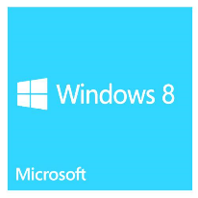
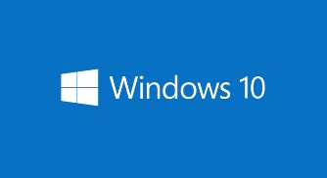
Hardware Compatibility
Check all system requirements and hardware
Retail packaging
Search Microsoft.com

Slide 11
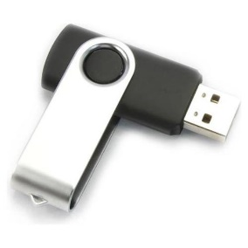

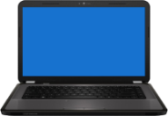
Boot Methods
Boot Method | Description
USB | The OS files and all necessary support files are loaded onto a USB device, such as a flash drive. The USB is connected to the computer and the OS starts via the files on the USB device.
CD-ROM/DVD | The OS files and all necessary support files are loaded onto an optical disk, such as a CD-ROM or DVD. The disk is inserted into the optical drive of the computer and the OS starts via the files on the disk.
ISO | All of the contents of an optical disk are contained in a single ISO file. ISO files stored on removable media or a host system are often used to install virtual machine OSs.
Internal storage drive | An internal HDD or SSD can hold all of the operating system's installation files and can be used to install the OS onto a different drive or a different partition on the same drive.
External storage drive | An external HDD or SSD can also be used for OS installation, most commonly over a USB interface.
PXE | The OS files and all necessary support are loaded onto a server. The OS boots over a network interface, accessing the OS files on the server, instead of using a local drive.

Slide 12
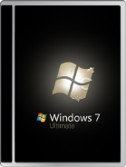

Installation Types
Clean install
Unattended installation
Repair installation
Upgrade
Multiboot
Remote network installation
Image deployment
Recovery

Slide 13
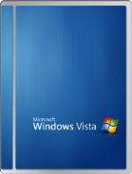
Third Party Drivers
OS installation files include many device drivers.
Newer hardware or less-typical hardware might require manual loading of drivers.

Slide 14
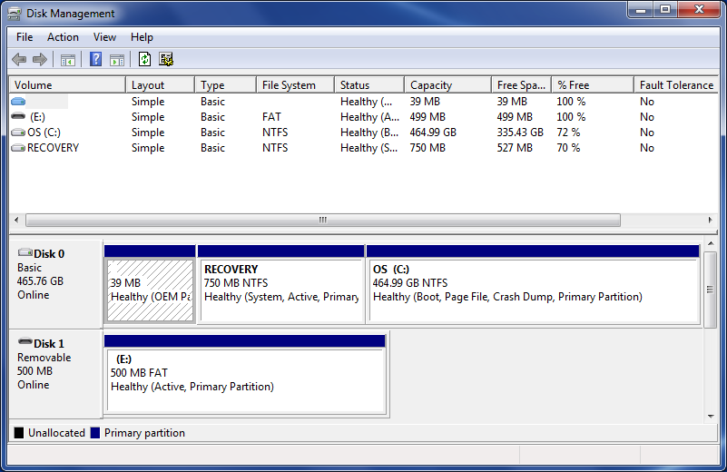
Partitioning
Partitions

Slide 15
File System Types
Type | Description
NTFS | For typical Windows installations. Can handle large disk partitions. More efficient than FAT32. File and folder compression.
FAT32 | For legacy Windows installations. Less secure than NTFS. Disk partition size restrictions.
exFAT | For sharing external files between Windows and OS X computers. Provides read/write access of Windows partitions to OS X users.
CDFS | Compact Disc File System. Enables multiple OSs to read the same optical disc.
ext2, ext3, ext4 | For typical Linux installations. ext4 is the latest, but all are supported.
NFS | Network File System. Hosted on a server. Clients access over the network as if the files were stored locally.

Slide 16
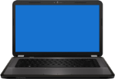

Workgroups vs. Domains
Administrator
Client Computers
Print Server
Client Computers
Content Management System

Slide 17
Workgroups vs. Domains (Cont.)
Client A
Client B
Domain Controller
Domain Controller
Client C
Client D

Slide 18
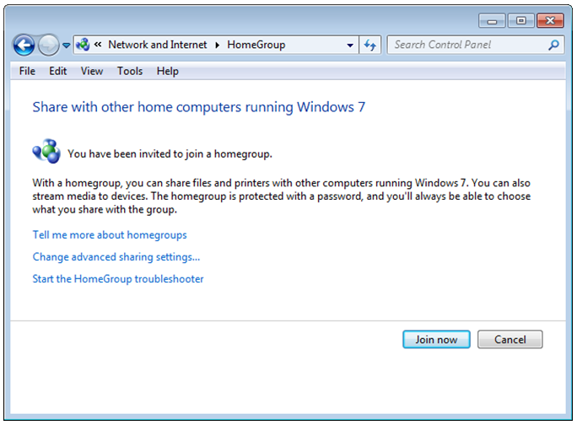
Homegroup vs. Workgroups
Homegroup: peer-to-peer networking
  For home networks
  File sharing
  Resource sharing
  Security and management
  options
  Password required to add
  computers to homegroup
  Optional on home networks
Workgroup: peer-to-peer
networking
  For home or business
  networks
  File sharing
  Resource sharing
  Distributed administration
  Required on home networks

Slide 19
Custom System Settings
Regional and language settings
Computer name
Date and time
Network configuration
Workgroup vs. domain setup

Slide 20
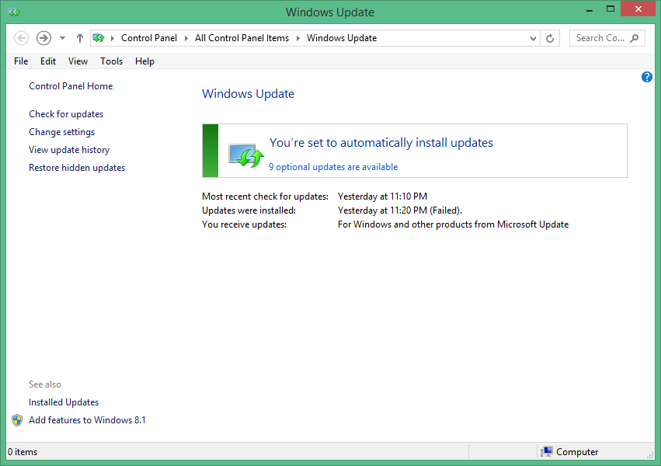
Software and Windows Updates

Slide 21
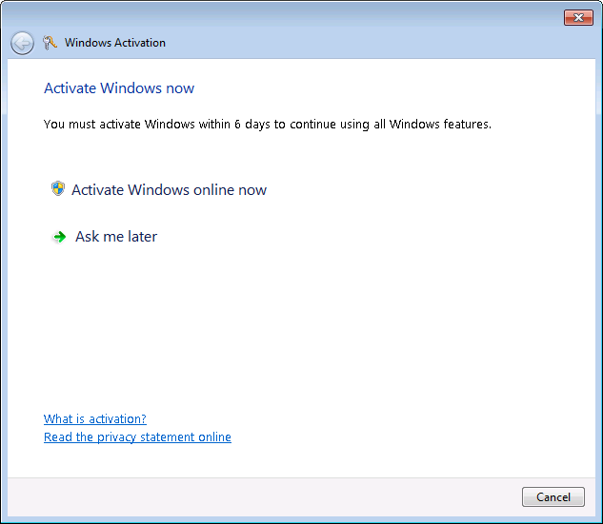
Microsoft Product Activation
Grace Period

Slide 22
Common Windows Features
File Explorer / Windows Explorer
UAC
System Restore
Administrative Tools
Windows Defender
Windows Firewall
Action Center / Security Center
Event Viewer
Control Panel
Gadgets

Slide 23
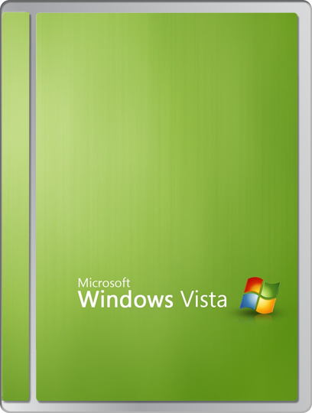
Windows Vista Features
Aero color scheme
Desktop Gadget Gallery

Slide 24
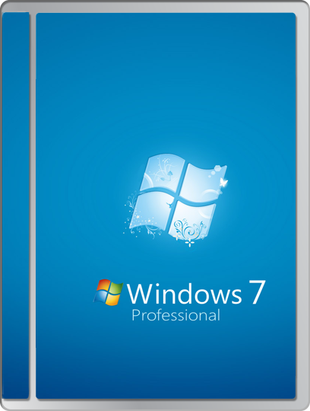
Windows 7 Features
Aero color scheme
Desktop Gadget Gallery
Multi-touch device support
Default disk partitioning changed
VHD file format
BitLocker
WinRE
Action Center
Snap feature
Virtual XP Mode
Compatibility Mode
Readyboost
Shadow Copy
Easy Transfer

Slide 25
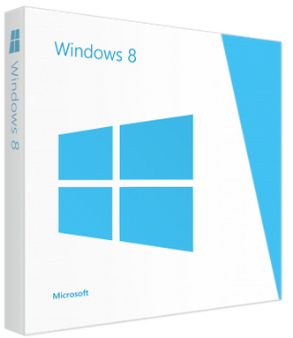
Windows 8/8.1 Features
Start screen
  Metro UI
  Pinning
Windows Store
Side-by-side apps
Live ID sign-in
One Drive
Faster boot process
Charms
Multi-monitor taskbars

Slide 26
Windows Vista and Windows 7 Task Manager
Applications
Processes
Performance
Networking
Users

Slide 27
Windows 8 Task Manager
Processes
Performance
App history
Startup
Users
Details
Services

Slide 28
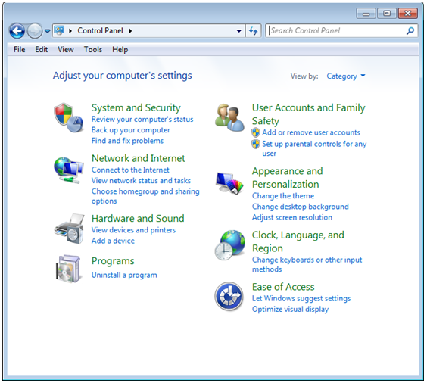
Windows Control Panel

Slide 29
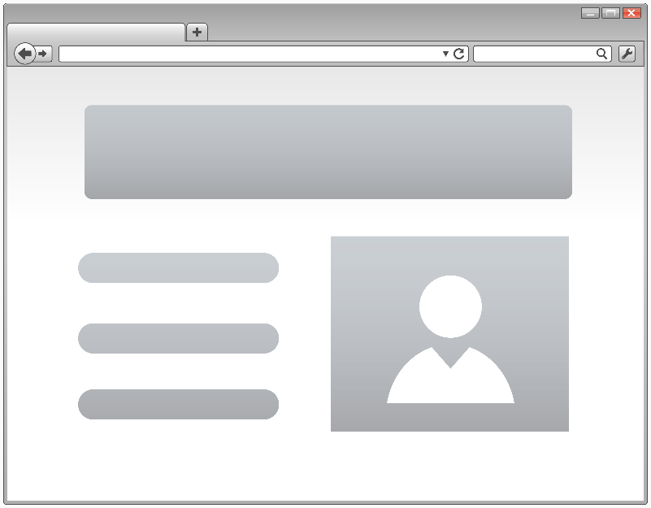
Internet Options
General
Security
Privacy
Content
Connections
Programs
Advanced

Slide 30
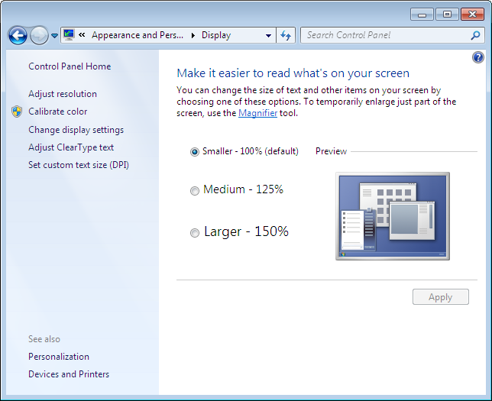
Display Control Panel

Slide 31
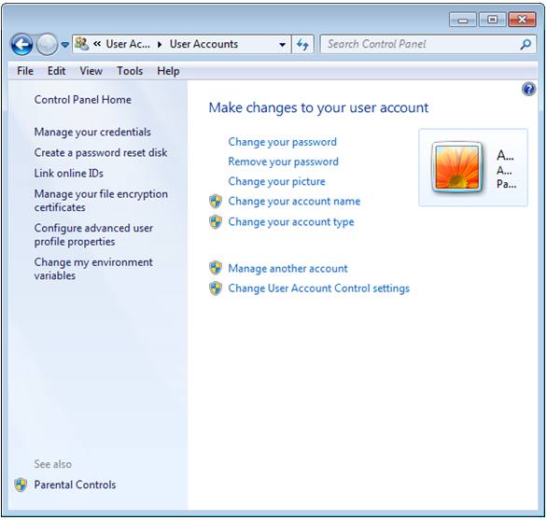
User Accounts Control Panel

Slide 32
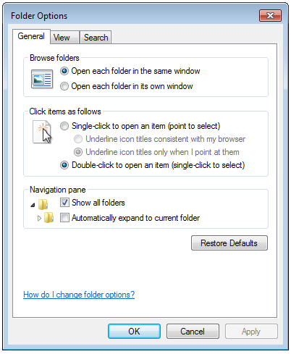
Folder Options Control Panel

Slide 33
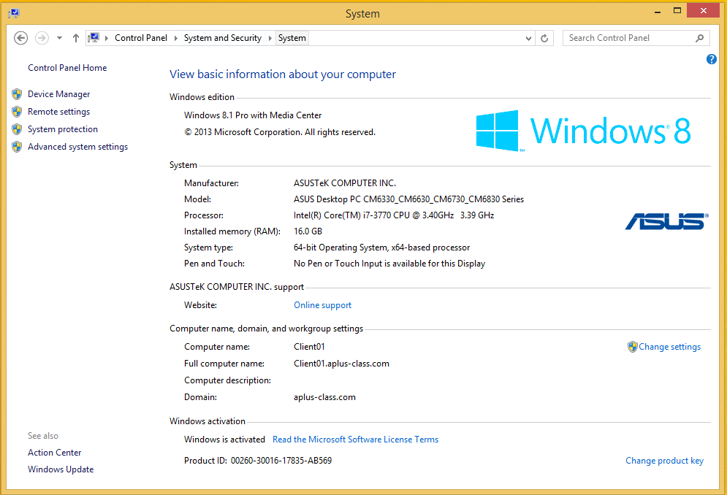
System Control Panel
General
Computer Name
Hardware
Advanced
System Restore
Automatic Updates
Remote

Slide 34
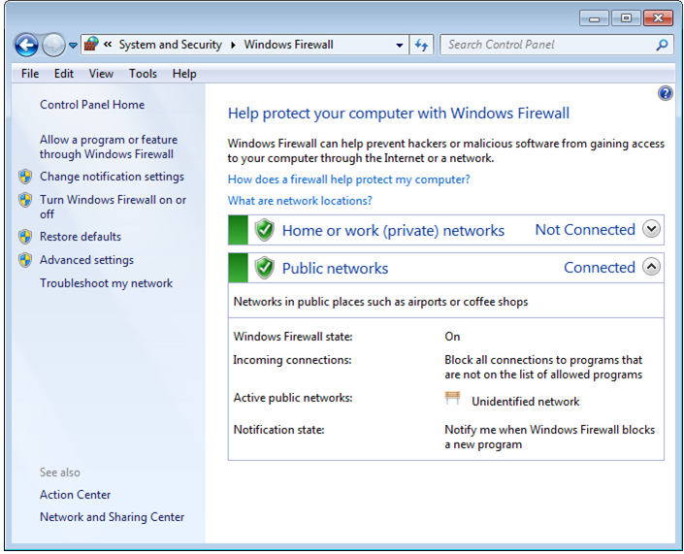
Windows Firewall

Slide 35
Power Options Control Panel
Hibernate
Power Plans
Sleep/Suspend/Standby

Slide 36
Programs and Features Control Panel
Enable and disable Windows features
View installed updates
Uninstall programs
Program Compatibility Troubleshooter

Slide 37
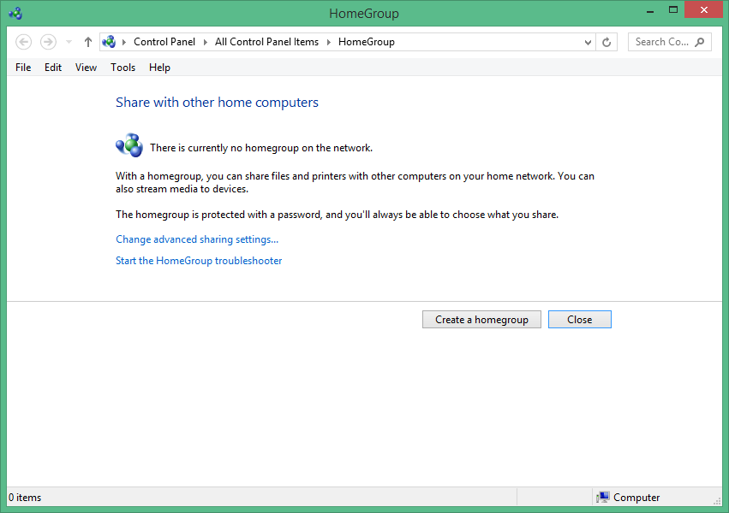
HomeGroup Control Panel

Slide 38
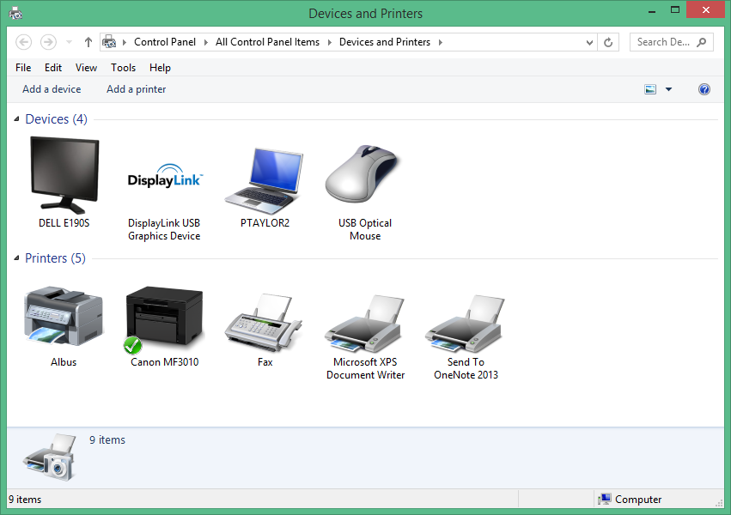
Devices and Printers Control Panel
Sales01
Office Printer

Slide 39
Sound Control Panel
Playback
Recording
Sounds
Communications

Slide 40
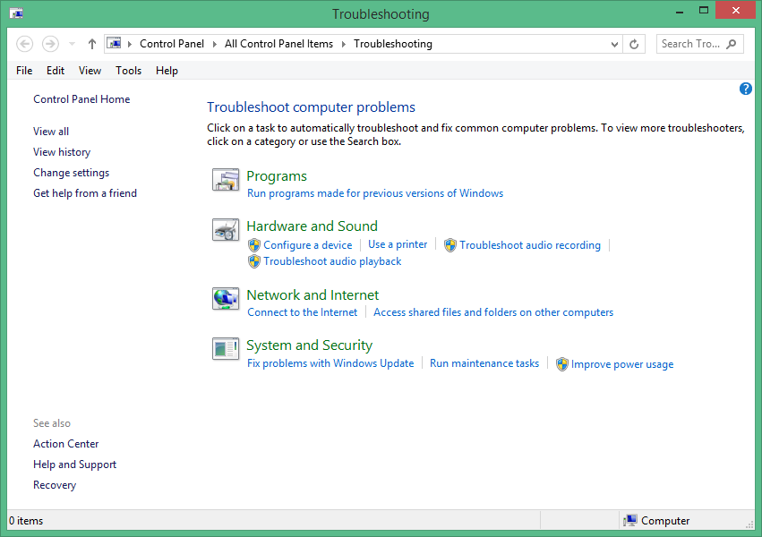
Troubleshooting Control Panel

Slide 41
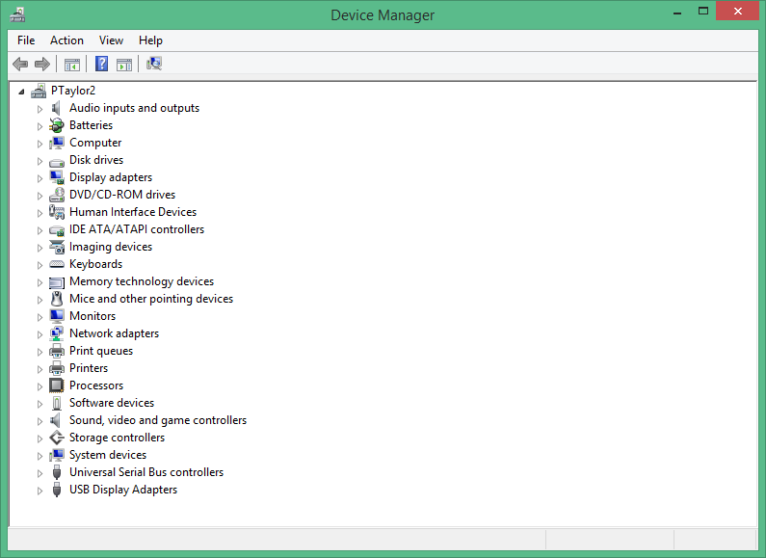
Device Manager
View devices attached to the PC
View device status
Enable and disable devices
Identify device drivers
Identify system resource allocations
Uninstall and reinstall devices

Slide 42
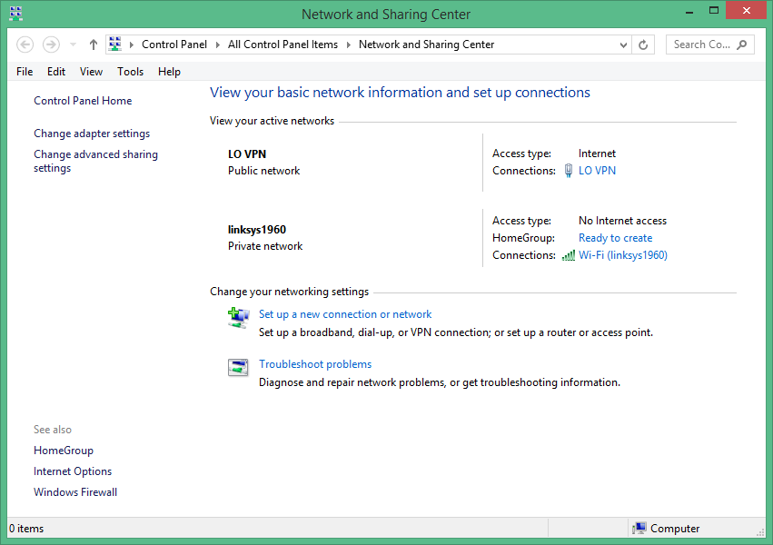
Network and Sharing Center
Office VPN
Office VPN
Home Network

Slide 43
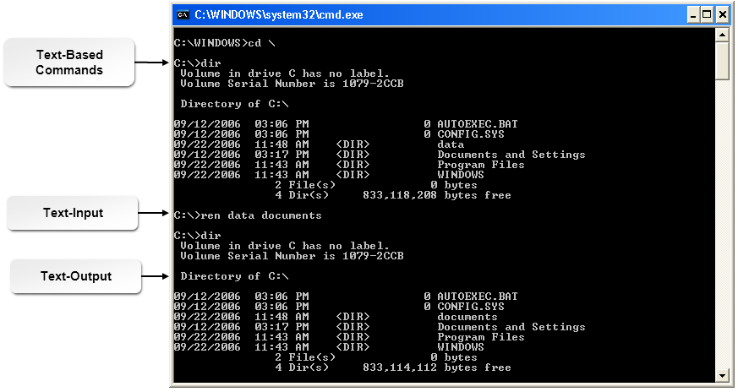
Windows Command Prompt

Slide 44
Windows Command Line Tools
Command | Description
TASKKILL | This command is typically used to end a task or process identified by PID or image name.
BOOTREC | If the Startup Repair option in System Recovery Options cannot repair system startup problems, use this command to manually troubleshoot the problem. This command writes a new boot sector, compatible with the installed OS, to the system partition.
SHUTDOWN | This command shuts down, restarts, logs off, or hibernates a computer, depending on the options used with the command.
TASKLIST | This command lists applications and services currently running on the local computer or a specified remote computer.
DISKPART | This command opens the DiskPart command interpreter, which you use to manage drives, disks, partitions, volumes, and virtual hard disks.
SFC | This command scans for corrupted Windows system files and restores any files it finds.
CHKDSK | This command checks disk integrity.
GPUPDATE | This command updates local and Active Directory group policy settings.
GPRESULT | This command displays group policy settings and RSOP for a user or PC.
EXIT | This command closes the command prompt.

Slide 45
Windows Administrative Tools
Computer Management
Local Users and Groups
Local Security Policy
Performance Monitor
System Configuration
Task Scheduler
Component Services
Data Sources
Print Management
Windows Memory Diagnostics
Windows Firewall with Advanced Security

Slide 46
Run Line Utilities
Command | Description
command | Opens a new instance of the command interpreter/command prompt interface.
dxdiag | Opens and runs the DirectX Diagnostic tool.
explorer | Opens Windows Explorer or File Explorer in whatever the default view is for the PC.
mmc | Opens the MMC.
[command].msc | Opens the management console for that entry (if one is available) when the .msc extension is added to the command.
msconfig | Opens the System Configuration utility.
msinfo32 | Opens the System Information utility, showing a summary of hardware, software, and other system components.
mstsc | Opens the Remote Desktop Connections utility.
notepad | Opens Notepad.
regedit | Opens the Registry Editor.
services.msc | Opens the Services console.

Slide 47
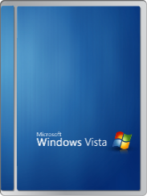
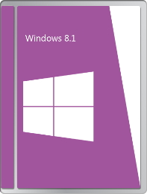
In-Place Upgrades
Installing a newer OS without removing the existing OS
No data backup, hard drive erasing, application reinstallation, etc.
Recommended only in certain circumstances
Clean Install Needed
In-Place Upgrade Supported

Slide 48
Supported Upgrade Paths
Current OS | Can be Upgraded to:
Windows Vista with SP1 | Any higher level of Windows Vista The same level or higher of Windows 7
Windows 7 | Any higher level of Windows 7 Any level of Windows 8 Any level of Windows 8.1
Windows 8 | Any higher level of Windows 8 Any level of Windows 8.1
Windows 8.1 | Any higher level of Windows 8.1

Slide 49
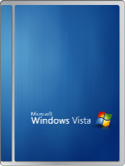
Compatibility Tools
Upgrade Advisor or Upgrade Assistant
Application Compatibility Modes

Slide 50



Migration Tools
Migration Tool | Description
USMT | A command line utility that copies files and settings from one Microsoft Windows computer to another, including user accounts, files, folders, Windows settings, email messages, and more.
Easy Transfer | A built-in data-migration utility in Windows Vista and above that helps transfer files, data, and settings from one personal computer to another.

Slide 51
Windows Upgrade OS Advisor
Determines if a PC meets the requirements for Windows 7
Scans hardware
Scans connected devices

Slide 52
Reflective Questions
Do you have experience installing operating systems? Do you feel you will be able to perform installations more efficiently as a result of the information presented in this lesson?
How often do you expect to be able to perform in-place upgrades instead of clean installs at your workplace?

