Slide 1
Working with Other Operating Systems
The OS X Operating System
The Linux Operating System

Slide 2
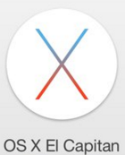
OS X
Developed by Apple Inc.
Based on Linux.
El Capitan is current version.
System requirements.
Features.

Slide 3
OS X User Interface
UI Feature | Description
Finder | Manages files and folders by using icons representing the computer, folders, files, and a trash can. Sometimes referred to as the Desktop.
Dock | Located along the bottom of the screen, it contains icons for all open programs and windows, as well as icons for any other items you have added to it.
Terminal | The command-line interpreter for OS X.

Slide 4
Trackpad Gestures
Gesture | Description
Tap to Click | When enabled, allows you to tap the trackpad instead of using the button below the trackpad to click.
Dragging | Tap the trackpad twice, then drag your finger. For longer drags, slide your finger again after lifting it for less than one second.
Drag Lock | When enabled, allows you to lift your finger for more than one second while dragging.
Secondary click | Either the lower right corner of the trackpad, or two fingers on the trackpad and one on the button below it.
Two-finger scroll | Scrolls like you are using the scrollbar. You can also access the Scrolling Speed slider this way.
Pinch Open/Pinch Close | Using two fingers, spread them apart to enlarge the screen content. Using two fingers, bring them closer together to reduce the size of screen content.
Screen zoom | While pressing the Control key, drag two fingers on the track pad to zoom in the entire screen.
Three-finger swipe to navigate | Drag three fingers horizontally on the trackpad to move to the next or previous page.
Four-finger swipe | Drag up to activate Show Desktop; drag down to activate Show all windows; and drag left or right to activate Program switcher.

Slide 5
OS X Features
Feature | Description
Mission Control | Manages open windows and spaces, which are similar to virtual desktops in Linux.
Keychain | Manages passwords and user account information.
Spotlight | Searches for words that you specify within files and app names on your computer, as well as in other locations.
iCloud | Provides cloud services to OS X and iOS users. Requires an Apple ID.
Gestures | Enables interaction with a touch device.
Remote Disc | Supports the sharing of optical drives among OS X computers.
Boot Camp | Enables the installation of Windows in a separate partition, and manages dual-boot computers.

Slide 6
OS X Management Tools
Tool/Function | Description | Accessed From
Time Machine | A utility that backs files and folders up to a separate hard drive (not removable media) that has been formatted as a Mac file system. | From the Apple menu, select System Preferences→Time Machine.
Snapshot | On Mac notebooks that don't currently have access to the Time Machine drive, local copies of files that are created, modified, or deleted are stored on the startup drive. They are copied to the Time Machine drive when it becomes available. | From the Apple menu, select System Preferences→Time Machine. The timeline is displayed on the right side of the Time Machine window.
Image recovery | Using the Disk Utility Restore application or the asr(8) tool, you can create a pre-configured copy of OS X from a computer on which OS X has been installed and configured. | To access the Disk Utility, press Command + Space to open Spotlight search, type Disk Utility, and press Return. You can also select the Launchpad icon on your dock, select the Other folder, and select Disk Utility. Or, open a Finder window, select Applications in the sidebar, double-click the Utilities folder, and double-click Disk Utility. Once you are in the Disk Utility application, select the Restore tab. For the asr(8) tool, open a Terminal window by selecting Applications→Utilities→Terminal, or from Finder, select Finder→Services→New Terminal at Folder or New Terminal Tab at Folder.

Slide 7
OS X Management Tools (Cont.)
Tool/Function | Description | Accessed From
Disk maintenance | The Disk Utility application can be used to verify or repair a disk. If you are unable to use this application, you can use the command line command fsck. | To access the Disk Utility, press Command + Space, type Disk Utility, and press Return. Or, select the Launchpad icon, select Other, and select Disk Utility. Or, in Finder, select Applications in the sidebar, double-click Utilities, and double-click Disk Utility. For the fsck tool, open a Terminal window by selecting Applications→Utilities→Terminal, or from Finder, select Finder→Services→New Terminal at Folder or New Terminal Tab at Folder.
Shell/Terminal | A Terminal window is where you can access the shell or command line in OS X. | Select Applications→Utilities→Terminal, or from Finder, select Finder→Services→New Terminal at Folder or New Terminal Tab at Folder.
Screen sharing | You can share your screen or share the screen of another Mac. You can use iCloud to share your screen , and you can use Finder to connect to a remote Mac. | To use iCloud to share your screen, from the Apple menu, select System Preferences→Sharing→ Screen Sharing. To use Finder to connect to a remote Mac, select Finder→Preferences, then in the sidebar, in the Shared section, select Back to My Mac.
Force Quit | If an app is not responding, you can use Force Quit from the Apple menu to open the Force Quit Applications window, then select the non-responsive app and select the Force Quit button. | From the Apple menu, select Force Quit to open the Force Quit Applications window. You can also access this window by pressing Command+Option+Esc.

Slide 8
OS X Best Practices
Scheduled backups
Scheduled disk maintenance
System updates
Patch management
Driver and firmware updates
Antivirus and antimalware updates

Slide 9
Linux Distributions
Free, open-source OS
Linux kernel
Distributions
  CentOS
  RHEL
  Fedora
  SUSE Linux Enterprise
  openSUSE
  Debian
  Ubuntu
  Mandriva
  Mint

Slide 10
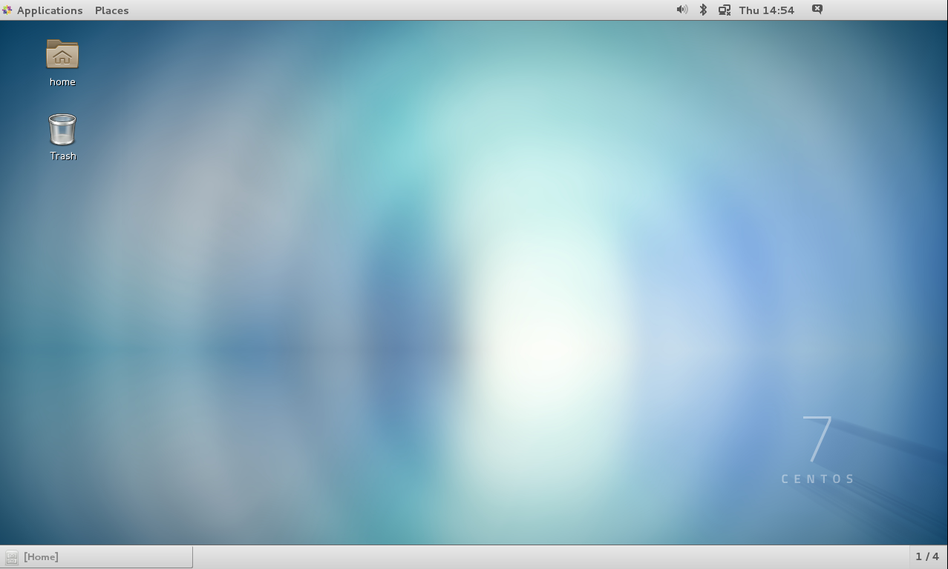
Linux GUIs

Slide 11
Linux GUIs (Cont.)
Applications Menu Category | Use to Access
Accessories | Applications for performing work-related tasks such as creating text documents and presentations, or using a calendar.
Internet | Applications for performing tasks on the Internet, such as web browsers, email clients, instant messengers, and web editors.
Sound & Video | Applications for viewing movies and listening to sound files and CDs.
System Tools | Options for changing the settings on the Linux system.
Documentation | Help for Linux.

Slide 12
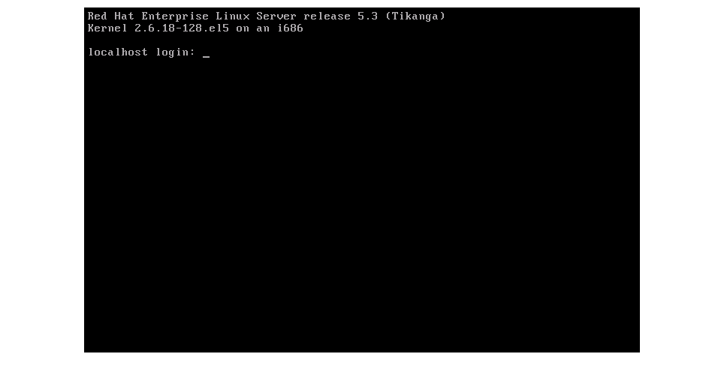
The Linux CLI

Slide 13
Superuser
Also known as root user, the administrative account on any Linux system.
Extremely powerful account; can do anything.
Use only when necessary.
Create a regular user for most tasks.
Use su or sudo command to elevate privileges

Slide 14
Linux Features
Interaction with Windows and OS X computers
Networking
Cloud services
Gesture support for touch devices

Slide 15
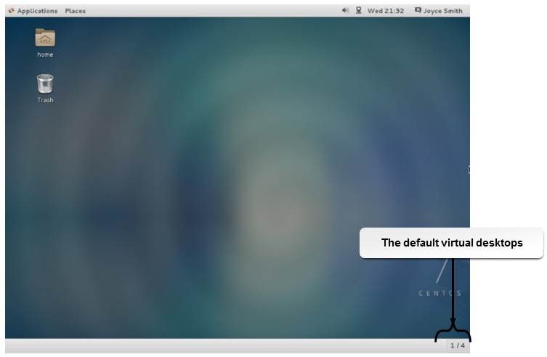
Virtual Desktops

Slide 16
GRUB
GRand Unified Bootloader
GRUB Legacy and GRUB2
  Though included in Linux distros, GRUB Legacy no longer actively developed
Loads the OS kernels

Slide 17
Remote Access/Screen Sharing
SSH
OpenSSH
SFTP
rdesktop
X forwarding
VNC

Slide 18
Linux Installation
Runs on many hardware platforms.
Installation methods:
  DVD or CD
  Over a network connection
  By accessing a network installation server
  From boot media (ISO or boot USB device)
Hardware compatibility.
Software compatibility.

Slide 19
Linux Filesystem Types
Filesystem Type | Description
ext3 | This is an improved version of ext2, which was the native filesystem in many Linux releases. In case of an abrupt system shutdown, ext3 is much faster in recovering data and better ensures data integrity. You can easily upgrade your filesystem from ext2 to ext3.
ext4 | The newest default filesystem for Linux distributions. It is backwards-compatible with the ext2 and ext3 filesystems. Among ext4’s improvements over ext3 are journaling, support of volumes of up to one exbibyte (EiB), and files up to 16 TiB in size. Ext4 is the default filesystem for CentOS/RHEL 7 and Ubuntu installations.
ReiserFS | This filesystem can handle small files efficiently. It handles files smaller than 1K and is faster than ext2 and ext3. If appropriately configured, it can store more data than ext2.
swap | This is not a true filesystem, but rather is a portion of the hard disk that is used in situations when Linux runs out of physical memory and needs more of it. Linux pushes some of the unused files from RAM to “swap” to free up memory.

Slide 20
Linux Management Tools
Backup and restore
Image recovery
Disk maintenance
Screen sharing
Force Quit

Slide 21
Backup and Restore Tools
Built-in utilities
  cpio
  rsync
  grsync
  dd
  dump
  restore
  tar
  gzip
  xz
Image recovery with dd
  Create image: dd if=/dev/hda of=~/hdadisk.img
  Restore image: dd if=hdadisk.img of=/dev/hdb

Slide 22
Shells and Terminal Windows
Shell | Description
Bash | The default Linux shell.
Bourne | The original UNIX shell.
C shell | Supports C language development.
Korn | A combination of the C and Bourne shells.

Slide 23

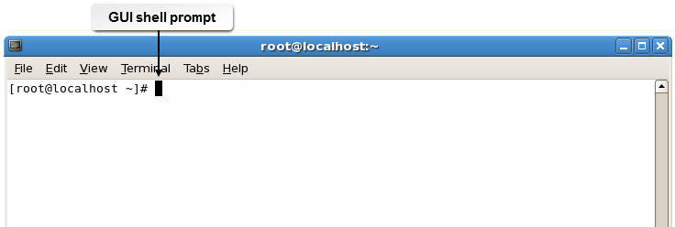
Shell Prompts

Slide 24
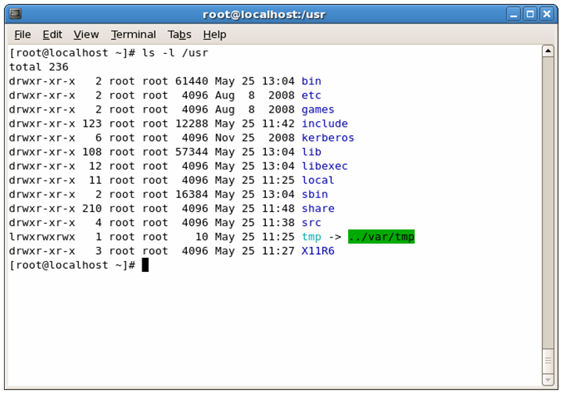
Linux Commands
Generic format: command –option argument
Arguments are usually the files or directories to be affected by the command.
Use Up Arrow and Down Arrow keys to cycle through previously entered commands.
Specify the directory path
as part of the command,
or move to the directory
and run the command.
Tab-completion feature.
Piping output to another
command.
Use semicolons to issue
multiple commands.
exec command.

Slide 25
Common Linux Commands
Command | Description
ls | Displays file listings.
cd | Changes the working directory.
pwd | Displays the name of the working directory.
passwd | Changes the password for the current user.
mv | Moves or renames files.
cp | Copies files and directories.
mkdir | Creates directories.
rm | Removes files.

Slide 26
Common Linux Commands (Cont.)
Command | Description
chmod | Modifies file or directory permissions.
chown | Modifies file or directory ownership.
ifconfig and iwconfig | Configures network interfaces. For wireless networks, use iwconfig.
ps | Displays currently running processes.
q | Exits from various commands.
su and sudo | su changes the ownership of a login session, while sudo runs programs as if the user were the root user.
apt-get | Installs or upgrades packages.
vi | Opens a text editor.

Slide 27
Common Linux Commands (Cont.)
Command | Description
dd | Copies and converts files for transferal to other media.
shutdown | Shuts down or restarts a Linux system.
grep | Enables you to search for specified content in files and directories
man | Displays manual pages.
apropos | Searches for possible commands to run.
date | Displays the current date and time.
whoami | Displays the user name of the currently logged in user.
rpm | Maintains packages.

Slide 28
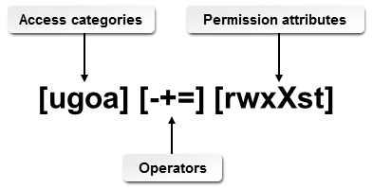
The chmod Command

Slide 29
Linux Best Practices
Schedule regular backups.
Schedule disk maintenance.
Check for available updates.
Test all patches before deploying throughout the organization.
When necessary, update drivers and firmware.
Install antivirus and antimalware software, and keep it updated.

Slide 30
Reflective Questions
Have you used OS X previously? If so, which edition? Does your organization use OS X?
Have you used Linux previously? If so, which distribution? Does your organization use Linux?

