Slide 1
Hardware Fundamentals
Personal Computer Components
Storage Devices
Mobile Digital Devices
Connection Interfaces

Slide 2
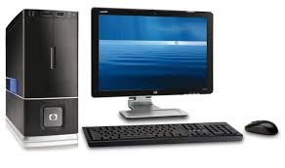
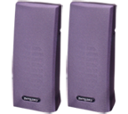
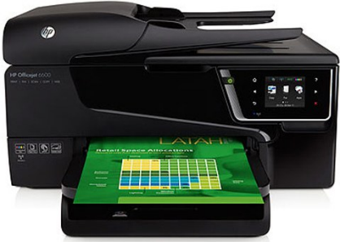
Common Computer Components
System unit
Display device
Peripheral device
Peripheral device
Input devices

Slide 3
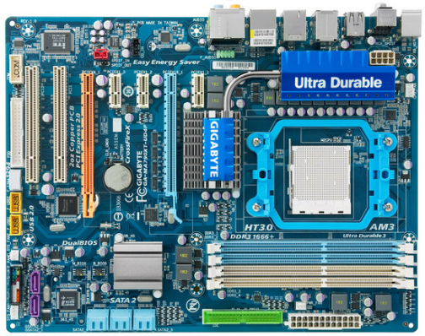
The Motherboard

Slide 4
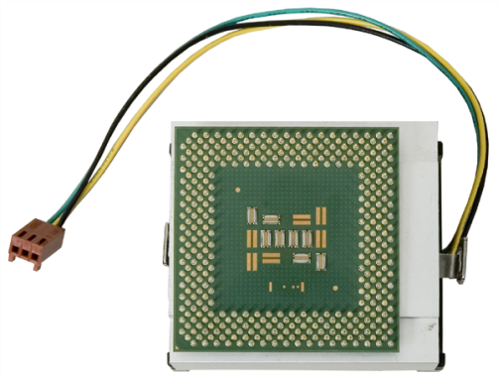
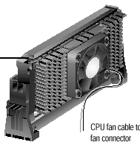
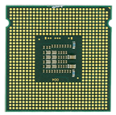
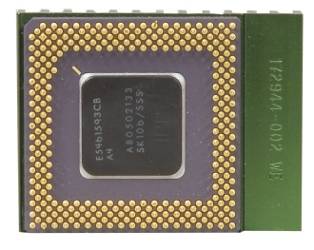
CPUs

Slide 5
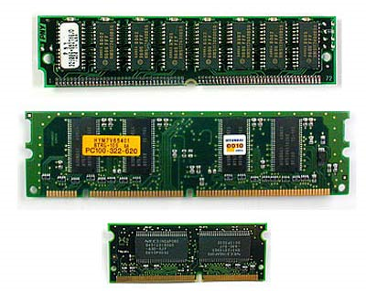
Memory

Slide 6


The System Bus
System bus
Hard drive controller
Video controller
Memory

Slide 7
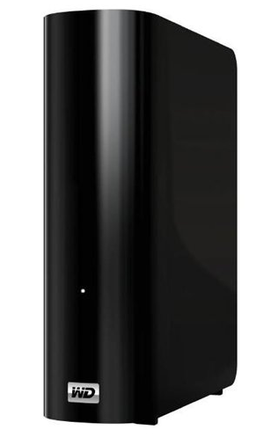
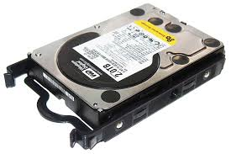
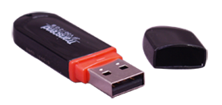
Storage Devices

Slide 8
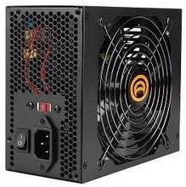
Power Supplies
Fan
Voltage switch
Power switch
Socket for power cord

Slide 9
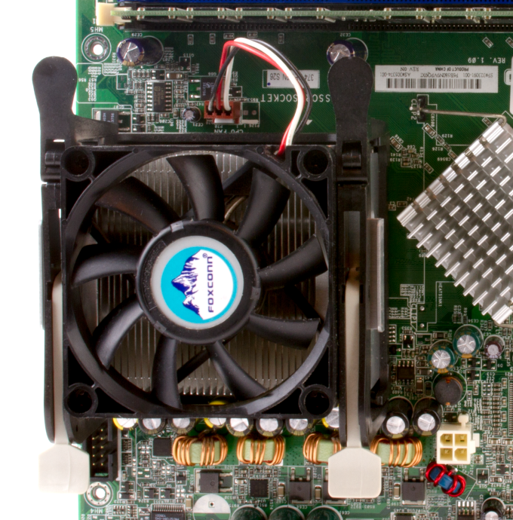
Cooling Systems
Fan

Slide 10
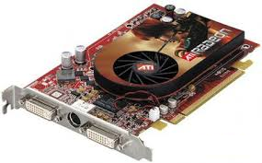
Expansion Cards
Cooling fan
Connector
Ports

Slide 11

Riser Cards

Slide 12




Firmware
Internet
Contains code to fix errors or support new hardware
}/* Startup sequence */
if ((usd=socket(AF_INET,SOCK_DGRAM,IPPROTO_UDP))==-1)
{perror ("socket");exit(1);}
setup_receive(usd, INADDR_ANY, udp_local_port);
setup_transmit(usd, hostname, NTP_PORT);
primary_loop(usd, probe_count, cycle_time);
close(usd);
return 0;
}
Firmware_update.exe
Firmware manufacturer
Programmable ROM chip

Slide 13
The System BIOS
ROM BIOS chip

Slide 14
UEFI
Operating system
Extensible Firmware Interface
Firmware
Hardware

Slide 15
The POST
Hardware Component | POST Test Criteria
Power supply | Must be turned on Must supply “power good” signal
CPU | Must exit Reset status mode Must be able to execute instructions
BIOS | Must be readable
BIOS memory | Must be readable
Memory | Must be able to be read by the CPU First 64 KB must be able to hold the POST code
Input/output (I/O) bus or I/O controller | Must be accessible Must be able to communicate with the video subsystem

Slide 16
Identifying PC Components, Step 2

Slide 17
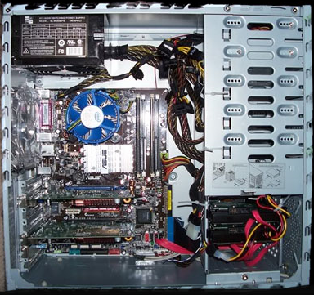
Identifying PC Components, Step 5
Notes:
OV?

Slide 18
Hard Drive Characteristics
Version | Characteristics
SATA 1.5Gb/s | Transfer speed: 1.5 Gb/s Interface throughput: 150 MB/s
SATA 3Gb/s | Transfer speed: 3.0 Gb/s Interface throughput: 300 MB/s Backwards-compatible with SATA 1.5Gb/s
SATA 6Gb/s | Transfer speed: 6.0 Gb/s Interface throughput: 600 MB/s Backwards-compatible with SATA 1.5Gb/s and SATA 3Gb/s
SATA 16Gb/s | Transfer speed: 16.0 Gb/s Interface throughput: 1969 MB/s Backwards-compatible with SATA 1.5Gb/s and SATA 3Gb/s
eSATA | External SATA connectivity Transfer speed: 3.0 Gb/s Interface throughput: 30 MB/s

Slide 19
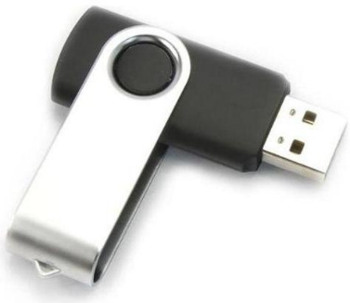
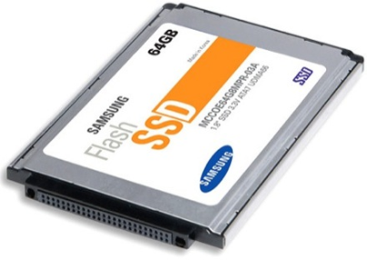
Solid State Storage
Device | Specifications
USB flash drive | Form factors include thumb drives and pen drives. Thumb drives can be small, from 50 to 70 mm long, 17 to 20 mm wide, and 10 to 12 mm thick. Data storage capacities vary, from 128 MB up to 128 GB. Data transfer rates also vary, from 700 KBps to 28 MBps for read operations, and from 350 KBps to 15 MBps for write operations.
Solid State Drive (SSD) | Does not need batteries, allowing makers to replicate standard disk-drive form factors (2.5-inch and 3.5-inch). Extremely fast (no moving parts). Can replace traditional computer hardware such as disk drives, optical drives, and network security appliances that include firewall and routing functions.

Slide 20
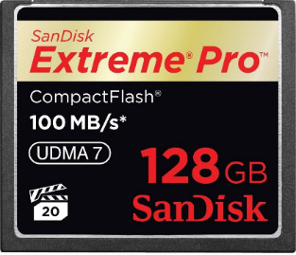
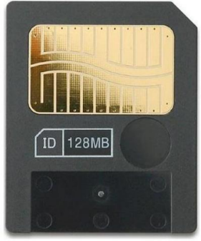
Solid State Storage (Cont.)
Device | Specifications
Compact Flash (CF) card | Flash memory card that is 43 mm long by 36 mm wide and often used in portable devices for additional storage. Type I: 3.3 mm thick; Type II: 5 mm thick. 50-pin contact Speed: 66 MBps up to 1 Gbps. Data storage: 100 GB up to 1 TB.
SmartMedia (SM) card | Flash memory card similar in size to CF cards (44 mm long by 37 mm wide by 0.76 mm thick). Often used for additional storage in digital cameras, digital recorders, and older PDAs. Speed: Up to 8 MBps. Data storage: Up to 128 MB.

Slide 21
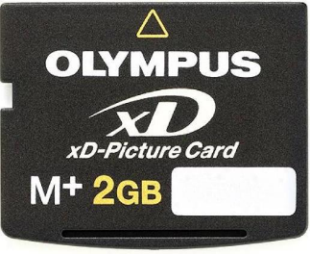
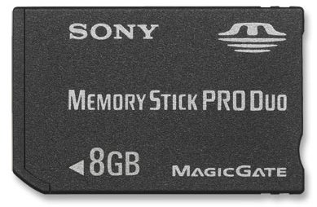
Solid State Storage (Cont.)
Device | Specifications
xD-Picture (xD) card | Flash memory card that is 20 mm long by 25 mm wide by 1.77 mm thick. Designed for use in digital cameras. Speed: 4 MBps up to 15 MBps for read; 1.3 to 9 MBps for write. Data storage: 2 to 8 GB.
Memory stick (MS) | Flash memory card that is 50 mm long by 21.5 mm wide by 2.8 mm thick. Speed: 2.5 MBps for read; 1.8 MBps for write. Data storage: Up to 16 GB.

Slide 22
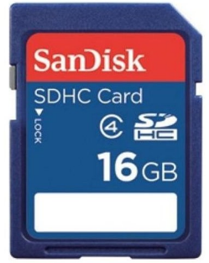
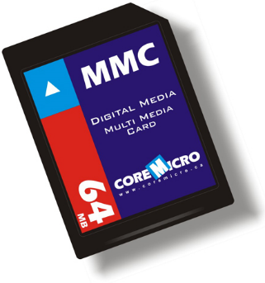
Solid State Storage (Cont.)
Device | Specifications
Secure Digital (SD) memory card | Dimensions: Original: 32 mm long by 24 mm wide by 2.1 mm thick. MiniSD: 21.5 mm long by 20 mm wide by 1.4 mm thick. MicroSD: 15 mm long by 11 mm wide by 1 mm thick. Speed: 10 to 20 MBps. Data storage: Up to 2 TB.
MultiMediaCard (MMC) | Dimensions: Original: 32 mm long by 24 mm wide by 1.5 mm thick. RS-MMC and MMCmobile: 16 mm long by 24 mm wide by 1.5 mm thick. MMCmini: 21.5 mm long by 20 mm wide by 1.4 mm thick. MMCmicro: 12 mm long by 14 mm wide by 1.1 mm thick. Speed: Up to 52 MBps. Data storage: Up to 8 GB. Often compatible with SD card readers.

Slide 23
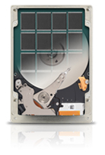

Solid State Hybrid Drives
Magnetic drive combined with flash memory
Flash memory used to cache most-accessed data
Provides HDD capacity and solid state performance

Slide 24
Optical Disc Characteristics
Disc Type | Description
CD-ROM | Compact Disc-Read Only Memory The capacity for CD-ROMs ranges from 700 to 860 MB.
CD-RW | CD-Rewritable CD-RW capacities also range from 700 to 860 MB.
DVD-ROM | Digital Versatile Disc-Read Only Memory Single-sided DVD-ROMs have a capacity of 4.7 GB, while double-sided DVD-ROMs can hold 9.4 GB.
Single Layer DVD-R | Single Layer Digital Versatile Disc-Recordable Single Layer DVD-Rs have a capacity of up to 4.7 GB.
Single Layer DVD+R | Single Layer Digital Versatile Disc+Recordable Single Layer DVD+Rs have a capacity of up to 4.7 GB. They are faster than DVD-Rs.
Double Sided DVD-R and DVD+R | Double-sided DVDs have one layer on each side of the disc. Discs can store up to 8.75 GB of data.
Dual Layer DVD-R | Dual Layer Digital Versatile Disc-Recordable Dual Layer DVD-R discs can hold up to 8.5 GB of data.

Slide 25
Optical Disc Characteristics (Cont.)
Disc Type | Description
Dual Layer DVD+R | Dual Layer Digital Versatile Disc+Recordable Dual Layer DVD+R discs can hold up to 8.5 GB of data. DVD+R is faster than DVD-R.
Single Layer DVD-RW | Single Layer Digital Versatile Disc-Rewritable Single Layer DVD-RW discs hold up to 4.7 GB of data.
Dual Layer DVD-RW | A DVD-RW disc that has two layers of writable space The maximum capacity of 8.7 GB for single-sided DVD-RWs and 17.08 GB for double-sided DVD-RWs.
DVD-RAM | Digital Versatile Disc-Random Access Memory A DVD that is rewritable and erasable. You can erase or rewrite specific sections of the disc without affecting other parts of the disc. Often used for backup storage.
BD-ROM | Blu-ray Disc-Read Only Memory BD discs have a capacity of up to 128 GB, depending on the number of layers. Each layer on the disc has a capacity of 25 GB. Newer discs have the capability of holding up to four layers of storage.
BD-R | Blu-ray Disc-Recordable (BD-R) BD discs have a capacity of up to 128 GB, depending on the number of layers.
BD-RE | Blu-ray Disc-Recordable Erasable BD discs have a capacity of up to 128 GB, depending on the number of layers.

Slide 26
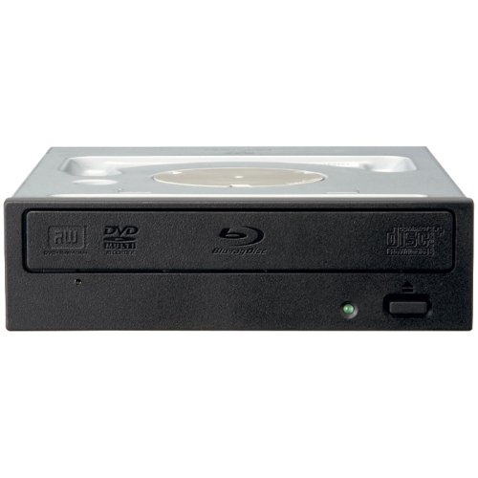
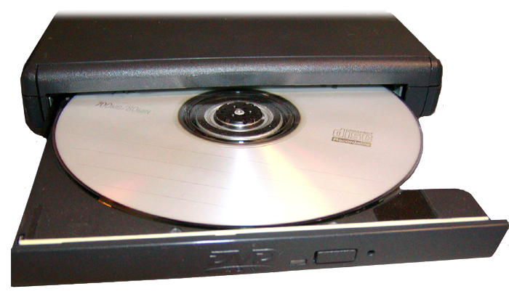
Optical Drives
CD
DVD
Blu-ray
Combo drives

Slide 27
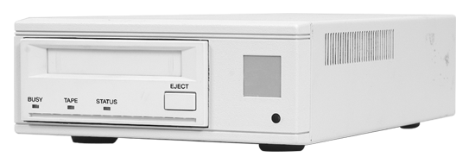
Tape Drives

Slide 28
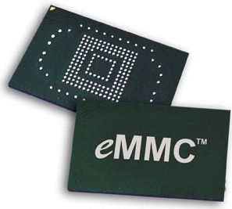
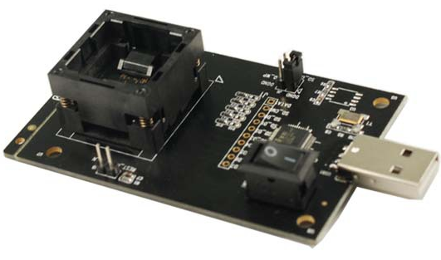
eMMC
Embedded Multimedia Controller
Flash memory and controller on the same silicon die

Slide 29
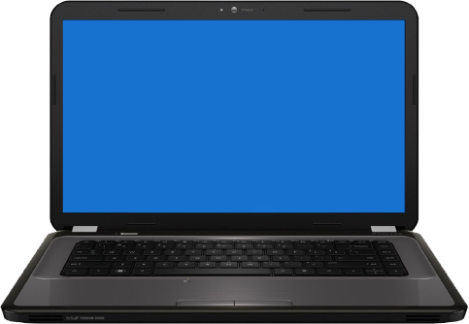
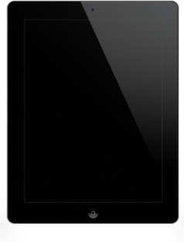



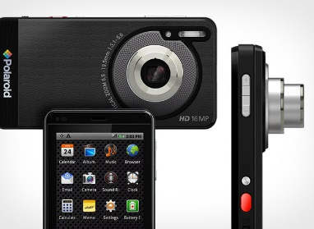
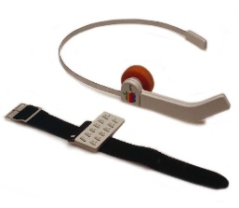
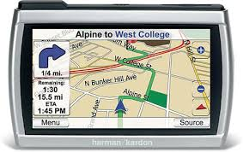
Mobile Digital Devices
Small form factor
Wireless network connectivity
Local nonremovable data storage
Laptop
Tablet
Smartphone
Phablet
Wearable technology
E-Reader
Smart camera
GPS device

Slide 30

Laptops
Display
Keyboard
Touchpad

Slide 31
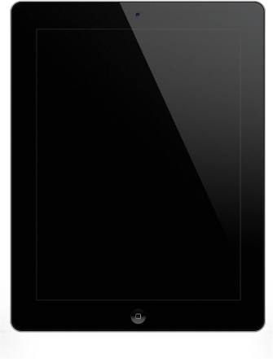
Tablets
Common components
  Touch screen display
  Virtual keyboard
  Solid state storage
Variable characteristics
  Size
  Operating system

Slide 32
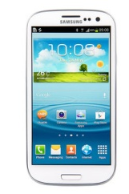
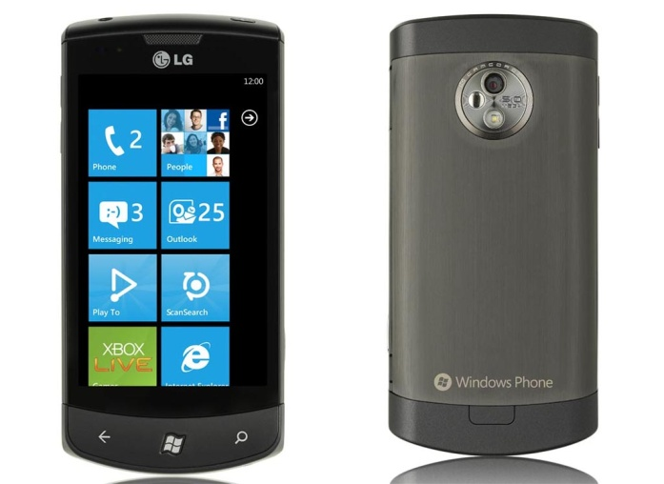
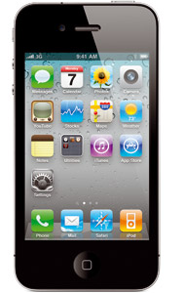
Smartphones
iPhone
Android smartphones
Windows smartphones

Slide 33
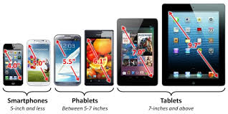
Phablets
Larger than a smartphone
Smaller than a tablet
Smartphones
(5.0 inches and less)
Phablets
(5.0 to 7.0 inches)
Tablets
(7.0 inches and above)

Slide 34

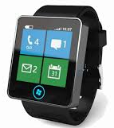
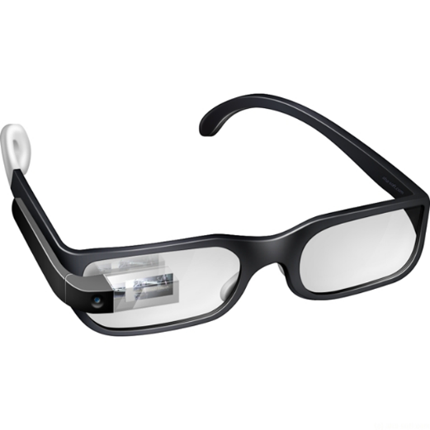
Wearable Technology
Mobile computing devices
Designed to be work under, with, or on top of clothing
Headset
Smart watch
Glasses

Slide 35
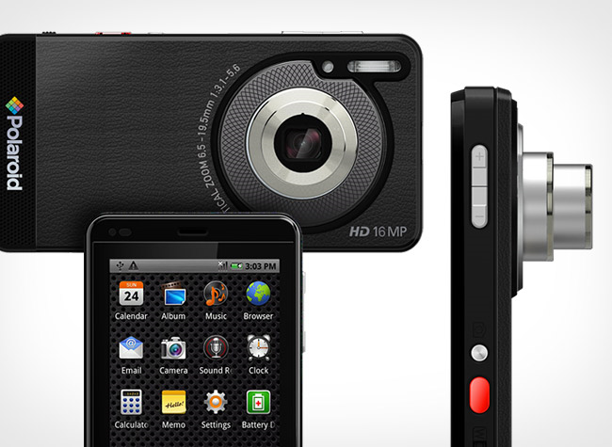
Smart Cameras
Digital camera with a mobile operating system installed
Processor, memory, and cellular and Wi-Fi support
Apps for editing, organizing, and storing photos

Slide 36

e-Readers
Generally tablet sized but with less functionality.
Can hold hundreds of e-books and digital periodicals.
Enhanced readability.
Longer battery life.

Slide 37
GPS Devices
GPS: Global Positioning System.
Provides navigational directions to reach specified destinations.

Slide 38
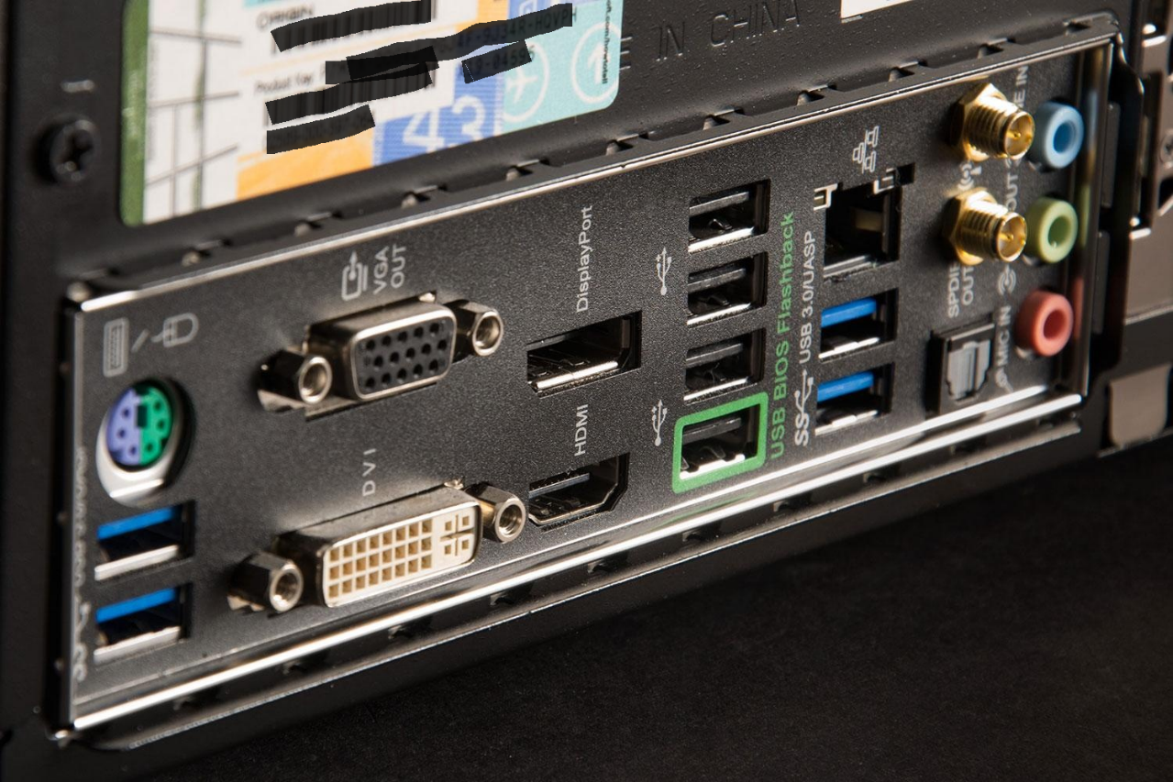
Physical Ports
Network connection port
Multimedia ports
Mouse and keyboard ports
USB ports
Video ports

Slide 39
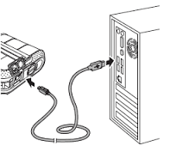
Computer Connections
USB ports
USB connectors
Cable

Slide 40
Characteristics of Connection Interfaces
Analog or digital
Distance limitations
Data transfer speeds
Signal quality
DRM support
Frequencies

Slide 41
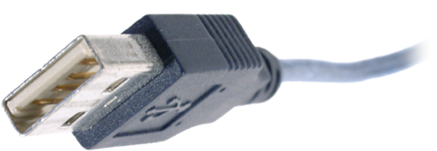
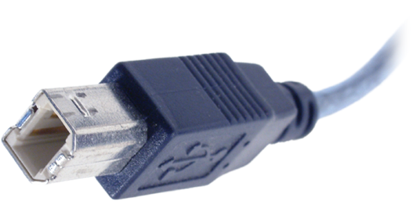
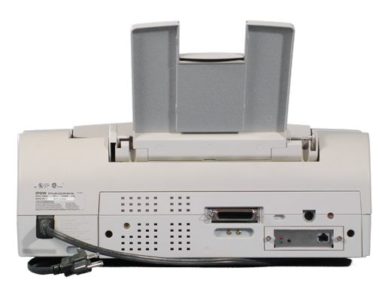
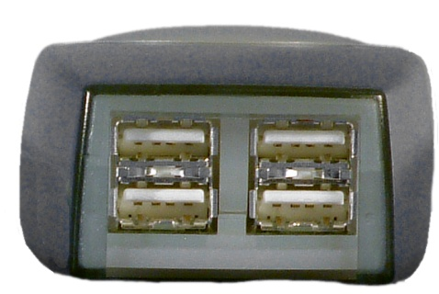
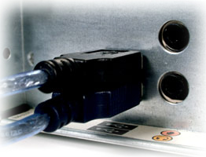
USB Connections
Type A connector connects to
USB port on the computer
or on a hub
Type B connector
connects to USB device

Slide 42

USB Connections (Cont.)
USB Type A
USB Type B
Mini USB
Micro USB
Notes:
Check to see if we need more current pics

Slide 43



IEEE 1394 Connections
IEEE 1394 (FireWire 400) cable
IEEE 1394 ports
IEEE 1394B (FireWire 800) cable

Slide 44


Thunderbolt Connections
Thunderbolt port
Thunderbolt connector and cable
Thunderbolt versions 1 and 2 use the Mini DisplayPort connector, while Thunderbolt 3 uses the USB Type C connector.

Slide 45

SATA Connections
SATA power cable
SATA data cable

Slide 46



Display Cables and Connector Types
VGA connector
HDMI connector
DVI connector

Slide 47






Other Connectors
RCA cable and connectors for analog audio
Coaxial cable and connectors for digital audio
Optical cable and connectors for digital audio
RJ-45 connectors on twisted-pair cable
RJ-11 connectors on telephone cable
PS/2 mouse and keyboard connectors

Slide 48









Adapters and Converters
DVI to HDMI adapter
DVI to VGA converter
HDMI to VGA converter
PS/2 to USB adapter
PS/2 to USB converter
Thunderbolt to DVI converter
USB to Ethernet adapter
Audio to USB adapter
USB A to USB B adapter

Slide 49
Wireless Device Connections
Connection Method | Description
RF (Radio frequency) | RF waves carry signals to wireless antennas 10 KHz to 1 GHz
Bluetooth | Short-range wireless communication, up to 30 feet 2.4 GHz (2.402 to 2.483) Pairing of devices required Up to 8 Bluetooth devices connected into a piconet
NFC (Near Field Communication) | Very-short-range wireless communication, touching or up to 10 cm 13.5 MHz Slower than Bluetooth but does not require pairing
IR (Infrared) | Short-range wireless communication 300 GHz to 400 THz Line of sight required

Slide 50
PC Ports

Slide 51
Reflective Questions
1. How many of the PC components described in this lesson were familiar to you?
2. Which device connections have you used? Which are new to you?

