Slide 1
Installing and Configuring Networking
Capabilities
Configure Basic Windows Networking
Configure Windows Proxy and Firewall Settings
Using Windows Networking Features
Install and Configure SOHO Networks

Slide 2
Network Connection Types
VPN
Dial-up
Wireless
  WAP
Wired
  Ethernet
WWAN cellular

Slide 3
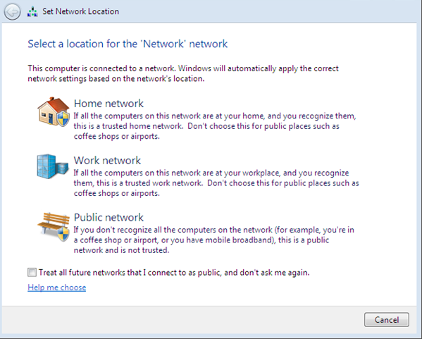
Network Location Settings

Slide 4
Network Card Properties
Property | Description
Speed and duplex settings | Speed: ranges from 10 MB/s to 1000 MB/s. Duplex modes: Half duplex Full duplex Auto negotiation
Wake-on-LAN | Enables a device to power up when it receives a network message from another computing device. Check the NIC’s properties in the system BIOS to determine if your NIC supports this.
Power over Ethernet | Enables data and electrical power to be transferred over an Ethernet cable.
Quality of Service | Prioritizes network traffic for identified devices according to established parameters.

Slide 5
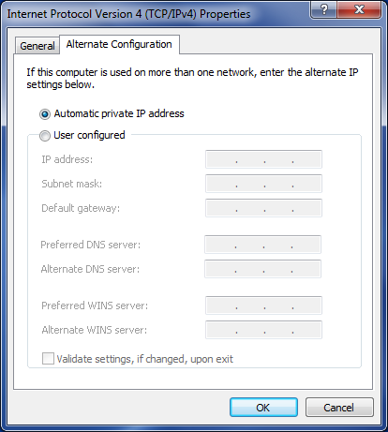
Alternate IP Address Configurations

Slide 6
Windows Networking Options
Networking Option | Description
Homegroup | Provides easy file and printer sharing for Windows 7, Windows 8, and Windows 8.1 computers.
Workgroup | Contains an unstructured, named collection of computers. Usually deployed in homes or small offices.
Domain | Requires at least one domain controller. Usually deployed in corporate or enterprise environments where centralized administration is practiced.

Slide 7








Directory Services
Users
Clients
Servers
Additional directories
Network devices
Active Directory
Additional services
Firewall services
Email server
Applications

Slide 8
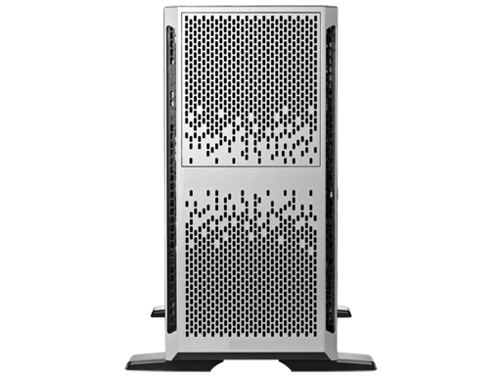
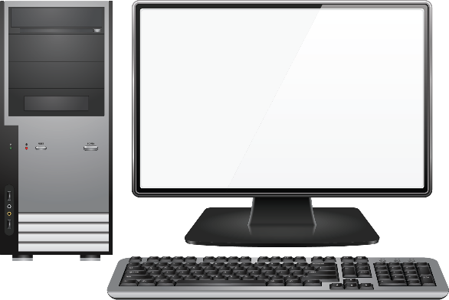
Proxy Settings
Protects client computers from outside computers
When configuring a client computer to be used with a proxy:
  Specify the correct address in the proxy server settings.
  Configure exceptions, including ranges.
  Configure HTTP and FTP connections.

Slide 9
Windows Firewall Settings
Enabling or disabling port security
Filtering inbound and outbound traffic
  Rules
  Exceptions
Reporting and logging activity
Protecting against malware and spyware
Blocking pop-ups
Assigning ports
Configuring port forwarding
Configuring port triggering
Enabling or disabling Windows Firewall

Slide 10
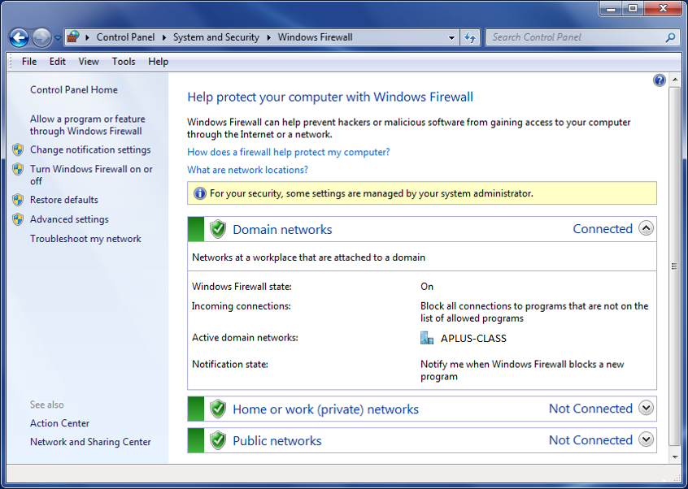
Windows Firewall Settings (Cont.)

Slide 11




DMZs
Internal Network
DMZ Network
Internal Firewall
External Firewall

Slide 12

NAT Implementations
NAT Server
24.96.83.120
192.168.12.20
192.168.12.30
192.168.12.100

Slide 13


DNAT
Internal Address | Public Address
192.168.25.101 | 211.14.248.68
192.168.25.102 | 211.14.248.69
192.168.25.103 | 211.14.248.64
192.168.25.104 | 211.14.248.65
192.168.25.105 | 211.14.248.61
Internal Address
192.168.25.101
192.168.25.102
192.168.25.103
192.168.25.104
192.168.25.105
211.14.248.60
211.14.248.61
211.14.248.62
211.14.248.63
….
Address Pool
NAT Server
(static NAT)
NAT Server
(DNAT)

Slide 14
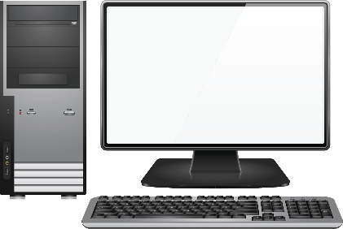


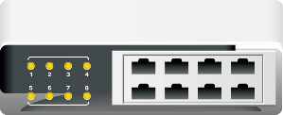
Network Shares
LHuber’s share
Finance share
JSmelt’s share
Sales share

Slide 15
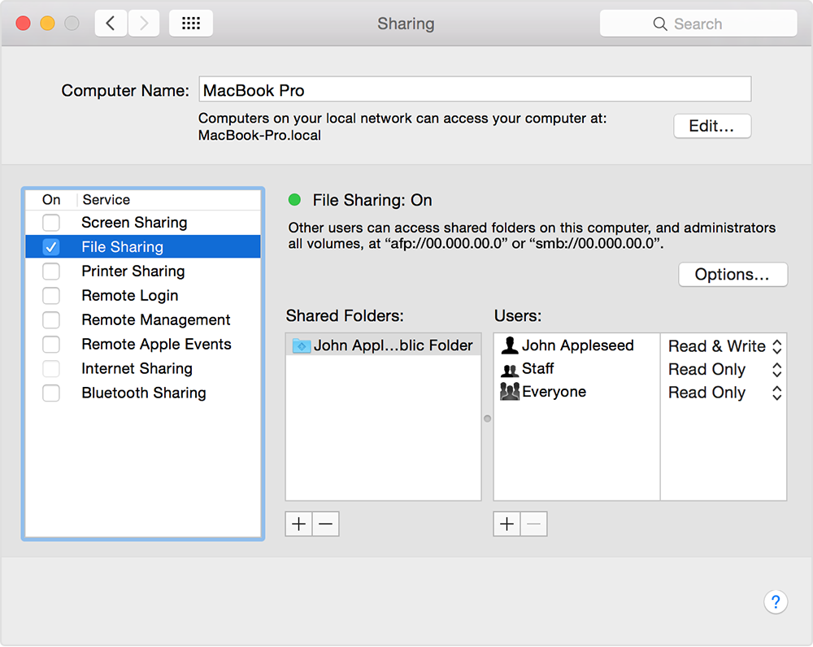
File Sharing with OS X
Share with up to 10 other users without a server.
AppleTalk service.
Network name for your computer.
File sharing service.

Slide 16
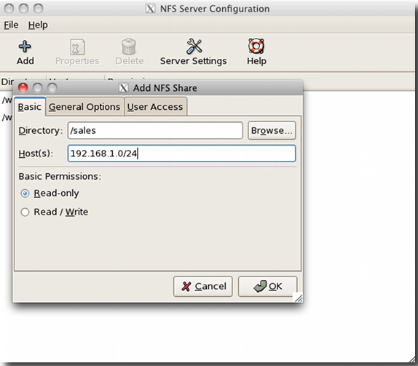
File Sharing with UNIX or Linux
Centralized file servers more common.
NFS protocol.
Implementation varies with OS versions and distros.

Slide 17
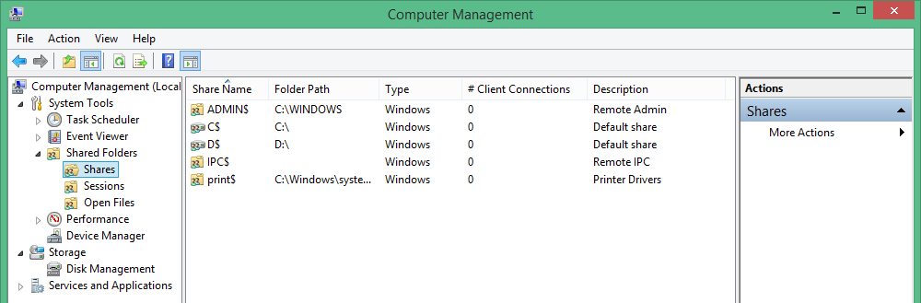
Windows Administrative Shares
Folders shared by default.
Hidden shares with dollar signs appended to share name.

Slide 18
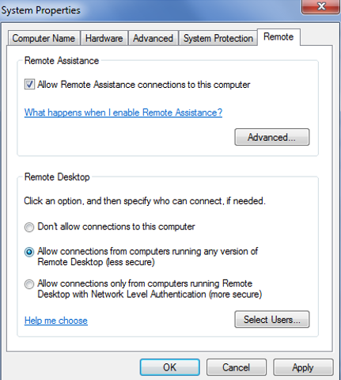
Remote Desktop

Slide 19
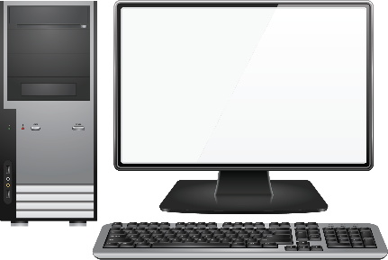



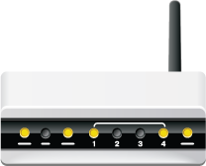
SOHO Networks
Small Office/Home Office networks
Connectivity and resource sharing on a small scale
Up to 20 computers
Wired and wireless connections
Same physical location, usually

Slide 20



Basic QoS
Parameters that control the quality provided to network traffic types.
Parameters include:
  Maximum amount of delay, signal loss, and noise per traffic type.
  Bandwidth priority for each traffic type.
  CPU usage for each data stream.
SLA between ISP (provider) and receiver (subscriber).
Subscriber
SLA
Provider

Slide 21
802.11 Wireless Standards
Standard | Description
802.11a | Relatively expensive 54 Mbps transfer rate at 5 GHz Range: up to 60 feet Not compatible with 802.11b
802.11b | Cheapest option 11 Mbps transfer rate at 2.4 GHz Range: up to 1,000 feet in open areas; 200 to 400 feet in enclosed spaces Not compatible with 802.11a
802.11g | 54 Mbps transfer rate at 2.4 GHz Compatible with 802.11b
802.11n | Up to 600 Mbps transfer rate at 2.4 or 5 GHz
802.11 ac | 433 Mbps to 1.3 Gbps transfer rate at 5 GHz Beamforming

Slide 22
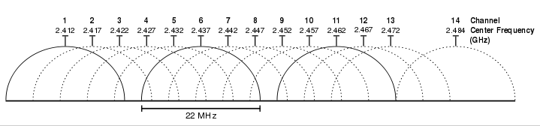
Channels

Slide 23

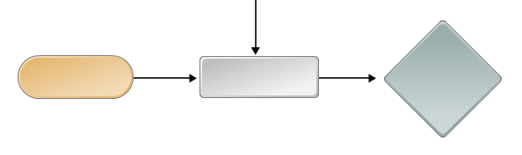
Wireless Encryption
WEP
  64-bit, 128-bit, and 256-bit encryption
  802.11a and 802.11b
WPA
  Addresses security issues with WEP
  Interim solution
  Strong authentication and data encryption
WPA2/802.11i
  Strong encryption and authentication
  TKIP
  AES
  EAP
Plaintext
Encryption
Encrypted Data

Slide 24
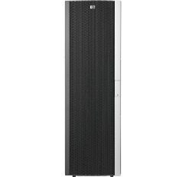


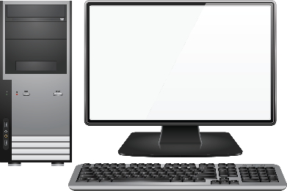
WAPs
Wireless connection
WAP

Slide 25




SSIDs
SSID = Company A
SSID = Company B

Slide 26

Port Forwarding and Triggering
Port triggering
  Automated port forwarding
  Specify triggering ports for receiving inbound traffic
Port forwarding
  Moves traffic from one network port to another node
Router with NAT capabilities

Slide 27
Router Settings
Basics
  Secure the router or AP administration interface.
  Change default administrative password and user names.
  Disable remote administration.
  Secure or disable the reset switch or function.
  Change default SNMP parameters.
  Upgrade firmware.
SSID
  Change default SSID.
  Verify no broadcasting to the network.
MAC filtering
  Apply address filtering.
  Controls which wireless clients can access the network.
Channels
  Change the default channel.
DHCP
  Configure DHCP or disable it and enter a static IP address.

Slide 28
Router Firmware
Updates from manufacture
  For new features, fixing security issues, or patching other issues.
Updates from other sources
  Change the functionality of the wireless router or device.
  OpenWrt and DD-WRT.

Slide 29

UPnP
Universal Plug and Play.
Enables wireless routers to discover WiFi-enabled devices more easily.
Can cause security issues.

Slide 30
Reflective Questions
What experiences do you have in working with any of the networking technologies discussed in this lesson?
Do you have experience working with SOHO networks? What do you expect to support in future job functions?

