Slide 1
Supporting Printers and Multifunction Devices
Printers and Multifunction Technologies
Install and Configure Printers
Maintain Printers
Troubleshoot Printers

Slide 2
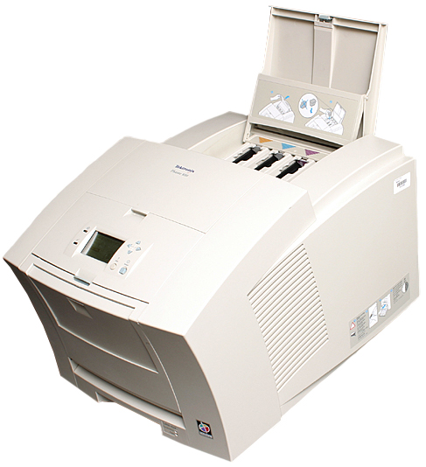
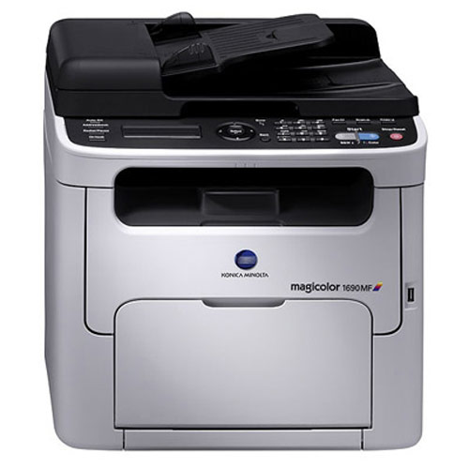
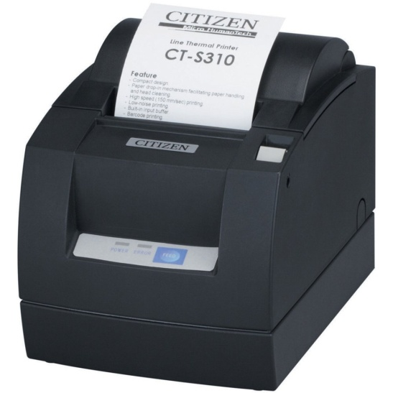
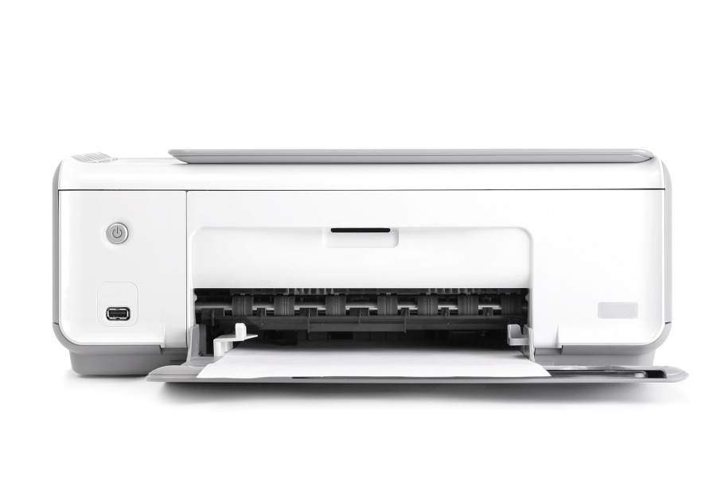
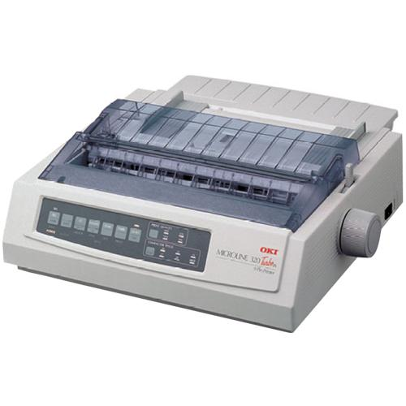
Printers

Slide 3
Printer Components
Component | Description
Mechanism for creating text and images | Impact printers typically use an ink coated ribbon. Low volume printers often use ink cartridges. High volume printers typically use toner. Store receipt printers might use ink or thermal process.
Paper feed mechanism | Printers need some method of moving the paper through the printer so that the ink or toner can be applied to the paper. Impact printers: sprockets that engage holes on the edge of continuous feed paper. Ink jet printers: wheels that pull the top sheet from a stack of cut paper. Laser printers: pickup rollers to move cut sheets. Specialized printers might use these or other methods of moving the paper.
Connection to computing devices | A printer is not all that useful if it cannot communicate with the devices that contain documents to be printed. Printers might connect through a: USB cable. Wired network card. Wireless card. Some printers also include card readers so users can save files to the memory card and print from the memory card directly onto the printer.
Paper input and output | Printers that use cut-sheet paper have a tray or opening for a stack of paper. There will also be a tray or opening where the printed pages are stacked after printing. Printers that use continuous feed paper might or might not have input and output trays. Thermal printers often use paper on a roll placed inside the printer device and the output is pulled across a serrated edge to remove the printed output from the roll.

Slide 4
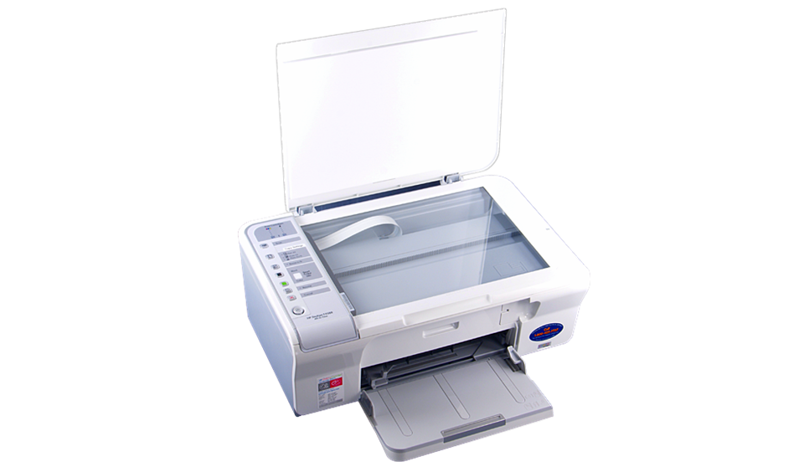
MFDs
AIO MFD
SOHO MFD
Heavy-duty MFD
Scanning
Faxing
Printing output tray

Slide 5
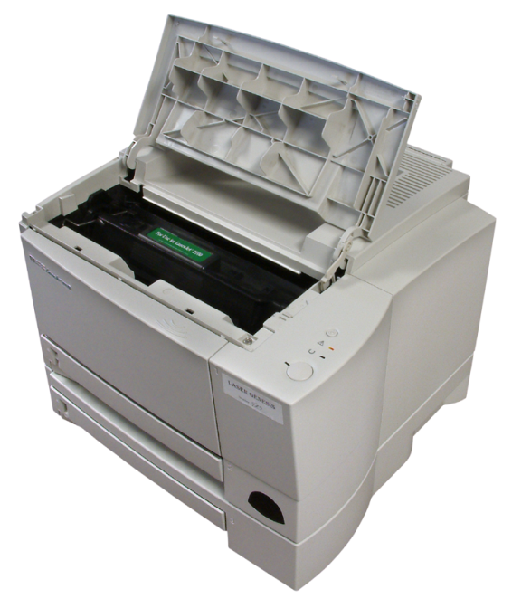
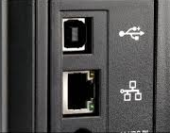
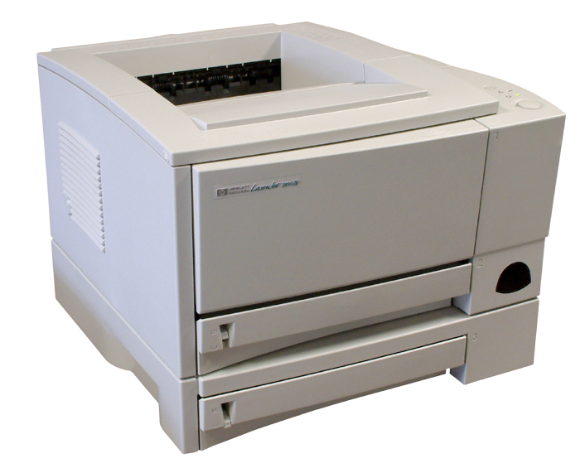
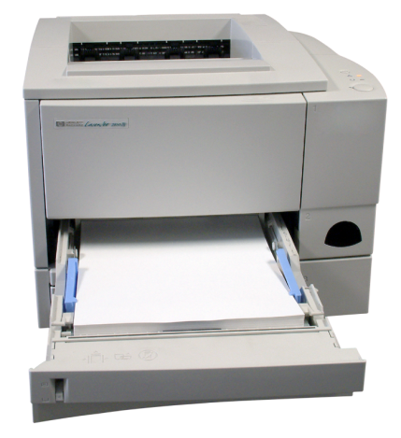
Laser Printers
Toner cartridge
Printer ports
Output tray
Input tray
Input trays

Slide 6
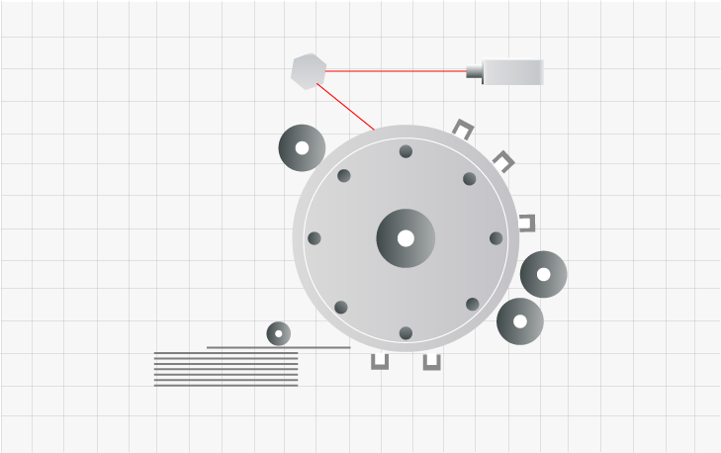
The Laser Print Process
Laser
Toner supply
Corona wires
charging the drum
EP drum
Fusing unit uses
heat and pressure to adhere toner to paper
Paper source
Corona wires
charging the drum

Slide 7
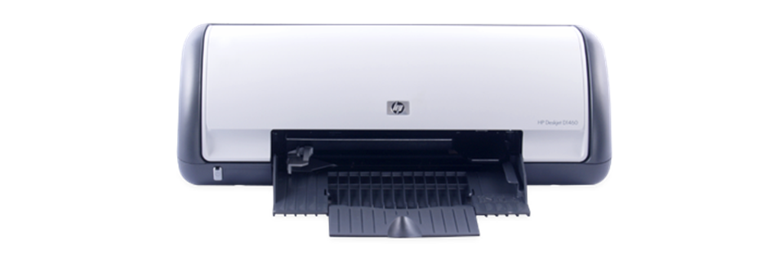
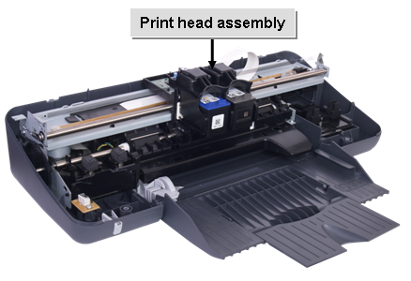
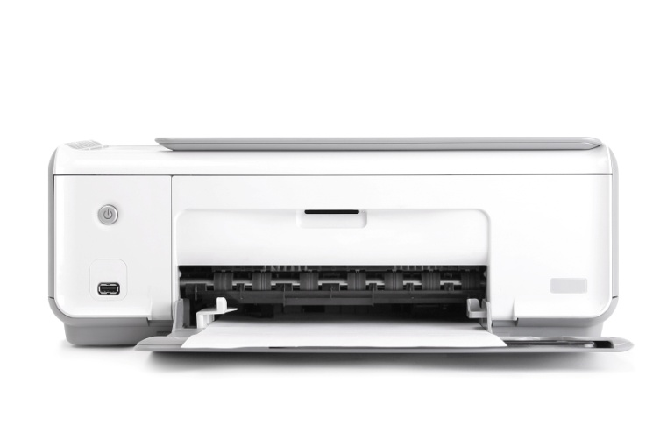
Inkjet Printers
Printhead assembly
Ink Cartridges
Ink cartridges

Slide 8

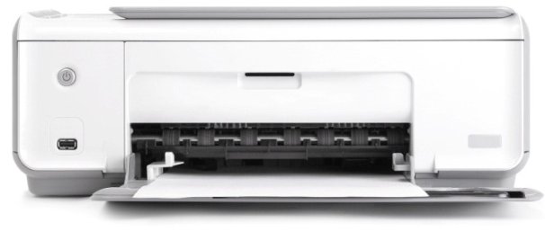
The Inkjet Print Process
Ink is sprayed
onto the paper
Paper
Printhead and
reservoir
Rollers

Slide 9
Thermal Printers
Can produce photo-quality output

Slide 10
Direct Thermal Print Process
Thermal printhead
Heated pins
Image
Thermal paper
Paper direction
Back pressure roller

Slide 11
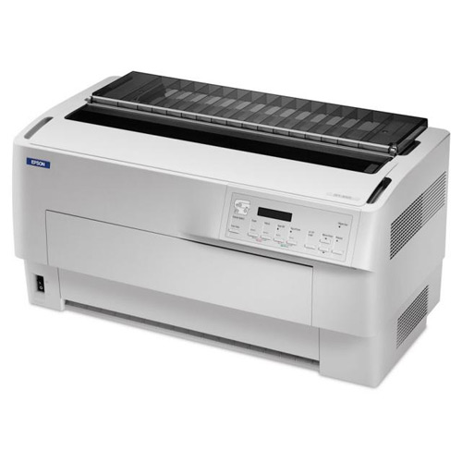
Impact Printers

Slide 12

The Impact Print Process
Ink ribbon
Paper
Printhead
Tractor

Slide 13
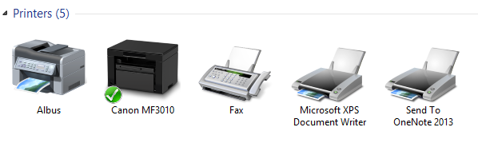
Virtual Printers
Reasons for using virtual printers:
  Send documents from PCs to fax servers.
  Creating documents that should not be changed.
  Making content available outside of the creating application.
  Combining multiple documents.
  Testing the appearance of the printed document.
Examples:
  Adobe Acrobat
  Nitro PDF Creator
  Microsoft XPS Document Writer
  Cute PDF
  GhostWriter
  Send to OneNote
Virtual printers

Slide 14
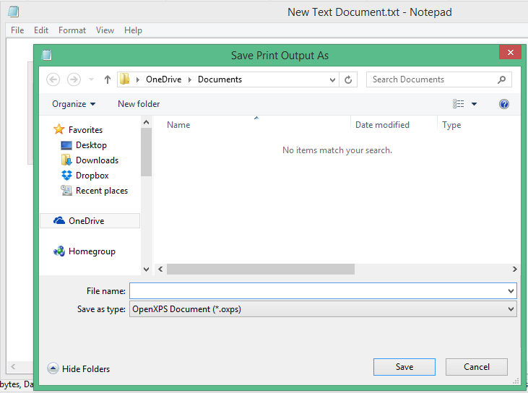
The Virtual Print Process
If necessary, install a virtual printer.
Open the application and the document you want to print.
Use the application’s Print option to select the virtual printer.
If necessary, configure options in the Print dialog box.
Select Print.
If necessary, select the location and name for the print file.

Slide 15
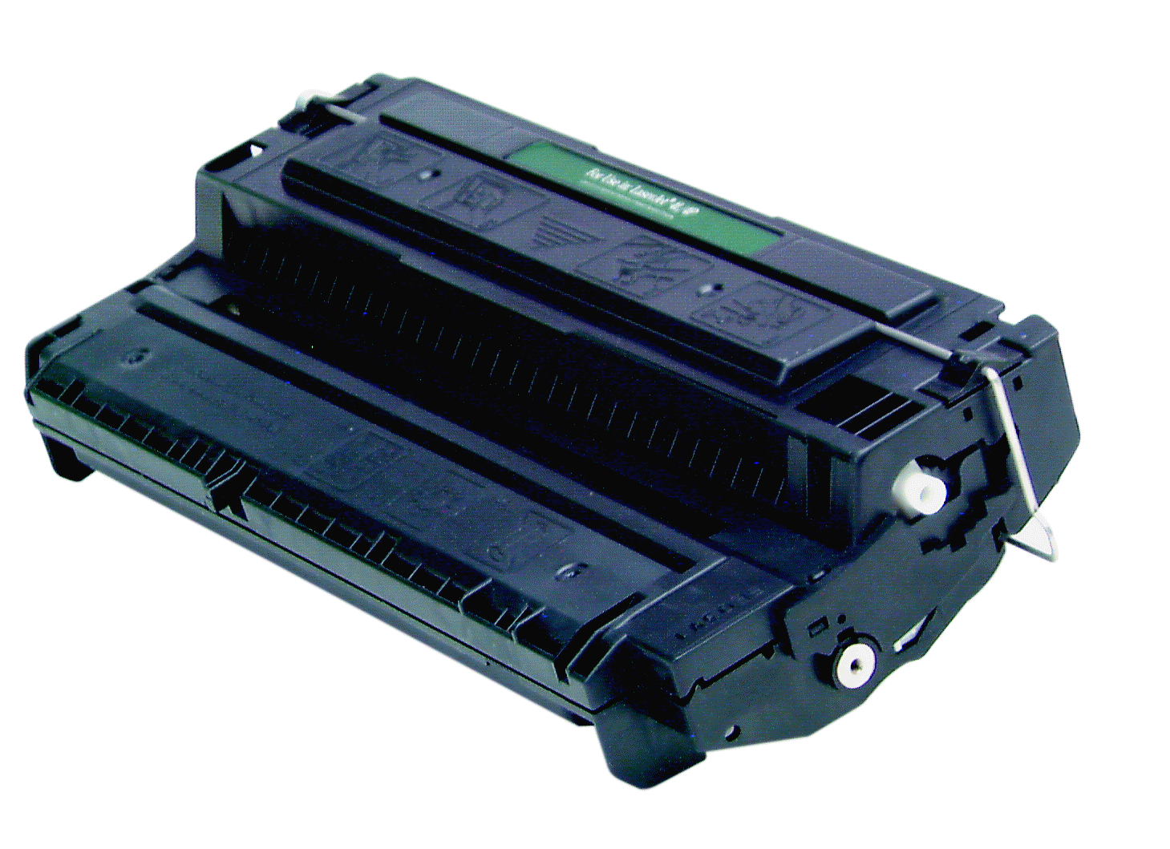
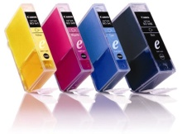
Printer Supplies and Media
Printer toner
Ink and ink cartridges
Paper and other media

Slide 16

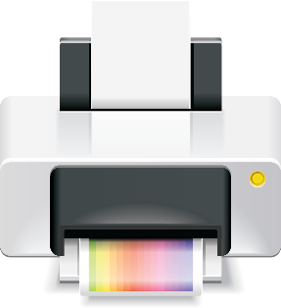
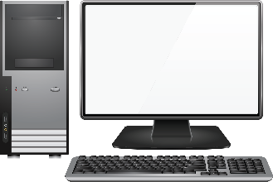

Local and Network-Based Printers
Local printers
  Connected to PC
  PC holds the print queue
Network-based printers
  Connected to network or print server
  Print server holds the print queue
Network-connected printers
  Connected to network
  Print server may reside on the printer itself
  Print server holds the print queue
Print queue
Print queue
Print queue

Slide 17
Print Device Sharing
Wired, generally via USB or Ethernet.
Wirelessly, using Bluetooth, 802.11x, or IR, and in infrastructure or ad hoc mode.
Using a print server to manage the print queue for network printers.
Using the Devices and Printers option in Windows 7 or Windows 8/8.1

Slide 18
Printer Configuration Options
Configuration Option | Description
Duplex | If automatic, enables users to print on both sides of the page with no additional effort. Otherwise, the user must manually reload paper to print on the other side.
Collate | Keeps all pages of a multipage document together when you print multiple copies of the document.
Orientation | Enables users to specify portrait (taller) or landscape (wider) paper orientation.
Print quality | Enables users to specify draft, normal, or high-quality output.

Slide 19





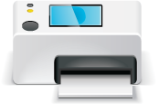
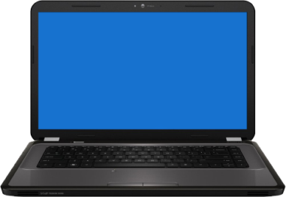
Cloud and Remote Printing

Slide 20
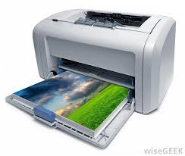
Laser Printer Maintenance
Replace the toner cartridge when needed.
Calibrate the printer when needed.
Apply maintenance kits:
  Fuser
  Transfer roller
  Paper feed roller
  Separation pads and rollers
Remove excess toner.
Provide proper ventilation.

Slide 21
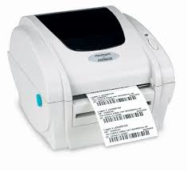
Thermal Printer Maintenance
Replace paper as needed.
Clean heating elements.
Remove debris from within and around printer.
Use isopropyl alcohol to clean sticky residue.

Slide 22
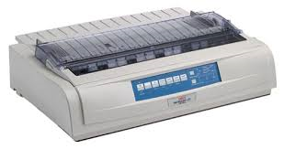
Impact Printer Maintenance
Clean paper and ribbon paths.
Replace printhead, ribbon, and paper as needed.
Remove dust from tractor feed wheels.
Provide adequate ventilation.

Slide 23
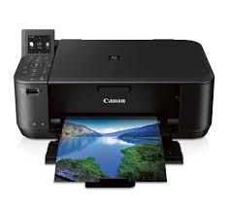
Inkjet Printer Maintenance
Use the printer frequently.
Replace ink cartridges as needed.
Calibrate as needed.
Use the printer’s cleaning routine to clean the printhead.
Run the nozzle test.

Slide 24
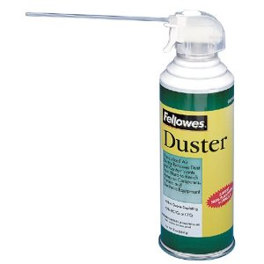
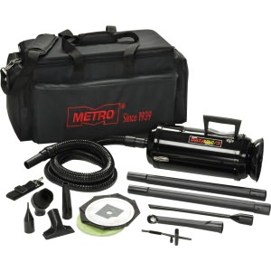
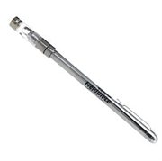
Common Printer Troubleshooting Tools
Maintenance kit
Toner vacuum
Compressed air
Extension magnet

Slide 25
Printer Software Tools
Resource | Description
Test patterns | Depending on the printer, you might be able to run test patterns to check the clarity and print quality of your printer. Doing so allows you to determine what settings need to be adjusted or what ink colors need to be refilled. Test patterns are either built in or external to the printer.
Printer spooler | You can use a printer spooler to determine where a print job is failing. Print jobs that make it through the spooler are usually experiencing hardware issues; print jobs that do not are often dealing with the sending application or a connection issue.
Power cycling | By turning off a printer for 10 to 30 seconds, and then turning it back on, you can clear the memory and start a fresh session.
General diagnostic utilities | Self-diagnostic programs Windows Troubleshooter Generic utilities

Slide 26
Printer Software Tools (Cont.)
Resource | Description
Device documentation | For device-specific issues, review the documentation for your imaging device.
Manufacturer websites | Most device manufacturers maintain technical information to help with printer troubleshooting and ongoing maintenance. You can also download updated printer or scanner drivers or diagnostic software tools from the manufacturer, or use web-based utilities to help you diagnose the problem.
Software vendor websites | OS vendors maintain libraries of technical information that can help troubleshoot known problems with specific devices, or general issues related to the printing function in the specific operating system.
Error codes and reports | Error messages can be displayed at the computer and at the printer. Review them all, including computer event logs.
Service logs and reports | Check previous service records to establish whether or not the issue is a recurring one.
Troubleshooting principles | Like any troubleshooting, follow a structured process. Gather information and identify symptoms. Review the data and establish a possible cause. Identify and test a solution.

Slide 27
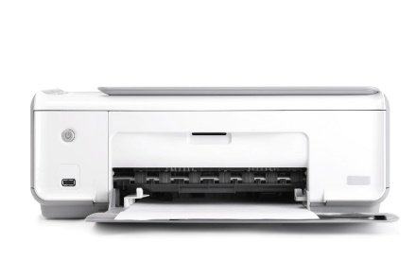
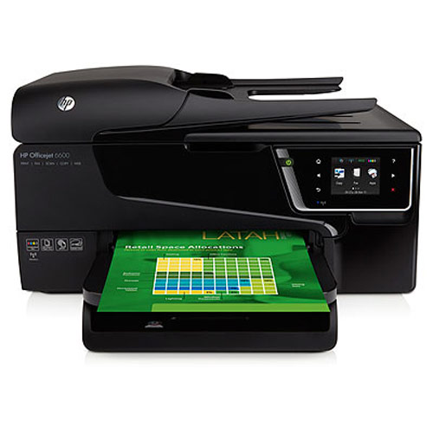
Common Printer Symptoms
Jobs in queue do not print.
Creased paper.
Paper not feeding from the tray.
Printing blank pages.
No connectivity.
Cannot install printer.
No image on printer display.
Print function not as expected.
Print quality issues.
Access issues.
Garbled output.
Jobs do not appear in queue.
Sporadic problems due to environment.
Sporadic problems and low memory errors.

Slide 28
Reflective Questions
When would you recommend to users that they user laser printers? Inkjet printers? Impact printers? Thermal printers?
Which printer maintenance tasks have you performed, on which types of printers? Which maintenance tasks are most important in your organization? Why are they so important?

