Slide 1
Networking Technologies
TCP/IP Properties and Characteristics
TCP/IP
Internet Connections
Ports and Protocols
Networking Tools

Slide 2
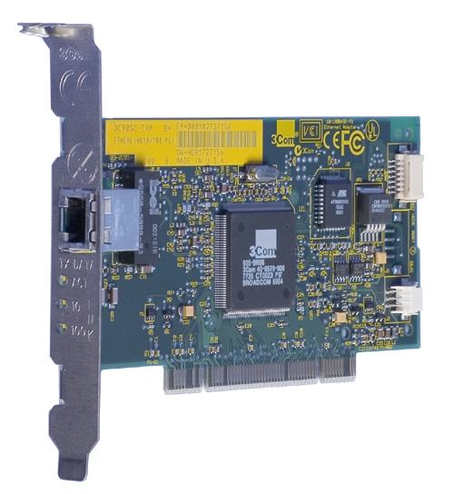
Network Interface Card Characteristics
Physical network address
Network connection port
Status indicator lights

Slide 3
Network Interface Card Characteristics (Cont.)
Characteristic | Description
Network connection port | One or more ports that are configured to connect to specific types of network cables.
Physical network address | A globally unique physical address assigned by the card manufacturer. Commonly referred to as the MAC address.
Status indicator lights | LEDs that provide information about the network connection. Link light Activity light Speed light

Slide 4

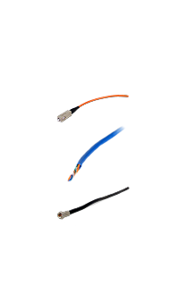

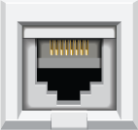

Ethernet
Ethernet
adapter
Media
types
Ethernet
adapter
Ethernet
adapter
Contention-based media access

Slide 5

Twisted Pair Cables
Insulated jacket
Four pairs of conductors
Wires twisted together

Slide 6
Twisted Pair Categories
Category | Characteristics
CAT 3 | Network Type: Telephone or Ethernet Maximum speed: 10 Mbps Maximum frequency: 16 MHz
CAT 5 | Network Type: Fast Ethernet Maximum speed: Up to 100 Mbps Maximum frequency: 100 MHz
CAT 5e | Network Type: Gigabit Ethernet Maximum speed: Up to 1 Gbps Maximum frequency: 100 MHz
CAT 6 | Network Type: Gigabit Ethernet Maximum speed: 10 Gbps Maximum frequency: 250 MHz Extended CAT 6 or CAT 6e cables perform better than CAT 6 when they are installed in an environment with high noise or RF interference.
CAT 6a or CAT 6 Augmented | Network Type: Gigabit Ethernet Maximum speed: 10 Gbps Maximum frequency: 500 MHz
CAT 7 | Network Type: Gigabit Ethernet Maximum speed: 10 Gbps+ Maximum frequency: 600 MHz

Slide 7
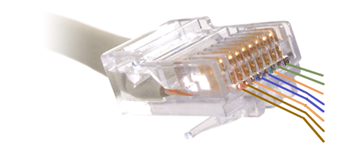

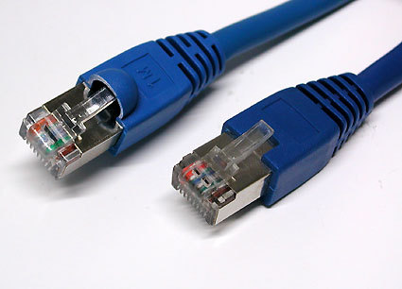
Twisted Pair Connectors
Eight pins
1 W/Green
2 Green
3 W/Orange
4 Blue
5 W/Blue
6 Orange
7 W/Brown
8 Brown
P3
P1 P2
P4
Four pairs of wires

Slide 8
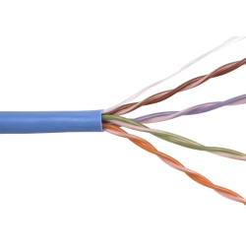
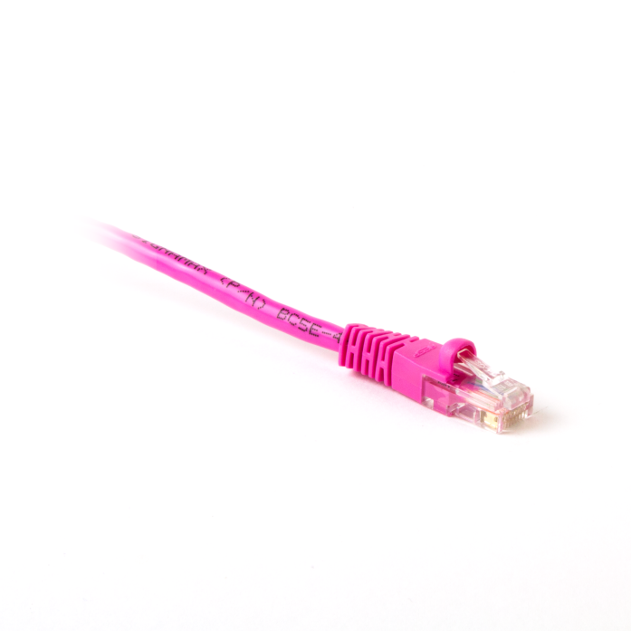
PVC Cable and Plenum Cables
PVC is inexpensive and flexible used to cover with twisted pair cabling.
Plenum jacketing does not give off noxious or poisonous gas when burned.
PVC
Plenum jacketing

Slide 9
Twisted Pair Wiring Standards
TIA and EIA
568 Commercial Building Telecommunication Cabling standard
  Regulates design, construction, and management of structured cabling systems.
  Unified communications system.
T568A
  Legacy standard for commercial systems that supported data, voice, and video.
T568B
  Preferred cable types for home-based networks.
T568C
  Latest standard combines home and commercial standards.

Slide 10
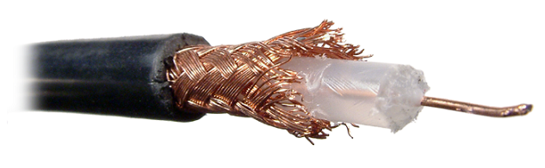
Coaxial Cables
Braided shielding
Non-conductive insulated coating
Single copper conductor

Slide 11
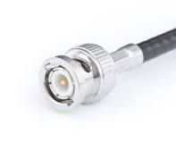
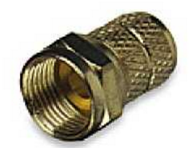
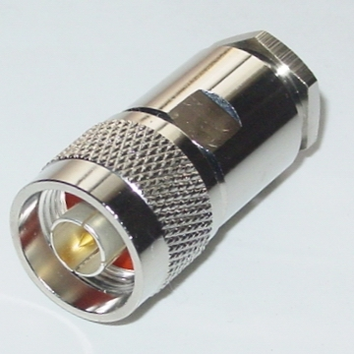
Coaxial Cable and Connector Types
F-connector
BNC connector
RG8 connector

Slide 12
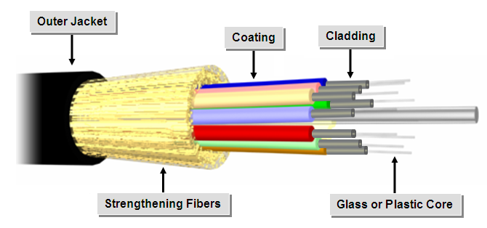
Fiber Optic Cables
Outer jacket
Coating
Cladding
Strengthening fibers
Glass or plastic core
Single core

Slide 13
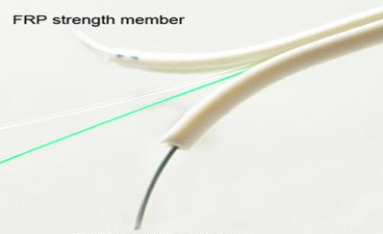
Fiber Optic Cables (Cont.)
Fiber
FRP strength member
Dual core
FRP = Flexible Reinforced Plastic

Slide 14

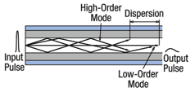

Types of Fiber Optic Cables
Single mode
Step index multimode
Graded index multimode

Slide 15






Fiber Optic Connectors
ST
SC
FC
LC
SMA
MT-RJ

Slide 16
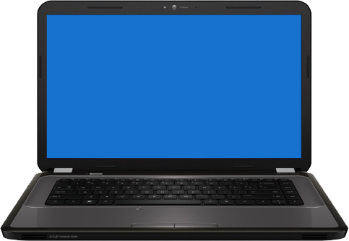

Wireless Connections
Radio waves
Satellite

Slide 17
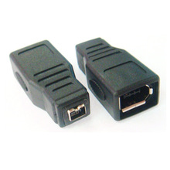
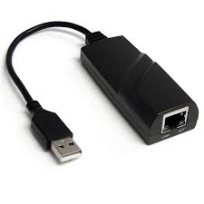
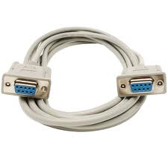
Other Network Connection Methods
USB network adapter
FireWire network adapter
RS-232 null modem cable

Slide 18
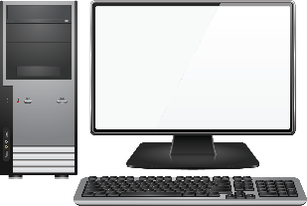

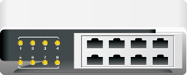


TCP/IP
TCP/IP enables communication across different network types.

Slide 19
IPv4 Addresses
Network segment
Node segment
Binary
11010000.01111011.00101101.00010010
208.123.45.18
Decimal

Slide 20
Subnet Masks
IP address
139.87.140.76
255.255.0.0
Removes the node portion of the IP address
Subnet mask
Network ID
139.87.0.0

Slide 21
Gateways
Gateway:
Converts data between incompatible systems or devices
Translates data between different operating systems
Implemented as hardware, software, or both
Default gateway:
Address where traffic for other networks is sent
Normally the address of a network router
Not required, but limited communication if not present

Slide 22
IP Address Classes
Address Class | Subnet Mask | Nodes
Class A | 255.0.0.0 | Up to 16,777,214 nodes
Class B | 255.255.0.0 | Up to 65,534 nodes
Class C | 255.255.255.0 | Up to 254 nodes

Slide 23
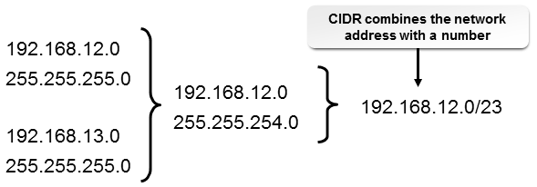
CIDR

Slide 24

IPv6 Addresses
Increases the available pool of IP addresses
Includes new efficiency features
Not compatible with IPv4, so its deployment is limited
An example IPv6 address
2001:0DB8:AC10:FE01:0056:0000:0000:0000
Hexadecimal format
0010 0000 0000 0001:0000 1101 1011 1000:1010 1100 0001 0000:1111 1110 0000 0001:
0000 0000 0101 0110:0000 0000 0000 0000:0000 0000 0000 0000:0000 0000 0000 0000
128-bit binary format

Slide 25
Comparing IPv4 and IPv6
Characteristic | IPv4 | IPv6
Address length | 32 bits | 128 bits
IPSec | Optional | Required
Deployment | Widespread | Limited

Slide 26
Addressing Schemes
Addressing Scheme | Description
Private | IP addresses that organizations use for nodes requiring IP connectivity within enterprise networks, but not requiring external connections such as to the Internet. In IPv6, referred to as site-local addresses.
Public | IP addresses that connect computers to the Internet. Assigned by ICANN.
APIPA/Link local | On Windows computers, an IPv4 address within the 169.254.0.0/16 block that is automatically assigned when there is no DHCP server available. In IPv6, an address in the FE80::/10 block.
Loopback address | Addresses in the IPv4 127.0.0.0/8 or IPv6 ::1 range are reserved for loopback. Information sent out from the device is routed back to the source without any processing or change. Mainly used for testing purposes.

Slide 27
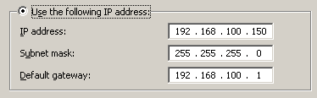
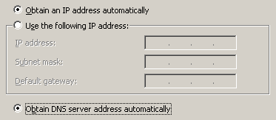
Static and Dynamic Addressing
Static addressing
Dynamic addressing

Slide 28
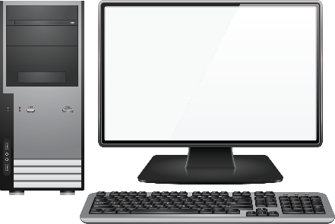
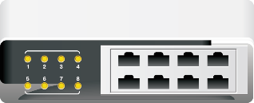
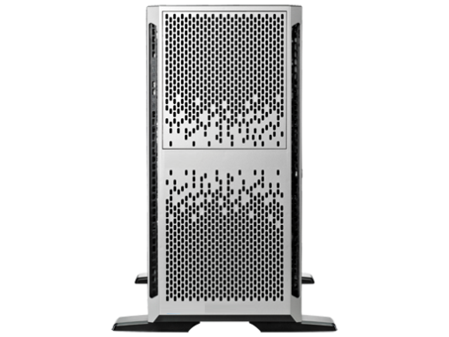
DHCP
192.168.100.151
192.168.100.150
192.168.100.152
IP address assignments
DHCP server
192.168.100.153

Slide 29
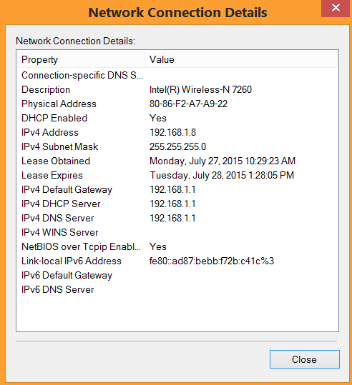
Client-Side DHCP Settings
DHCP settings

Slide 30
DNS
.com
.org
www.develetech.com
www.buildingwithheart.org
mail.develetech.com
donors.buildingwithheart.org

Slide 31

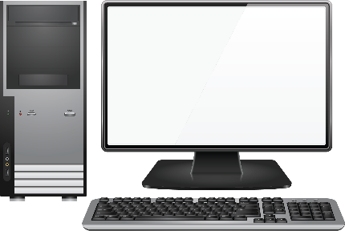

Client-Side DNS
Client-side resolver cache
DNS client
Remote host with no address in client resolver cache
DNS server

Slide 32



ISPs
Internet connectivity device
ISP

Slide 33
Internet Connection Types and Features
Connection Method | Description
Cable | Cable or cable-modem transmissions use a cable television connection and a specialized interface device to provide high-speed Internet access to homes and small businesses.
DSL | DSL transmits digital signals over existing phone lines to provide high-speed Internet access.
Dial-up | Dial-up lines are local loop telephone connections that use modems, existing phone lines, and existing long-distance carrier services to provide low cost, low bandwidth WAN connectivity, and remote network access.
Fiber | Fiber connects devices to the Internet using fiber optic cable.
Satellite | Satellites provide wireless Internet connectivity to rural and remote areas.
ISDN | ISDN carries both voice and data over digital phone lines or PSTN wires.
Cellular | Cellular uses radio signals to transmit network data over the cellular telephone system.
LOS | Line of sight is a wireless connection method in which endpoints can transmit signals to one another as long as they are unobstructed by physical objects.

Slide 34

TCP and UDP
TCP
UDP
A connection oriented, guaranteed delivery protocol
Breaks up data into datagrams, reassembling, resending, and resequencing
Complex slower service
A connectionless, best effort protocol
Transmits data and ensures integrity, but lacks reliability, flow-control, and error recovery functions
Less complex than TCP, faster service

Slide 35
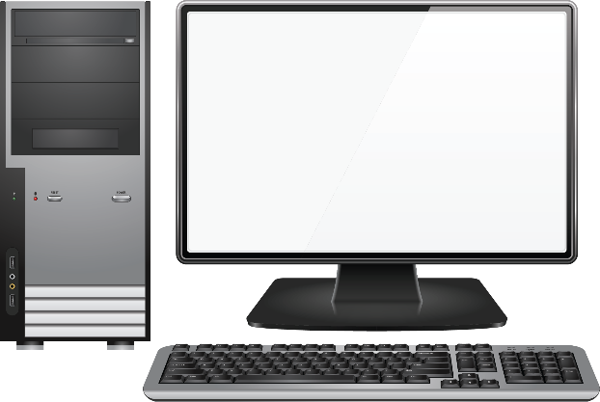
Network Ports
The endpoint of a logical connection
All ports are assigned a port range from 0 to 65,535
IANA separates port numbers into three blocks
SSH?
Port 22
DNS?
Port 53
DHCP?
Port 68
HTTP?
Port 80
HTTPS?
Port 443

Slide 36
Port Ranges
Port Range | Description
0 to 1,023 Well-known ports | Well-known ports used by common services, such as HTTP (TCP port 80), IMAP (TCP port 143), and DNS (UDP port 53).
1,024 to 49,151 Registered ports | Registered ports are registered by software makers for use by specific applications and services that are not as well known as the services in the well-known range.
49,152 to 65,535 Dynamic or private ports | Dynamic or private ports are set aside for use by unregistered services and by services needing a temporary connection.

Slide 37
Common Ports
Port 21: FTP
Port 22: SSH
Port 23: TELNET
Port 25: SMTP
Port 53: DNS
Port 80: HTTP
Port 110: POP3
Port 137: SMB/NetBIOS
Port 138: SMB/NetBIOS
Port 139: SMB/NetBIOS
Port 143: IMAP
Port 427: SLP
Port 443: HTTPS
Port 445: SMB/CIFS
Port 548: AFP
Port 3389: RDP

Slide 38
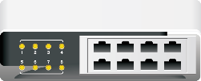
LDAP
LDAP/DNS client
2
1
LDAP server
DNS server
LDAP servers store directory data
DNS servers locate LDAP servers

Slide 39

SNMP
SNMP agents
Servers
Routers
SNMP
management
system
Printers

Slide 40


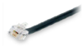
SMB
NetBIOS client
TCP/IP
IPX/SPX
NetBEUI

Slide 41
CIFS
Common Internet File System
File sharing across OSs
Related to SMB

Slide 42


SSH
Password is encrypted
Password
011001
slogin
Session is secured

Slide 43
AFP
Apple File Protocol.
Still used for some communication between Macintosh computers.
SMB2 used for communication between Macintosh and Windows computers.

Slide 44
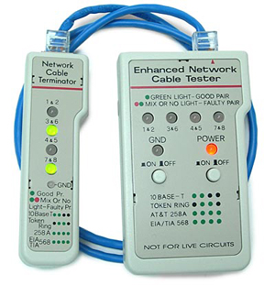
Cable Tester

Slide 45

Cable Strippers

Slide 46
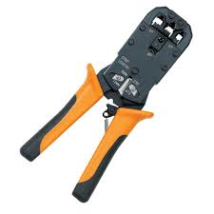
Crimpers

Slide 47
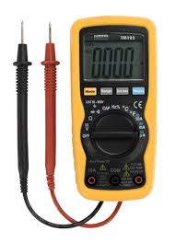
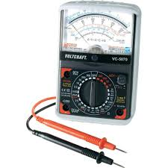
Multimeters
Digital multimeter
Analog multimeter

Slide 48
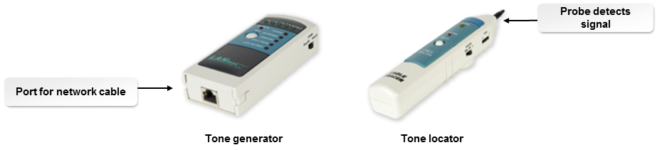
Tone Generators and Probes

Slide 49
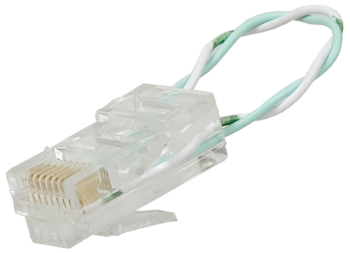
Loopback Plugs
Crosses over transmit/receive lines

Slide 50
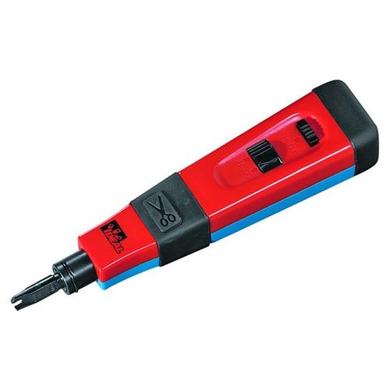
Punch Down Tools

Slide 51

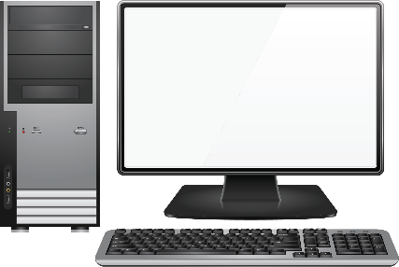


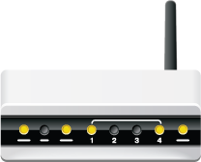
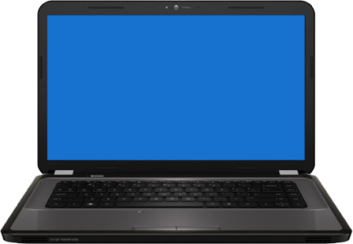
Wi-Fi Analyzer
Wi-Fi spectrum analyzers used for detecting problems on WLANs and other wireless networks
Can detect:
  Wireless devices
  Points of interference
  Overall health of the WLAN
WiFi analyzers monitor the health of wireless networks.

Slide 52
Networking Utilities
Utility | Description
ipconfig and ifconfig | Displays TCP/IP configuration and enables you to release or renew DHCP IP address leases.
ping | Tests connectivity on a TCP/IP network.
tracert and traceroute | Identifies and tests all points along the route used to send a packet to a destination.
nslookup | Verifies that the computer can connect to a DNS server and find the IP address for a given computer name.
netstat | Shows the status of each active network connection.
net | Manages Microsoft network resources from a command line.
Local Area Connection or Wireless Network Connection | Verifies that a devices is connected to the network and can send and receive data.
Network troubleshooters | Provides a wizard-like interface for you to work through the possible causes and resolutions for various common network issues.

Slide 53
Reflective Questions
What do you think are the most important network concepts covered in this lesson?
What experience do you have with any of the technologies discussed in this lesson?

