Slide 1
Networking and Security Fundamentals
Network Types
Network Components
Common Network Services
Cloud Concepts
Security Fundamentals

Slide 2




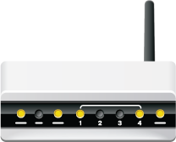


Networks

Slide 3

Network Models
Client-server
Peer-to-peer

Slide 4
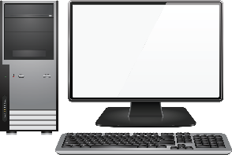
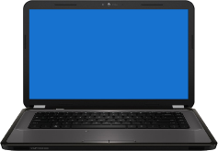
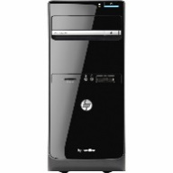

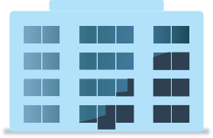


LANs
LAN 1
LAN 2

Slide 5


WANs
Long-Range Transmission
LAN 1
LAN 3
LAN 2

Slide 6


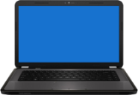
PANs

Slide 7




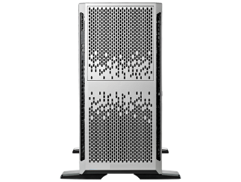
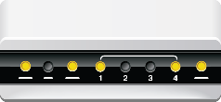

MANs
LAN
Router
LAN
LAN
LAN
City

Slide 8
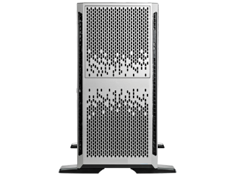


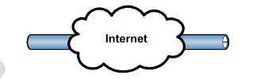

VPNs

Slide 9
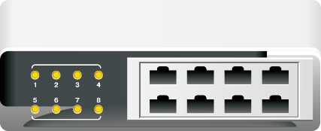
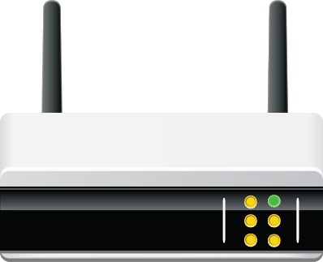
Network Devices
Common devices:
  Switches
  Routers
  Access Points
Patch panels
Older technology:
  Hubs
  Bridges
  Repeaters

Slide 10
Legacy Devices
Device | Description
Hub | Connects the nodes in a physical star topology network into a logical bus topology. A hub contains ports that you connect devices to. When data from a transmitting device arrives at a port, it is copied and transmitted to all other ports (all other nodes receive the packets). But only the specified destination node reads and processes the data (all other nodes ignore it). Two common types of hubs used were passive and active: Passive hub: Ports physically wired together, similar to a patch panel. Active hub (multiport repeater): Receives incoming data and retransmits it out all ports with a signal boost.
Bridge | An older version of a switch with fewer ports and is software-based, rather than hardware-based.
Repeater | A device that regenerates a signal to improve signal strength over transmission distances. Enables you to exceed the normal limitations on segment lengths imposed by various networking technologies. Sometimes referred to as a signal extender.

Slide 11
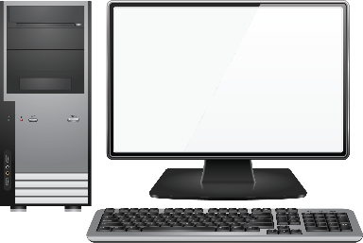
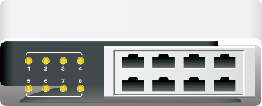
Switches
Switches connect pairs of ports.

Slide 12
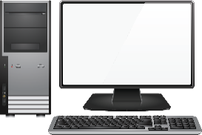


Routers
Divides network based on network addresses

Slide 13


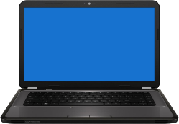
Access Points
Device that provides a connection between wireless devices
AP

Slide 14
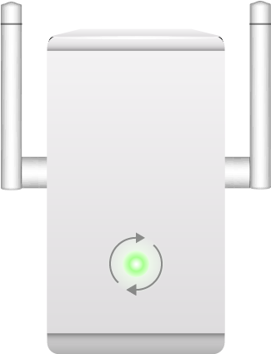
Repeaters and Extenders
Regenerate signals to improve signal strength over transmission distances.
Extend network segment length or wireless range.
Was originally used with coaxial cable.
Used in fiber optic networks and wireless networks.
AP
Wi-Fi repeater

Slide 15
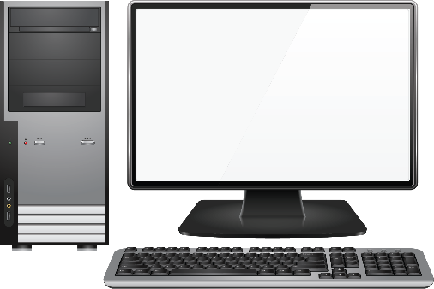

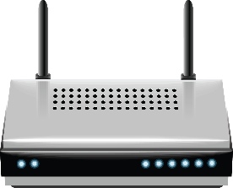

Modems
Analog
Digital
Modem
Public telephone network
Modem
Digital
Analog

Slide 16
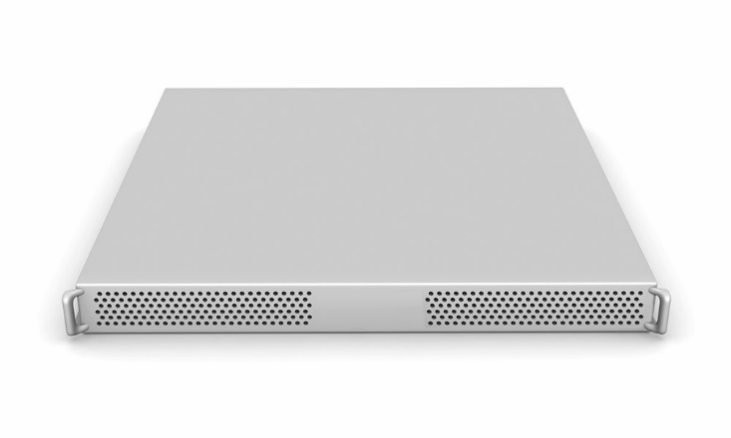
Firewalls
Software or hardware solution.
Blocks unsolicited network traffic.
Configured by administrator to control incoming and outgoing transmissions according to organizational policies.

Slide 17
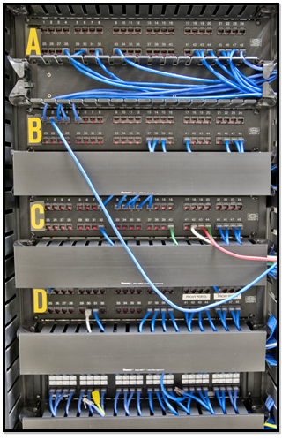
Patch Panels
Rack in wiring closet
Patch cables
Patch panels

Slide 18
Server Roles
Server Role | Description
Web server | Provides access to personal, corporate, or education Web site content.
File server | Stores programs and data files intended to be shared by multiple users.
Print server | Enables multiple network users to share common printers.
DHCP server | Automatically assigns network IP addresses to client computers.
DNS server | Provides common naming conventions for identifying networked computers.
Proxy server | Protects network computers by downloading and storing files on their behalf.
Mail server | Stores incoming email messages and forwards outgoing email messages.
Authentication server | Compares login credentials to an access list to determine the level of access a computer user should have to network resources.

Slide 19
Internet Appliances
Internet Appliance | Description
IDS | Hardware and/or software that scans, audits, and monitors computers to identify potential malicious acts.
IPS | An inline security device that monitors suspicious traffic and reacts in real time to block it..
UTM | Combines the features of a firewall, a gateway antivirus solution, an IDS, and an IPS into one hardware device.

Slide 20
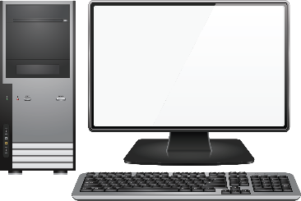
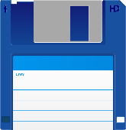
Legacy Systems
Older systems.
Perform specific function.
Often support proprietary software that has not been updated.
MS-DOS
MS-DOS

Slide 21
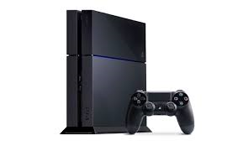
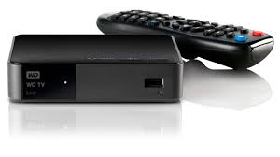
Embedded Systems
Consumer products.
OS on chip or set of chips within the product.
Often Linux-based.

Slide 22

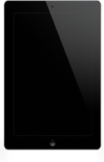
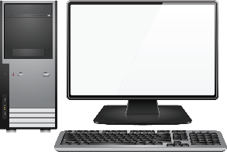

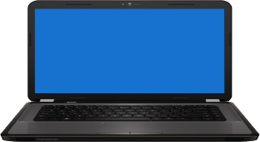
Cloud Services
Infrastructure
Software
Platform
Identity
Network

Slide 23
Types of Cloud Services
Cloud Service Type | Description
IaaS | Infrastructure as a Service. Renting resources and services instead of building and maintaining a data center. Billing based on resources consumed.
PaaS | Platform as a Service. Fully configured system set up for a specific purpose.
SaaS | Software as a Service. Applications available over the Internet. Ideal for mobile and transient workforces.

Slide 24
Types of Clouds
Cloud Type | Description
Private | A cloud infrastructure operated solely for a single organization.
Public | Provides its services over a network that is open for public use.
Community | A cloud infrastructure shared by multiple organizations that have common interests.
Hybrid | A combination of two or more distinct clouds.

Slide 25
Benefits of Cloud Computing
Benefit | Description
Rapid elasticity | To end users, cloud storage often appears to be unlimited storage space. This is due to rapid elasticity. Users request additional space, and the provider allocates additional resources seamlessly to the end user. This can often be done dynamically without any need for the user to contact the hosting provider.
On-demand | On-demand cloud services enable end users to request and access cloud resources as they are needed.
Resource pooling | Resource pooling enables the cloud services provider to service multiple customers to suit each customer's needs without any changes made to one customer affecting any of the other customers.
Measured service | Measured service refers to the cloud provider's ability to monitor and meter the customer's use of resources. This supports the customer's ability to dynamically make changes to the resources they receive.

Slide 26
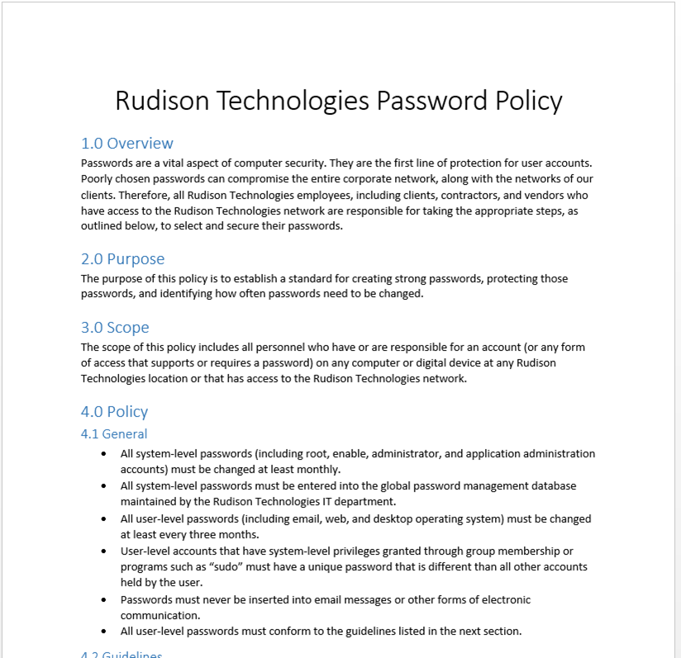
Corporate Security Policies
Individual Policy
Resources to Protect
Formal Policy Statement
Implementation Measures

Slide 27
Strong Passwords
Minimum Length
8 } K ) r n # b
Numbers
Special Characters
Uppercase Letters
Lowercase Letters

Slide 28
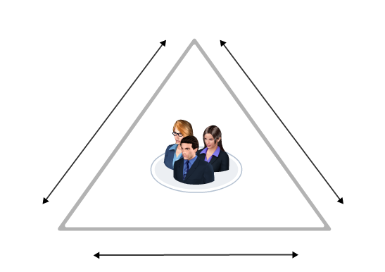

User Education
Awareness
Communication
Education

Slide 29





The Principle of Least Privilege
User and software has only minimal level of access to:
  Facilities
  Computing hardware
  Software
  Information
User 1
User 4
Perform their
jobs with fewer
privileges
Perform their
jobs with more
privileges
User 2
User 3
Data Entry Clerks
Financial Coordinators

Slide 30

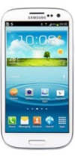

Common User Security Practices
System Security
Social Networking Security
Physical Security
Device Security

Slide 31
Authentication Methods
Authentication Method | Description
User name and password | A user or computer must have a valid user name and an associated secret password. The user submits the user name/password combination to an authenticating system such as a network directory server, which validates the credentials against a database and verifies the user's identity.
Biometrics | Authentication schemes based on individuals' physical characteristics, such as fingerprints or vocal patterns. Biometrics require specialized equipment and software to store, access, and verify the physical information.
Tokens | Tokens are physical or virtual objects, such as RSA tokens, smart cards, and ID badges that store authentication information. Tokens can store personal identification numbers (PINs), information about the user, or passwords.
Multifactor authentication | An authentication scheme that requires verification of two or three authentication factors. It can be any combination of what you are, what you have, and what you know. System designers determine what specific factors are required during the design phase.
Mutual authentication | A security mechanism that requires that each party in a communication verify its identity. First, a service or resource verifies the client’s credentials, and then the client verifies the resource’s credentials. Mutual authentication prevents a client from inadvertently submitting confidential information to a non-secure server. Any type or combination of authentication mechanisms can be used.

Slide 32

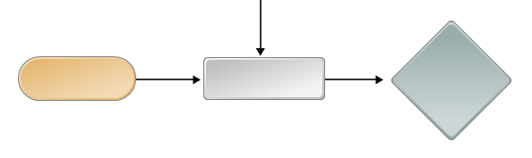
Encryption
Plaintext
Encryption
Encrypted Data

Slide 33





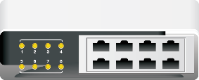
Malware
Attacker

Slide 34
Reflective Questions
Which of the network features presented in this lesson does your organization currently use and support? Which ones do you think they should use if they are not currently using them?
How do the security fundamentals presented in this lesson support the network components and services and cloud features presented in this lesson?

