Slide 1
Supporting Mobile Digital Devices
Install and Configure Exterior Laptop Components
Install and Configure Interior Laptop Components
Other Mobile Devices
Mobile Device Accessories and Ports
Mobile Device Connectivity
Mobile Device Synchronization
Troubleshooting Mobile Device Hardware

Slide 2
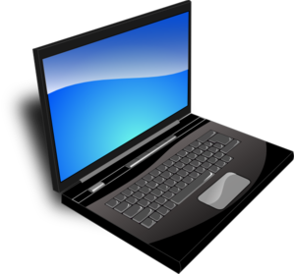
Laptops
Display
Keyboard
Touchpad

Slide 3
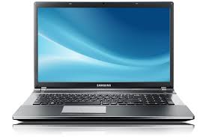
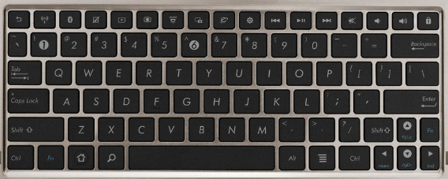
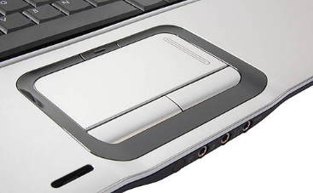
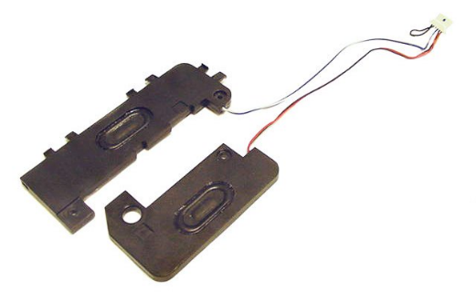
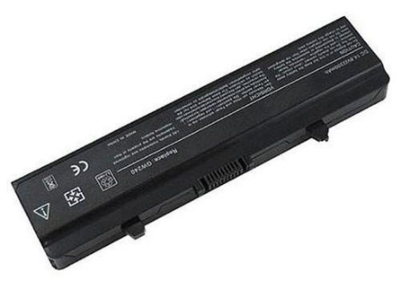
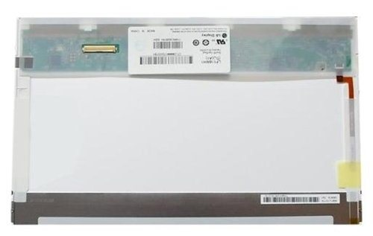
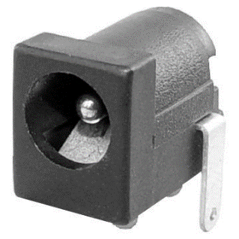
Laptop Hardware Components
Keyboard
Touchpad
Plastics
Speakers
Battery
DC jack
Screen

Slide 4
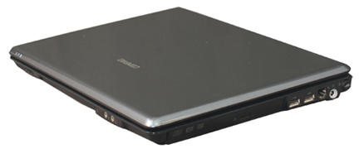
Guidelines for General Laptop Support
Verify adequate cooling mechanisms.
Check warranty restrictions and guidelines before attempting to service a laptop.
Be careful with the wires that pass through the laptop’s hinges.

Slide 5
External Laptop Expansion Options
Laptop ports
  USB: Usually 2 ports; may include eSATA in combination with USB
  Thunderbolt: Typically found on Mac laptops
  Ethernet
  External monitor: Usually DisplayPort or HDMI
Optical drives
  Internal drive
  Shared network drive
  External USB drive
USB adapters
  USB to RJ-45
  USB to Wi-Fi
  USB to Bluetooth
Network port
Optical drive
USB ports

Slide 6
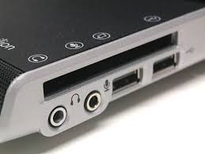
Express Cards
Mobile expansion card developed by PCMCIA to replace PC cards.
Provides PCI Express and USB 2.0 connectivity.
34 mm or 54 mm wide.
Slots on side of laptop.
Express Card slot

Slide 7
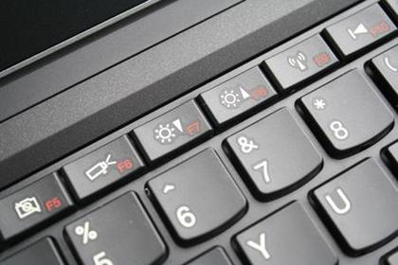
Special Function Keys

Slide 8
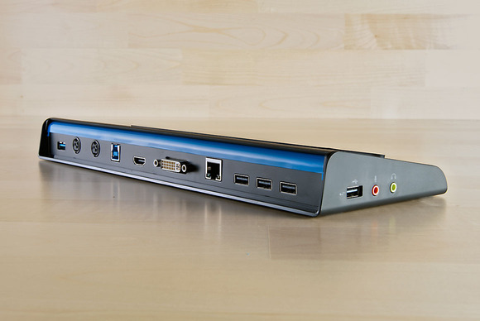
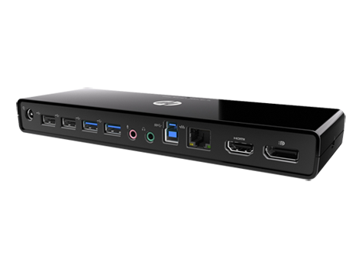
Laptop Docking Solutions
Docking station
Port replicator
Media/accessory bay
Docking station
Port replicator

Slide 9
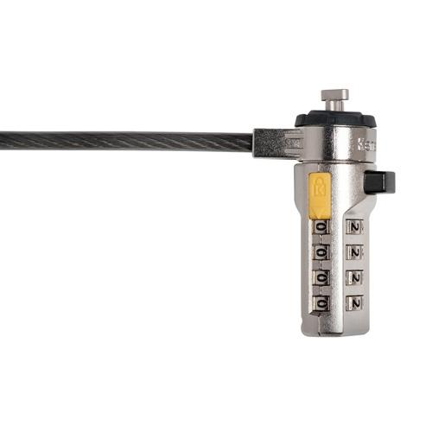
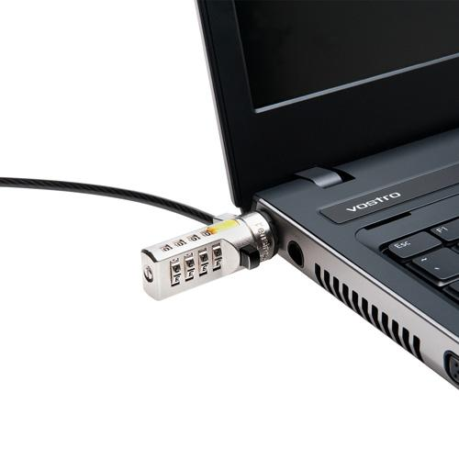
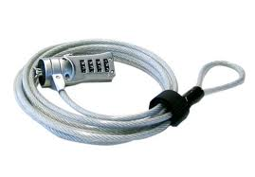
Laptop Locks

Slide 10
Interior Laptop Components
Component | Description
Motherboard | Similar to desktop motherboards, except: Smaller Reduced power consumption More integrated components More power options
CPU | Lower power consumption than desktop CPUs Lower heat generation than desktop CPUs No fans Surface-mounted or socket-based
Storage drive | 1.8-inch, 2.5-inch, and 3.5-inch form factors Slower than desktop HDDs Newer laptops have SSDs and hybrid drives. Ease of removal varies widely

Slide 11
Interior Laptop Components (Cont.)
Component | Description
Memory | More expensive than desktop RAM SODIMMs, MicroDIMMs, and proprietary memory modules Flash memory
Optical drive | Similar to desktop optical drives, except smaller
Wireless card | Integrated into or independent from the motherboard
Webcam | Still images and video Resolution up to 1080p HD Software for image manipulation
Microphone | Supports web conferencing and web calling Can be part of a headset Noise-cancelling capabilities

Slide 12
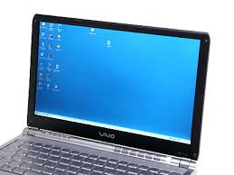
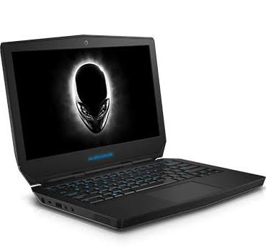
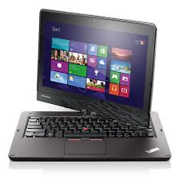
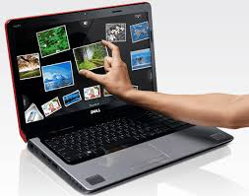
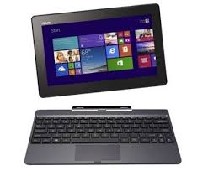
Types of Laptop Displays
TFT
OLED
Removable
Rotating
Touch screen

Slide 13
Laptop Display Components
Component | Description
Inverter | Converts DC power to AC power needed for the display.
Backlight | Fluorescent or LED lighting that illuminate an LCD display from the back or the sides.
Wi-Fi antenna | Installed around the sides of the display and connects to the network card for wireless network connectivity.
Webcam | Often built into the plastics above the display and provides real-time video streaming over a network.
Microphone | Often built into the plastics near the webcam and enables audio input,
Digitizer | On touch screen displays, a layer of sensors between the LCD display and a layer of glass that enables the translation of the analog touch signal to a digital signal.

Slide 14
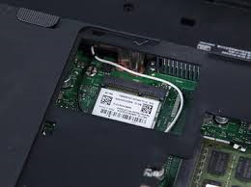
Mini-PCIe Cards
A very small expansion card, possibly only a few centimeters long.
Internal cards installed by hardware manufacturer.
Typically used to provide networking capabilities.
Supports USB 2.0, diagnostic wiring for wireless networking, and SmBus.

Slide 15
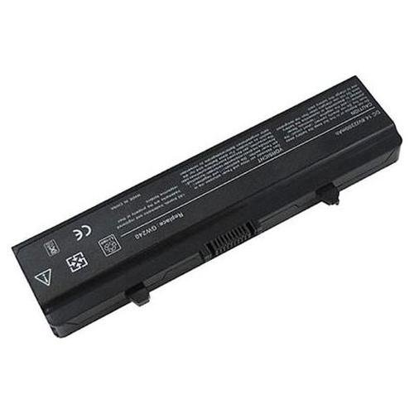
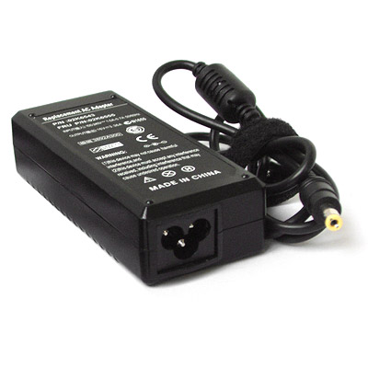
Laptop Power Supplies and Batteries

Slide 16
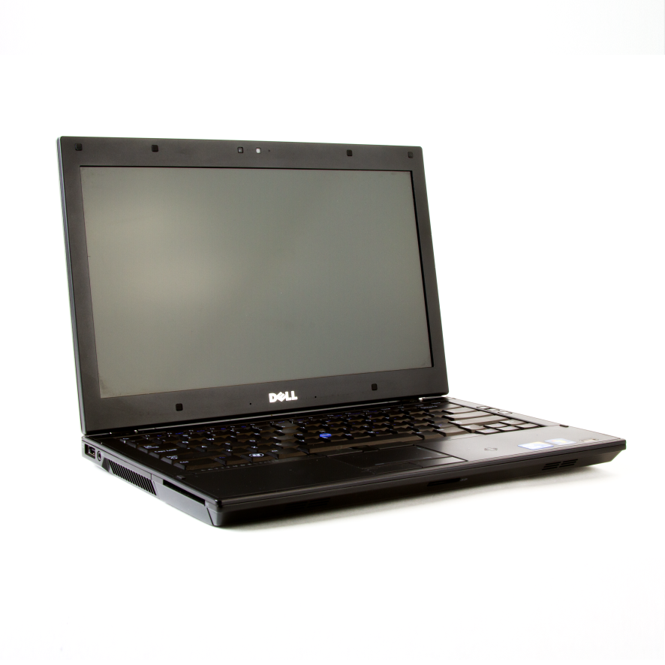
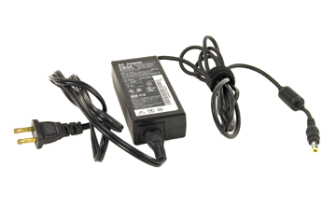
Auto-Switching and Fixed Input Power Supplies
Most laptops use auto-switching power adapters.
Fixed power supplies support only single voltage and frequencies.

Slide 17
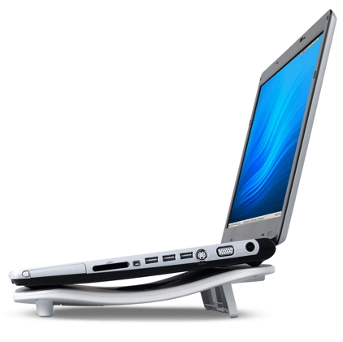
Laptop Cooling Considerations
Laptop CPUs
Fans
Battery use
Cooling pads

Slide 18
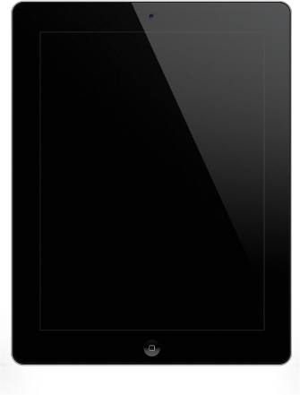
Tablets
Larger than mobile phones, but smaller than a laptop.
Operating systems include:
  iOS
  Android
  Windows 7
  Windows 8
  Windows 8.1
  Windows 8.1 RT
  Windows 10
  Blackberry OS

Slide 19
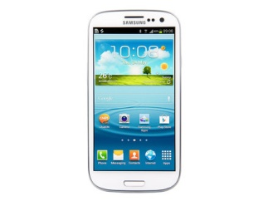
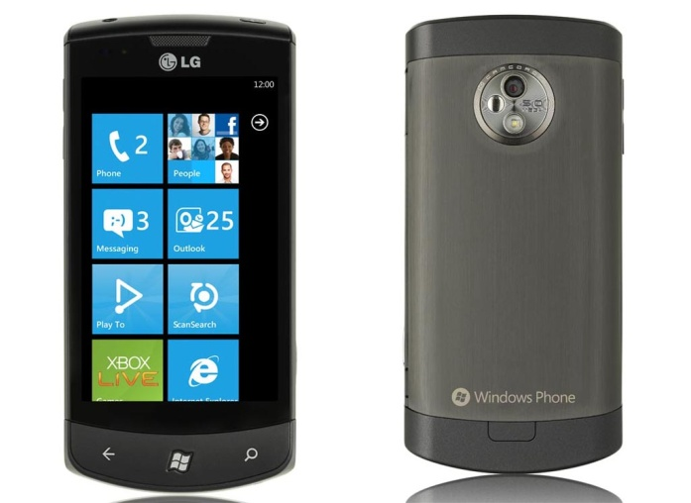
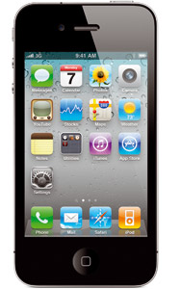
Smartphones
iPhones
Android smartphones
Windows smartphones

Slide 20
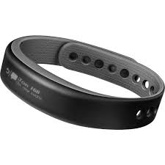
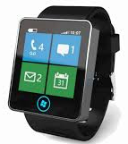
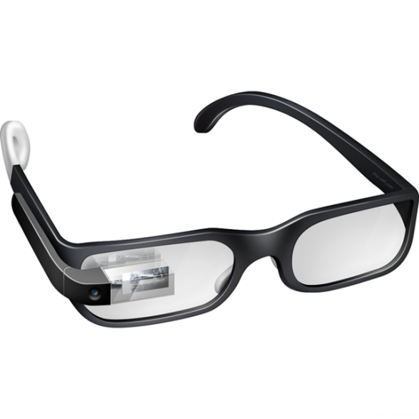
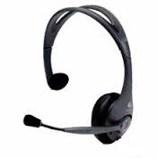
Wearable Devices
Smart watch
Fitness monitor
Glasses
Headset

Slide 21
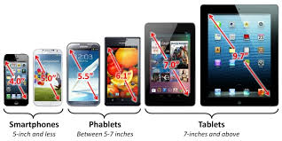
Phablets
Larger than smartphones.
Smaller than tablets.
Smartphones
(5.0 inches and less)
Phablets
(5.0 to 7.0 inches)
Tablets
(7.0 inches and above)

Slide 22
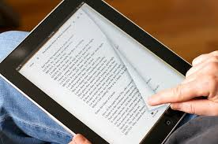
e-Readers
Similar to tablets.
Sized to conform to standard paper book sizes.
Optimized screen for reading text.
Internal storage for eBooks.
Wi-Fi networking to download content.

Slide 23
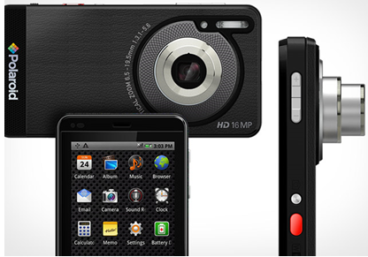
Smart Cameras
Camera with Wi-Fi, NFC, and GPS built in.
Efficient uploading and sharing of photos.
Apps for image quality and automatic settings.

Slide 24
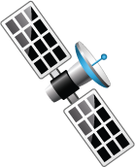


GPS
Global Positioning System.
Derives accurate location information.
Data retrieved from multiple satellites.

Slide 25
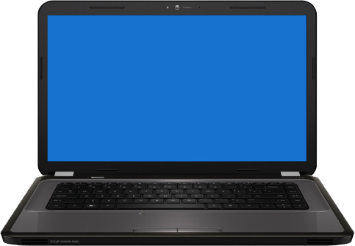
Connection Types
NFC
Proprietary ports
  Vendor-specific ports for power and communication
Micro USB or Mini USB ports
Lightning ports
  Apple products
Bluetooth
Infrared
Mobile hotspot or tethering

Slide 26
Accessories
Accessory | Description
Headsets | Earphones with a boom mic or Bluetooth devices that clip to your ear.
Speakers | Headphone jack or Bluetooth connection.
Game pads | Wireless connections enable game play or app navigation.
Docking stations | Provides power and other functionality, such as playing music or movies.
Extra battery packs and chargers | Enables additional use of device while traveling or the capability of charging the battery on the go.
Protective covers or waterproofing | Protect smartphones and tablets from damage by dropping or immersion in water.
Credit card readers | Enables mobile vendors to accept credit card payments on their smartphones or tablets.
Flash memory cards | MicroSD cards work with smartphones, tablets, and other mobile devices to store and transfer photos, videos, and movies.

Slide 27
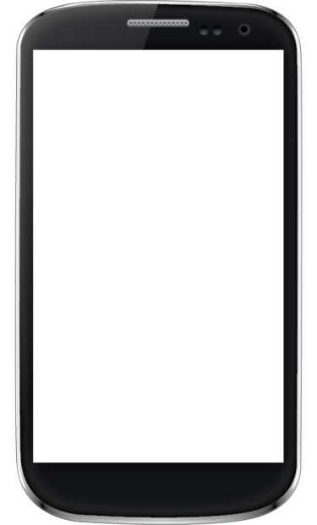

Radio Firmware
Operating system separate from user interface.
Controls base functions of the device:
  USB
  Network
  GPS
Baseband RTOS

Slide 28
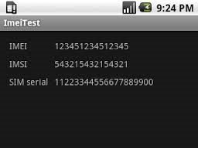
IMEI and IMSI Numbers
International Mobile Equipment Identity
  Stored in the EIR database.
  Uniquely identifies the mobile device.
International Mobile Subscriber Identity
  Stored on the device’s SIM card.
  Uniquely identifies the subscriber.

Slide 29
PRI, PRL, and Baseband Updates
Preferred Roaming Index.
Preferred Roaming List.
Together, they support optimal data and voice quality while in transit.

Slide 30
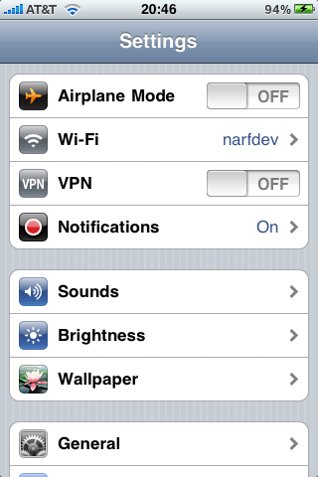
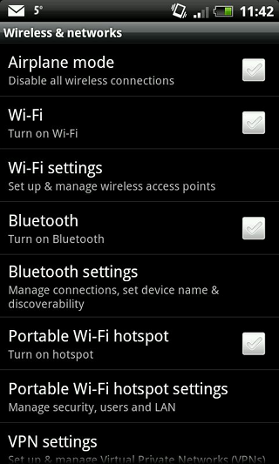
Network Configuration Settings
Johnsmith
iPhone network configuration
Android network configuration

Slide 31
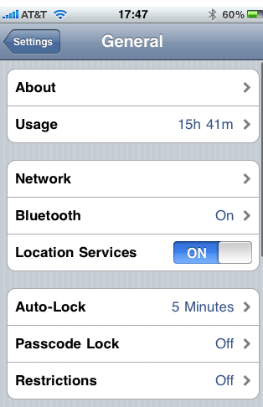
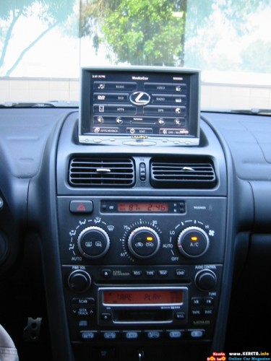
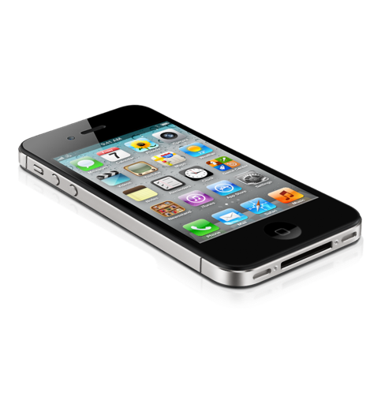
Bluetooth Connectivity

Slide 32
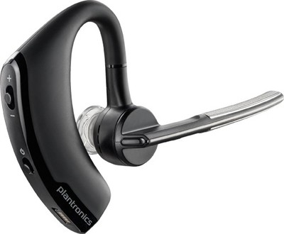

The Bluetooth Pairing Process
Enable Bluetooth (allow device discoverability)
Enable pairing
Find the device for pairing
Determine if a PIN code is needed
Enter the PIN code
Verify the connection
Test the connection

Slide 33

Email Configuration Methods
Email can be configured to synch with many different system including:
  Yahoo! Mail
  Microsoft Exchange
  Windows Live
  Gmail
  Hotmail

Slide 34
Email Server and Configuration Settings
Server Information | Description
Protocol | POP3 IMAP4
Security | SSL TLS
Ports | Different servers might use different ports for incoming and outgoing mail. Depends on protocols used.

Slide 35
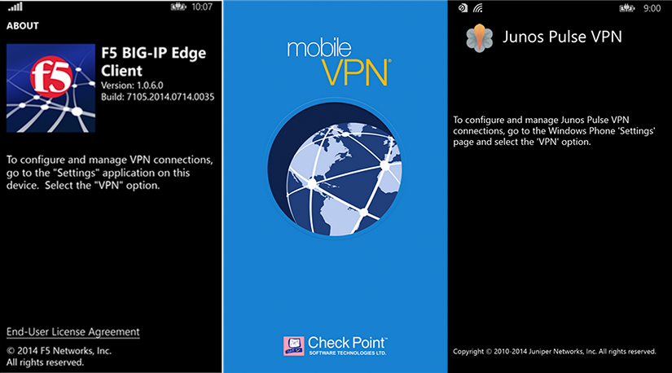
Mobile Device VPN Connections

Slide 36
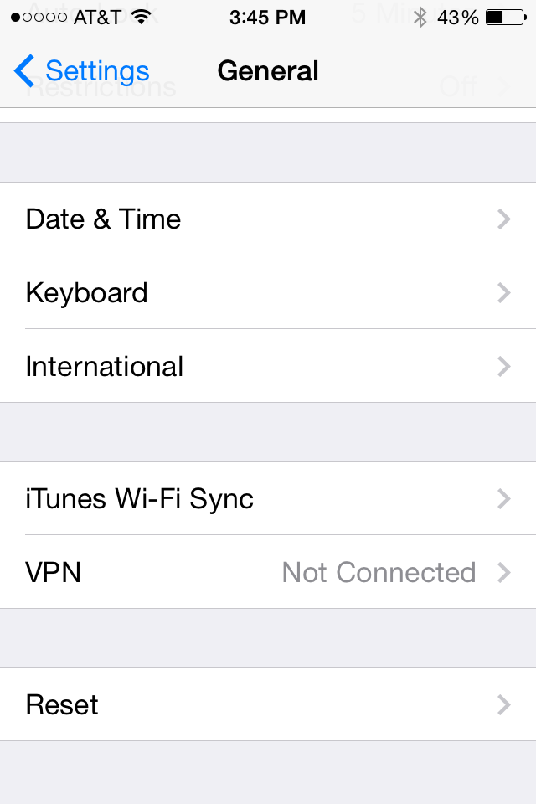


Mobile Device VPN Connections (Cont.)

Slide 37



Mobile Device VPN Connections (Cont.)

Slide 38

Data Synchronization

Slide 39
Types of Data to Synchronize
Contacts
Programs
Email
Pictures
Music
Videos
Calendar
Bookmarks
Documents
Location data
Social media data
eBooks

Slide 40
Data Synchronization Methods
EAS
  Exchange ActiveSync
  Connect to Exchange server
  Access email, calendars, and contacts
Cloud services
  iCloud
  OneDrive
  Google Drive
Subscription services
  Dropbox
  iTunes
Online storage services

Slide 41
Data Synchronization Requirements
You might need a specific system account.
You might need an email account.
If using Exchange, control may be given to the Admin.
Organizations may have specific requirements.
Certain devices might require additional software.
Certain devices might require using specific network protocols to enable synchronization.
The device may need to authenticate a service, not just vice versa.

Slide 42
Handling and Maintenance Techniques
Technique | Description
Handling | Avoid placing mobile devices in pockets where they can be damaged when you sit. Avoid placing fingerprints on the screen and the screen protector as you apply the protective device. Avoid dropping mobile devices. Use protective cases whenever possible. Avoid temperature extremes.
Maintenance | To help with laptop cooling, keep air ducts clear of dust and debris. Follow manufacturer instructions for charging batteries. Use approved battery chargers. Never expose batteries to fire or water. Do not drop, throw, or otherwise jolt batteries. Use approved batteries for each device. Use power management features to extend battery life. When shipping or transporting devices, select a protective enclosure. Avoid carrying devices by a corner.

Slide 43
Operating Environment Best Practices
Environmental Factor | Description
High temperature | Exposure to high temperatures can cause expansion within portable computing devices and compromise circuitry. High temperature can also lead to the failure of cooling systems to maintain adequate operating temperatures, leading to the overheating and failure of internal components such as the processor, video processor, and hard drive.
Rapid temperature fluctuation | Rapid changes in temperature, such as those seen when transporting a device from one climate to another, could result in condensation within the device. Devices should be allowed to come to room temperature before being powered on after a temperature change.
High humidity | Avoid operating in high humidity as condensation within the device may occur and promote corrosion. All manufacturers specify operating humidity levels. It is important to follow manufacturer operating procedures/guidelines at all times. Most systems can operate at high humidity without a problem, as long as there is no condensation (5% to 95% relative humidity, non-condensing).
Low humidity | ESD is more likely to occur in low-humidity environments ranging anywhere from 10% - 35% relative humidity.
RFI | Erratic errors can occur when mobile devices are exposed to radio towers, two-way radios, cordless telephones, and microwave ovens. Moving the device further from such sources will help in resolving interference issues. Properly shielded cables for peripherals will also minimize the effects of RFI.

Slide 44
General Mobile Device Issues
Display issues
Battery issues
Device temperature
Battery power issues
No power when connected to AC
Ghost cursor and pointer drift issues

Slide 45
Common Mobile Device Keypad Issues
Nonstandard key placement
Function keys
Numeric keys
Sticking keys
Keyboard too small
Keyboard not responding

Slide 46
Common Touch Screen Issues
Dirty
Touch not registering in the correct location
Damaged screen
Erratic behavior
Can’t see screen elements
User wearing gloves

Slide 47


Common Wireless Connectivity Issues
Intermittent wireless connectivity
No Bluetooth connectivity
No wireless connectivity

Slide 48

Mobile Device Disassembly Best Practices
Document and label all cable and screw locations.
Organize parts as you remove them from the device.
Use manufacturer’s documentation to help locate components.
Use appropriate hand tools.

Slide 49
Reflective Questions
In your professional experience, have you supported mobile devices? If not, what kind of experience do you have with them?
What type of technical support do you think will be expected of an A+ technician as mobile devices become even more prominent within the workplace?

