Slide 1
Supporting Display Devices
Install Display Devices
Configure Display Devices
Troubleshoot Video and Display Devices

Slide 2
Display Device Types
Display Device Type | Description
LCD | Compact, lightweight, and energy efficient flat-panel display. CCFL or LED strips for backlight source. TN or IPS technology. Touch screens. Glasses and goggles.
OLED | Organic compounds provide light emission. Variety of dimensions used for monitors, TV screens, tablets, and mobile phones. Green technology.
Plasma | Flat panel display using Xenon and Neon rays. High contrast, brightness, and vibrant colors viewable from different angles. Large dimensions used for TV screens.
Projector | Display video output to a white board or other surface for audience-style viewing. Display video to multiple monitors.

Slide 3
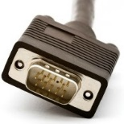
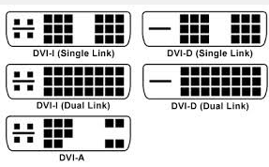
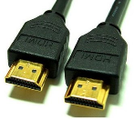

Display Device Connections
Cable and Connector Type | Description
VGA | DB-15 connector. Used for LCD monitors. Sometimes referred to as HD15 or DE15. Mini-VGA also available.
DVI | Support analog and digital display devices. TMDS sends data over a high-speed connection. Single-link and dual-link. Three configurations: DVI-A, DVI-D, and DVI-I.
HDMI | First industry-supported uncompressed all digital A/V interface. Supports HDTV, SDTV, and EDTV. Use on PCs that support DVI.
Mini-HDMI | HDMI technology for portable devices. Micro-HDMI also available.

Slide 4
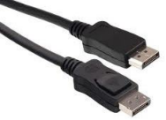
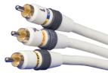

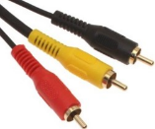
Display Device Connections (Cont.)
Cable and Connector Type | Description
DisplayPort | Expects to replace DVI and VGA. Not backward-compatible with DVI or HDMI. Uses TMDS link technology to send high-bandwidth audio and video signals. Supports gaming and other graphic-intensive uses.
Component | Component video is analog video data on three or more channels Y consists of luminance and represents the brightness of the image. Pr consists of Red minus luminance. Pb consists of Blue minus luminance. Sometimes refers to RGB signals.
Composite | Analog video format that combines video information on one channel.
RCA | Transmit audio and video among devices. TVs, digital cameras, game systems. Can also provide power and digital audio. Colors indicate what connector can be attached.

Slide 5
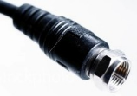
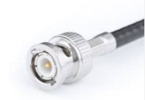
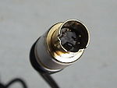
Display Device Connections (Cont.)
Cable and Connector Type | Description
Coaxial cable | Copper cable with a central conducting core surrounded with an insulator, shielding, and a jacket. Data signals are sent through the core. The shielding and jacket reduce EMI.
BNC | Connector most often used with coaxial cable. Can connect radio equipment, aviation electronics, video signals, and other data signals. Two versions: single strand and double strand.
MiniDIN-4 | Used for S-Video connections. Two signals: brightness and color.

Slide 6
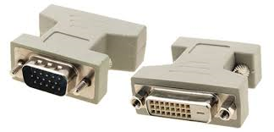
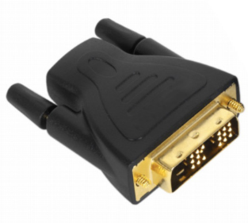
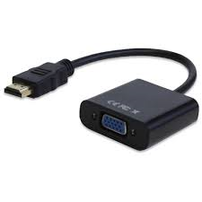
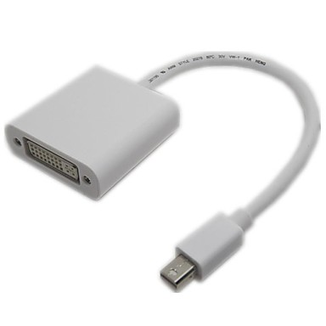
Video Adapters and Converters
DVI to HDMI
DVI to VGA
Thunderbolt to DVI
HDMI to VGA

Slide 7
Aspect Ratios
Resolution | Number of Pixels | Aspect Ratio
320 x 200 | 64,00 | 8:5
640 x 480 | 307,200 | 4:3
800 x 600 | 480,000 | 4:3
1,024 x 768 | 786,432 | 4:3
1,280 x 1,024 | 1,310,720 | 5:4
1,600 x 1,200 | 1,920,000 | 4:3
1,600 x 900 | 1,440,000 | 16:9
1,920 x 1,080 | 2,073,600 | 16:9
1,680 x 1,050 | 1,764,000 | 16:10
1,920 x 1,200 | 2,304,000 | 16:10

Slide 8
Display Device Settings and Features
Display Setting or Feature | Description
Resolution | How many pixels make up the dimensions of the display. Expressed as width by height. Higher resolutions can show more items on the screen.
Native resolution | Fixed resolution for LCD or other flat-panel displays. Best quality image when input signal matches native resolution.
Refresh rate | Frequency per second that a CRT monitor is refreshed or the screen redrawn. Expressed as hertz (Hz). 60 to 70 Hz is typical. No need to adjust LCD refresh rates.
Brightness | How much light is emitted from a display device. Expressed in lumens.
Analog or digital | Analog or digital inputs supported. Most devices providing the input signals (like a computer) are digital. Display devices such as LCD or LED can support digital input signals, and do so via DVI connections between the input device and the display device.
Privacy and antiglare filters | Screens attached to a display device. Reduce screen glare from other light sources. Protects display from dust and scratches. Prevents others from viewing screen contents.
Color depth | How many bits used to store a pixel’s color. Higher number of bits means more colors can be displayed.

Slide 9
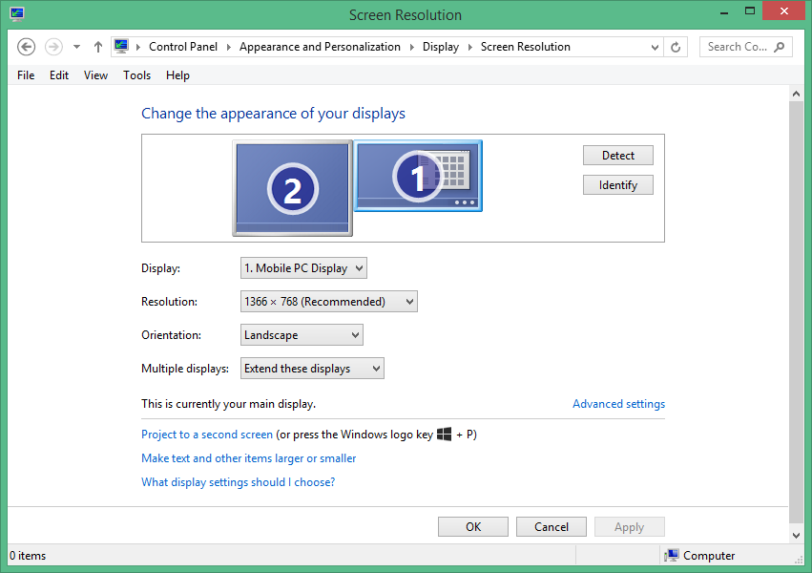
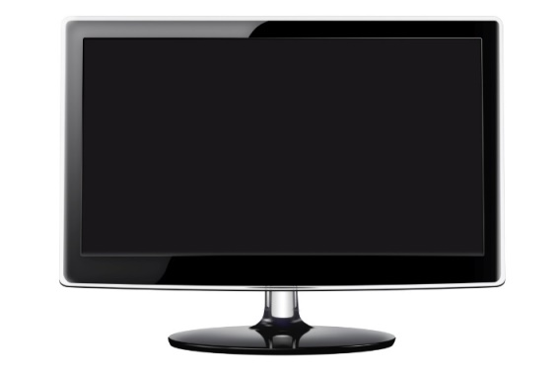
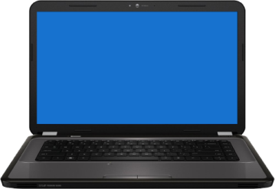
Multiple Displays
Typically two displays.
Professional workstation or gaming environment.
Primary monitor needs to be designated.
Second monitor for additional desktop space or duplicate display.

Slide 10
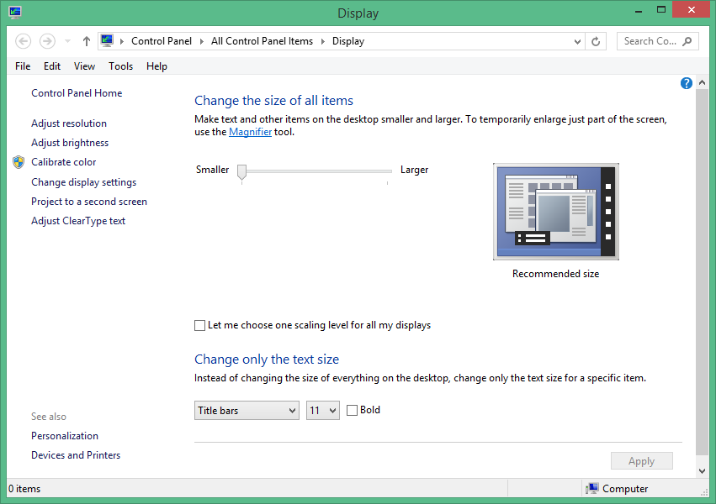
Windows Display Configuration Tools

Slide 11
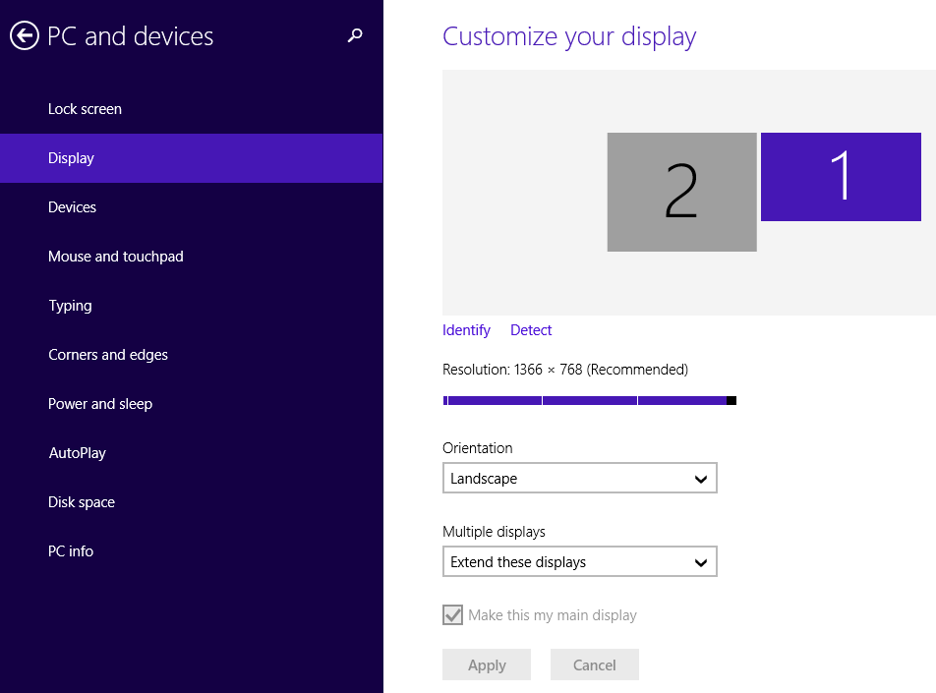
Windows Display Configuration Tools (Cont.)

Slide 12

Common Video and Display Issues
Dark screen
Dim image or no image in screen
Flickering or distortion on CRT monitors
Display turns itself off
Application problems
Defective pixels
Color issues
Physical damage
Distorted geometry
Burn-in
Oversized images and icons
Video card issues

Slide 13
Reflective Questions
1. What types of monitors do you have experience with? What types of connections have you used to connect those monitors to computers?
2. In your current job role, have you had to troubleshoot display device problems? If so, what did you do and how did you resolve the issues?

