Slide 1
Managing Data Storage
Identify RAM Types and Features
Troubleshoot RAM Issues
Install and Configure Storage Devices
Configure the System Firmware
Troubleshoot Hard Drives and RAID Arrays

Slide 2
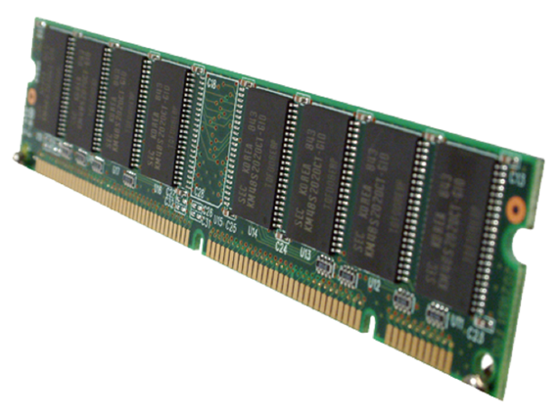
RAM Modules

Slide 3
RAM Types
Type of RAM | Description
DDR | Double Data Rate Synchronous DRAM (DDR SDRAM) transfers data twice per clock cycle, which means it processes data on the rising side and falling side of the system clock. It is a replacement for SDRAM. DDR uses additional power and ground lines and is packaged on a 184-pin DIMM module.
DDR2 | DDR2 chips increase data rates over those of DDR chips. DDR2 modules require 240-pin DIMM slots. Although DDR2 chips are the same length as DDR, they will not fit into DDR slots.
DDR3 | DDR3 chips transfer data at twice the rate of DDR2, and use 30 percent less power in the process, Like DDR2, DDR3 chips use 240-pin connections, but cannot be used interchangeably because of differences in notch location and electrical requirements.

Slide 4
Single-Sided vs. Double-Sided Memory
Single-sided:
  An expansion bank of RAM where all of the available memory is accessible by the PC.
  Chips can be on one or both sides of the RAM module.
Double-sided:
  Two banks of RAM where only one bank is accessible by the PC at one time.
  Chips are placed on both sides of the RAM module.

Slide 5
ECC vs. Non-ECC
ECC:
  Uses several bits of a data string to check for errors.
  ECC chip
  Used only in upper-end systems such as high-end workstations and servers.
Non-ECC:
  Standard desktop PCs.
  Often used parity to detect data errors, but cannot correct errors that are found.

Slide 6
RAM Configurations
Single channel
Dual channel
Triple channel
Quad channel

Slide 7
Parity vs. Non-Parity
Parity:
  Older error-checking method that is used in RAM to detect errors that occur during transmission.
  Uses a single parity bit to determine if pieces of data match.
  Seldom used except for in server computers.
Non-Parity:
  Relies on other system components to check for RAM transmission errors.
  Used in most PCs.

Slide 8
Buffered vs. Non-Buffered
Buffered RAM
  Control chip helps the memory controller.
  Used with large amounts of RAM, like in servers.
  Often includes ECC circuitry.
Non-buffered RAM
  Communicates directly with the memory controller.
  Often found in workstations and gaming PCs.
  Less expensive and faster than buffered RAM.

Slide 9
RAM Compatibility
Specification | Description
CAS latency | Column address strobe (CAS) is a signal the processor sends to a memory circuit to activate a column address. The latency indicates how many clock cycles it will take for the memory module to or write a column of data from a memory module and return the data requested by the CPU. Make sure that additional modules have the same CAS latency.
Timing | RAS. RP time. Row Active Time.
Voltage | The voltage should be the same as the existing memory modules.

Slide 10
Common RAM Issues
Symptom | Possible Causes
Computer crashes, system lockups, and unexpected shutdowns | ESD, overheating, or other power-related problems that can affect memory. Registry writing to bad memory, General Protection Faults (GPFs), and exception errors caused by software and operating system.
Memory errors appear on screen | Memory address errors at boot time. Applications that require large amounts of memory or that don’t release memory.
Blank screen on bootup | Memory is not correct for the system. Memory module is not fully inserted into the slot.
Computer does not boot. POST beep codes sound. | CPU cannot communicate with memory due to the memory being improperly installed or the BIOS not recognizing the memory. For additional information on specific beep codes visit www.computerhope.com/beep.htm.
Some or all newly installed RAM is not recognized | You exceeded the maximum amount of RAM that can be addressed by the system. The wrong memory type was installed. The memory was not installed in the proper sequence. You might need to leave empty slots between multiple modules, or you might need to install modules in a different configuration.

Slide 11
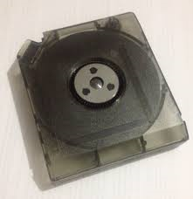
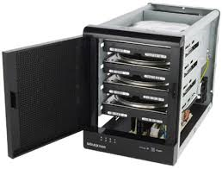


Storage Devices
Internal and external devices
Media:
  Optical disks
  Magnetic media
  Solid state drives
  RAID arrays

Slide 12
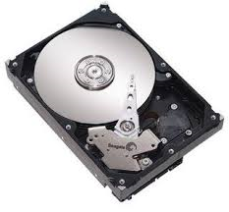
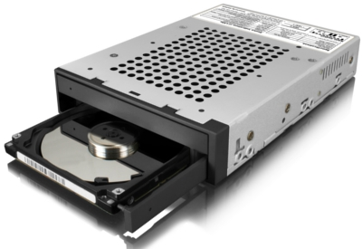
Internal Storage Device Considerations
Does the computer have existing internal storage devices?
Does the device need additional drivers installed?
Does the computer have an available power supply cable to supply power to the device?
Does the computer have an available drive bay for the storage device?
Do you have the necessary data cables to connect the storage device to the controller?
Does the placement of the device interrupt the air flow of the case?

Slide 13
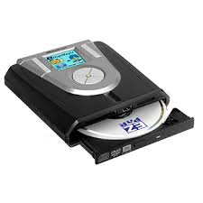
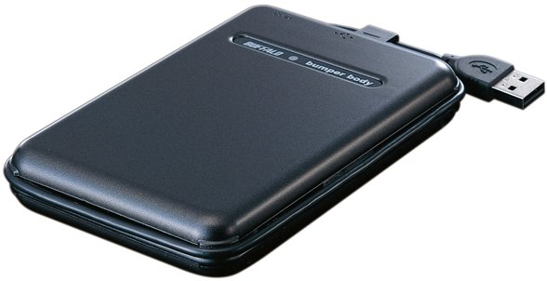
External Storage Device Considerations
What interface does the external storage device require (USB, FireWire, or eSATA)?
Do you need a cable to connect the external storage device to the computer?
Do you have an available source of power for the storage device?

Slide 14
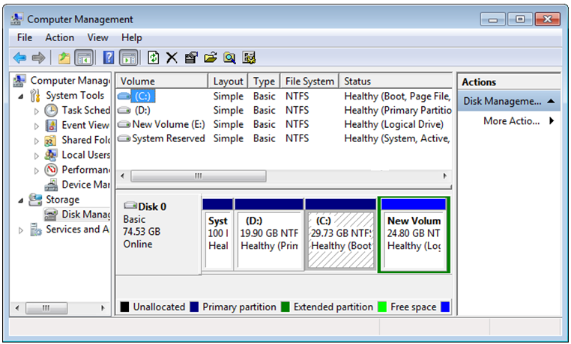
Disk Management

Slide 15


RAID
Data can be restored if one disk fails
Data written to multiple disks
Redundant Array of Independent Disks

Slide 16
RAID Standards
Software-based
  Often through OS software.
Hardware based
  RAID controller makes independent disks appear as one drive.

Slide 17
Common RAID Levels
RAID Type | Description
RAID 0 | Implements striping, which is the process of spreading data across multiple drives. Striping can dramatically improve read and write performance. Provides no fault tolerance because the data is spread across multiple drives, if any one of the drives fails, you will lose all of your data. You need at least two physical disk drives to implement striping. The largest size RAID-0 partition that can be created is equal to the smallest available individual partition times the number of drives in the set.
RAID 1 | Two identical drives used for mirroring or duplexing. Mirrored drives share a controller. Duplexed drives have individual controllers. Provides redundancy since each drive has the same data on it.
RAID 5 | Spreads data and parity information across multiple drives. Minimum of three drives needed for implementation. Parity information used to reconstruct data from failed drives.
RAID 10 | Combination of RAID 0 and RAID 1. Striping and mirroring to provide both performance and fault tolerance. Minimum of four disks needed for implementation.

Slide 18
System Firmware
Special software stored in memory chips.
Enables communication between the hardware and the OS.
Accessed each time the PC boots up.
BIOS
  Basic Input/Output System
  Traditional firmware implementation
  Had some limitations
UEFI
  Unified Extensible Firmware Interface
  Addresses limitations in BIOS
  Offers secure boot feature

Slide 19
Firmware Upgrades
Support new hardware.
Address known issues.
Enable advanced PnP and power management.
Comply with vendor support requirements.

Slide 20
System Firmware Components
System components that you can configure through the system firmware:
RAM
Hard drives
Optical drives
CPU

Slide 21
System Firmware Configuration Options
Configuration Option | Description
General | Motherboard information System date and time Boot sequence System firmware version
Security settings | Password management Full drive encryption TPM status Laptop-tracking software configuration Secure Boot in UEFI
Enabling and disabling devices | Type and size of HDDs Advanced drive settings Preferred default monitor Power management options
Clock speed | Optimize clock speed for the CPU
System configuration | Integrated NICs USB controllers Other ports
Video | Manage video controller settings

Slide 22
System Firmware Configuration
Options (Cont.)
Configuration Option | Description
Performance | CPU settings Multicore support status Processor mode
Virtualization support | Manage virtualization settings Depends on OEM model
Power management | Recovery from power loss Advanced power options
Maintenance | Asset tag management Service from outside vendor

Slide 23
Secure Boot
Available with UEFI version 2.2.
Checks drivers before they are loaded.
  Unsigned drivers cannot load.
Supported in Windows 8/8.1 and some Linux distros.
Enabled by default.
  Might need to disable.
  Cannot disable in Windows RT.

Slide 24
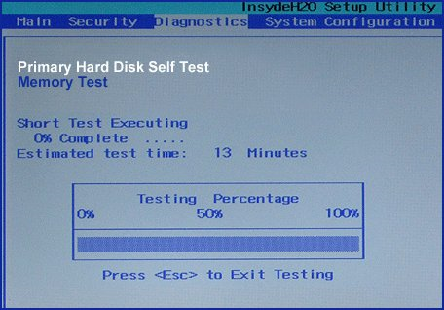
Built-In System Firmware Diagnostics

Slide 25
System Firmware Monitoring Capabilities
Monitoring Capability | Description
Temperature | Check temperature of CPU, motherboard, and the overall system. Check for overclocking. Verify that CPU is running in a safe temperature range.
Fan speeds | CPU fan. System fans. Balance RPM with CPU and motherboard temperature.
Intrusion detection | Sensor alerts system firmware when the case cover is removed.
Voltage | VCC. Memory voltage. VDD voltage. AGP voltage.
Clock | Verify accuracy of system clock.
Bus speed | Verify CPU speed properly correlates to bus speed.

Slide 26
Drive and Array Troubleshooting Tools
Tool | Description
Screwdriver | Enables you to remove a faulty HDD from a drive bay.
External enclosures | Enables you to protect and provide power to an HDD.
CHKDSK | Check Disk utility scans for and corrects file system and disk errors.
BOOTREC | Enables you to perform system recovery tasks for Windows Vista and Windows 7.
DISKPART | A superset of the commands available in the Disk Management GUI tool.
FORMAT | Format utility prepares disk partitions for a file system.
FDISK | Creates and manages disk partitions.
File recovery software | Recovers deleted files.

Slide 27
Common Hard Drive Symptoms
Failure to boot
POST error
Drive is not recognized
Drive read/write failure
Computer will not boot
Grinding noises
Loud clicking noises
Possible data corruption
Slow performance
External drive issues
Removable drive issues
OS not found
BSOD

Slide 28
Common Array Issues
RAID not found when computer boots up.
  RAID may not be configured within the system firmware.
  Motherboard does not recognize RAID.
RAID stops working suddenly.
  Settings have changed within the system firmware.
  Motherboard may not support RAID.
  RAID controller firmware not configured correctly.

Slide 29
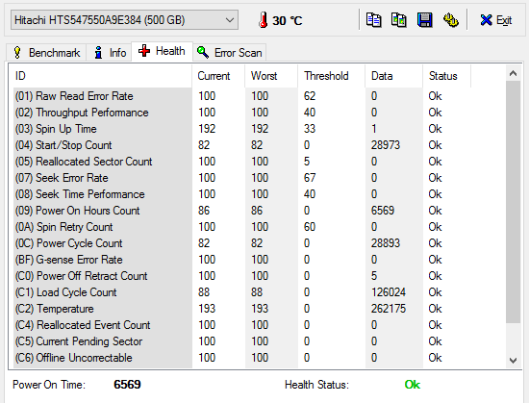
SMART
Self-Monitoring, Analysis, and Reporting Technology
Anticipates storage device failures

Slide 30
Reflective Questions
What types of storage devices have you worked with? Have you installed additional hard drives or replace hard drives?
Which system firmware have you worked with, if any? What types of configuration did you perform?

