Slide 1
Customized Client Environments
Types of Common Business Clients
Custom Client Environments

Slide 2
Thick Clients
Performs most or all computing functions on its own.
Requirements include:
  The computer must meet the standard requirements for running the selected operating system.
  Full application versions are installed and run directly from the client computer using its own resources. The applications are installed using traditional methods and are stored on the hard drive.
  If data is stored locally, then access to storage locations is a required with a consistent pathway to data.
  If data is stored on the network, then a consistent path should be established to the storage location with proper security implementations.
  Hardware should be robust enough to run all required applications.

Slide 3
Thin Clients
Relies on other computers and servers for programs, processes, and services.
Can be highly specialized based on job role.
Requirements include:
  The computer must meet the minimum requirements to run the selected operating system.
  The computer uses basic applications that can be accessed over the Internet. The applications do not get installed on the computer and do not use up any hard drive space. RAM is used to run the application from the server.
  The computer must have a fast network connection to access the server that is hosting the applications.
  The computer might require specialized software in order to access the applications hosted by the server.
  The computer may require a specific browser in order to run any web-based applications.

Slide 4

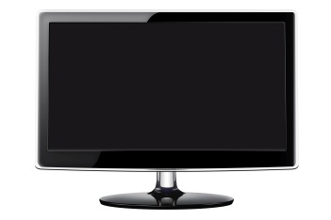
Virtualization Workstations
Windows
Linux
Solaris
Windows
Linux
Solaris
Requirements include:
  As much RAM as the motherboard will support.
  The maximum number of CPU cores possible.
  Virtualization OS if the local PC will be the VM host, or virtualization client software installed on the PC if the VM is hosted on a server.
  Fast network connections for server-side VM hosting.

Slide 5
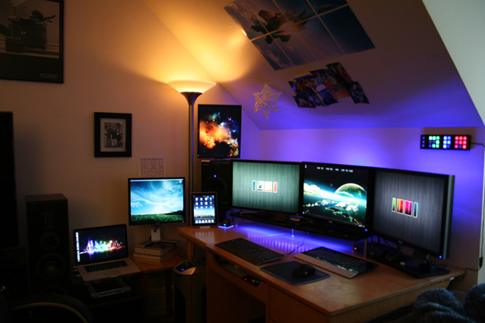
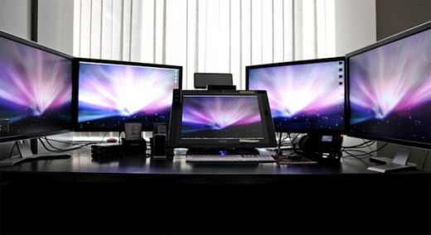
Graphic Design and CAD/CAM Workstations

Slide 6
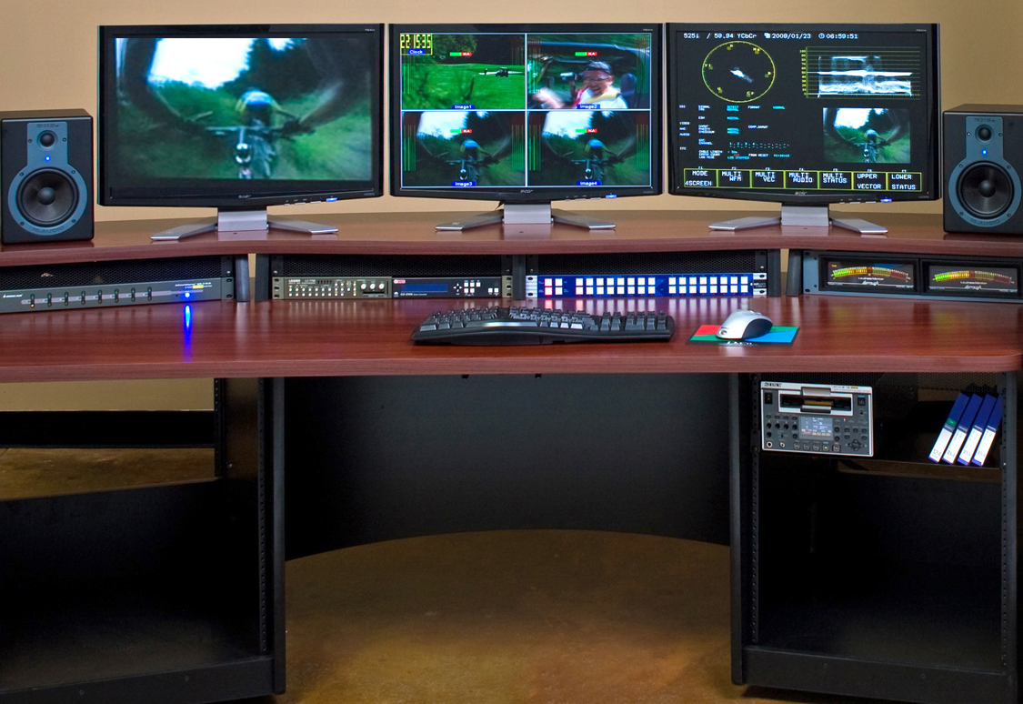
Audio/Video Editing Workstations

Slide 7
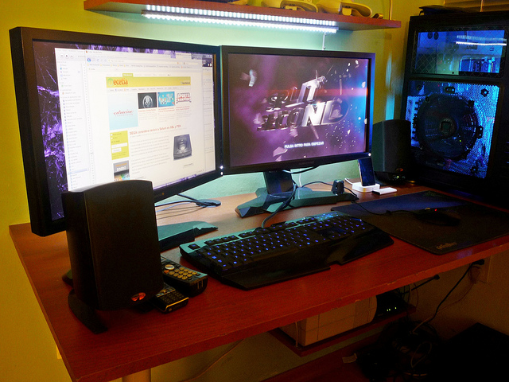
Gaming PCs

Slide 8
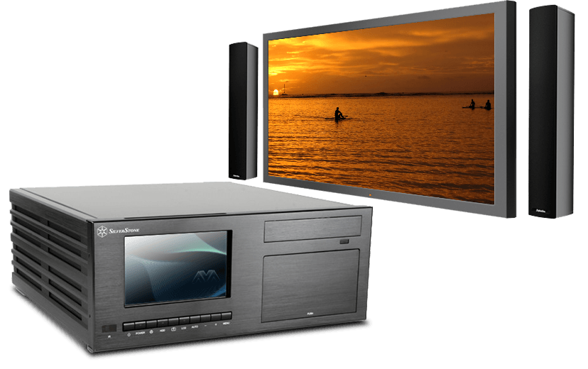
Home Theater PC

Slide 9
Home Server PCs
Connects various computing devices in the home.
Stores videos, music, pictures, and other files.
Manages file and print sharing.
Wireless network connectivity.

Slide 10
Reflective Questions
Have you had any experience with any of the workstation or server setups presented in this lesson?
What types of custom client setups do you think you will encounter the most in your role as an A+ technician?

