Slide 1
Operating System Fundamentals
PC and Mobile Operating Systems
PC Operating System Tools and Utilities

Slide 2
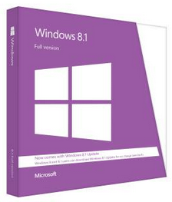
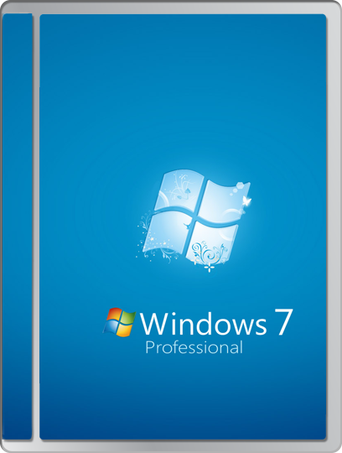
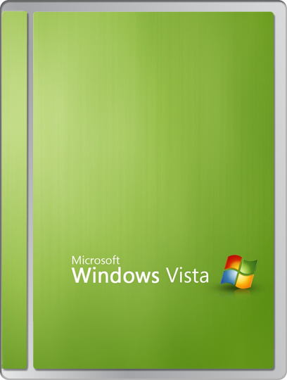
Microsoft Windows
Most popular desktop and server OS
All versions feature:
  Graphical user interface
  Wide application and device support
  32-bit or 64-bit processing
  Native networking
  Built-in applications and accessories
Often preinstalled on commercial PCs
Current versions found deployed:
  Windows 8/8.1
  Windows 7
  Windows Vista

Slide 3
Microsoft Windows Features
Feature | Description
Start Screen | Windows 8/8.1 user interface Main point of access for computer resources Tiles
Modern UI | Windows 8/8.1 user interface, also known as Metro UI Start Screen and tiles Live Tiles provide real-time information
File structure and paths | By default, all drives and partitions are organized separately Roots are indicated by a letter such as C;\ Directories reside hierarchically below the root and are separated by backslashes in the directory path (C:\Windows\system32) Maximum length for a directory path is 260 characters.
Side by side apps | Tile from two to four Windows Modern apps on a monitor Depends on monitor configuration
Pinning | Pin Modern apps to the Start Screen Pin traditional applications to the desktop taskbar
Live sign in | Email address that identifies you to Microsoft Log in to Windows 8/8.1 computers Log in to services like OneDrive Log in to devices like Windows phones

Slide 4
Microsoft Windows Features (Cont.)
Feature | Description
OneDrive | Microsoft cloud storage Available om any device when you use Live sign in
Windows Store | Source for Windows apps Free and paid apps Certified compatibility with Windows 8/8.1
Multi-monitor taskbars | List all open apps on the taskbars for both monitors Show only the apps on second monitor on its taskbar, and all open apps on main monitor taskbar Show only the apps on each monitor on their taskbars
Charms | Universal system tools for Windows 8/8.1 Available on the right side of any screen Search, Share, Start, Devices, and Settings
Windows PowerShell | Command line interface Run cmdlets (administrative commands)

Slide 5
Microsoft Windows Features (Cont.)
Feature | Description
Aero | Color scheme available in Windows Vista and Windows 7 Glossy and transparent effects Live Preview Flip 3D
Gadgets | Available in Windows Vista and Windows 7 Mini applications for displaying information Gadget Gallery
Sidebar | Available in Windows Vista and Windows 7 Vertical area along the edge of the desktop Stores gadgets
BitLocker | Security feature introduced with Windows 7 Full disk encryption
Shadow Copy | Available in Windows Vista and later versions Creates snapshots of data
System Restore | Available in Windows Vista and Windows 7 Monitors for changes to system files, drivers, and the Registry Creates system restore points that you can use to roll back certain changes

Slide 6
Microsoft Windows Features (Cont.)
Feature | Description
ReadyBoost | Available for Windows Vista and later versions Performance enhancer Augment RAM with external storage
Compatibility mode | Available for Windows Vista and later versions Allows older applications to run in newer versions of Windows
Windows XP mode | Available for Windows 7 Download for running Windows XP software and applications
Windows Defender | Available for Windows Vista and later versions Antispyware software
Category view and classic view | Available for Windows Vista and Windows 7 Category view shows Start menu, Control Panel, and other interfaces arranged in groups of related items Classic view shows Start menu, Control Panel, and other interfaces arranged in lists or series of icons
Action Center | Available in Windows 7 and later versions Provides summary information about a computer’s status Messages about security and other issues that you need to deal with

Slide 7
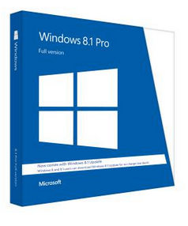
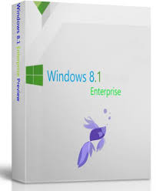
Versions of Microsoft Windows
Basic edition targeted at home user
  Lower cost
  Fewer features
Professional edition targeted at business user
Enterprise edition targeted at enterprise user

Slide 8

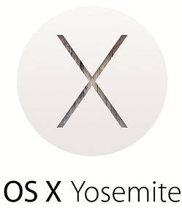

Other PC Operating Systems
UNIX
Linux
Apple OS X
Notes:
8

Slide 9


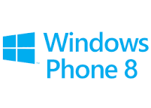
Popular Mobile Operating Systems
Apple iOS
Android
Windows Phone 8.1
Notes:
9

Slide 10
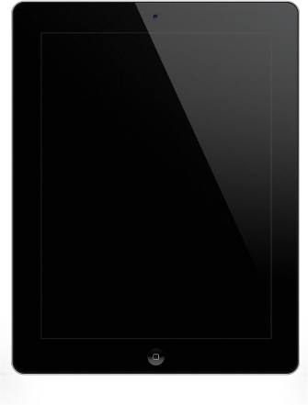
Common Features of Mobile OSs
Same interface control elements
  Switches, buttons, and sliders
Gesture-based interaction
Screen orientation adjustments
GPS capabilities
Emergency notification
Device calibration
Connection to Wi-Fi networks
Mobile payment options

Slide 11

iOS
Runs on iPhone, iPod touch, and iPad
Closed source OS
App source is the App Store in iTunes
Virtual assistant is Siri
Options for launching apps:
  Home screen
  Notification Center
  Siri
  Spotlight
  Launcher apps

Slide 12
Android
Layered environment based on Linux
  OS, middleware, and built-in apps
Open Handset Alliance
  Supports open source apps
App source is Google Play
Virtual assistant is OK Google
Options for launching apps:
  Android Launcher
  OK Google
  Launcher apps

Slide 13
Windows Phone 8.1
Closed source OS
Includes some built-in apps
Same look and feel as Windows on a PC or tablet
App source is the Windows Store
Virtual assistant is Cortana
Options for launching apps:
  Windows Mobile Device Center Launcher
  Cortana
  Launcher apps

Slide 14






User Authentication
Identification
  Who are you?
Authentication
  How can I tell?
Authorization
  OK, you have access to these resources.
Authentication factors
  Something you know
  Something you have
  Something you are
Multifactor authentication
  Two or more factors
Password: **********

Slide 15
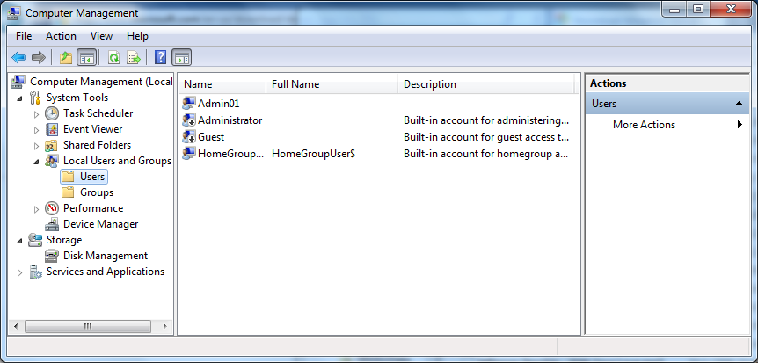
Local Users and Groups
Accounts created and stored on a PC.
Used in Windows 7, Windows Server 2008, and Windows Server 2012.
Assign permissions and rights to control access to resources.

Slide 16
Types of User Accounts
User Account | Description
Windows 8/8.1 Administrator account | Maximum amount of control over a computer. Account typically created when OS is installed. Only use this type of account when complete control is required.
Windows 8/8.1 Standard account | Use for day-to-day activities.
Windows 8/8.1 Child accounts | Parents or other authority figures can monitor or limit computer usage. Configure using Family Safety settings.
Windows 7 Administrator | Complete administrative access. Protect with a strong password. Might want to rename the account.
Windows 7 Standard User | Use for day-to-day activities. Need additional permission to install or remove software. Also known as non-privileged user account.
Windows 7 Guest account | Limited access for individuals who do not have a user account. Disabled by default.

Slide 17
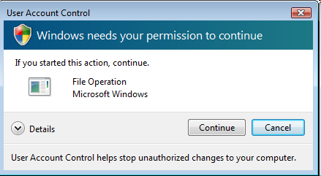
Windows User Account Control

Slide 18
Group Accounts
Group Account | Description
Administrators | Perform all administrative tasks on a computer. When an account is created during Windows installation, that account is automatically added to this group.
Users | Run applications and perform other day-to-day computer tasks for which the group has been granted permissions.
Guests | Perform any tasks for which the group has permissions. By default, all that members of this group can do is access the system.
Event Log Readers | Read event logs.
Remote Desktop Users | Log on remotely from another Windows computer.

Slide 19
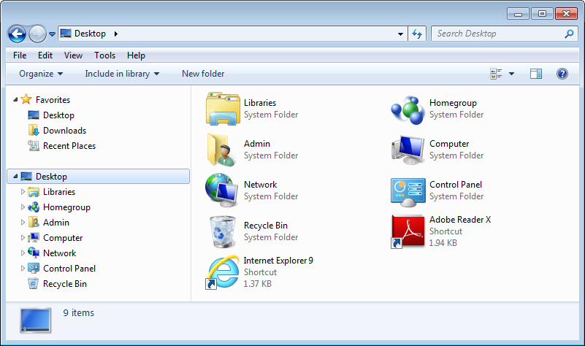
System Files and Folders
System folders

Slide 20
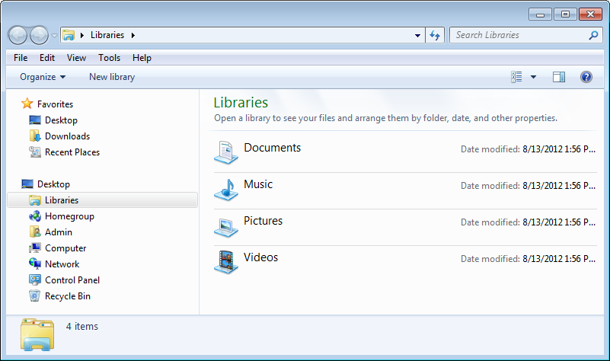
Windows Explorer

Slide 21
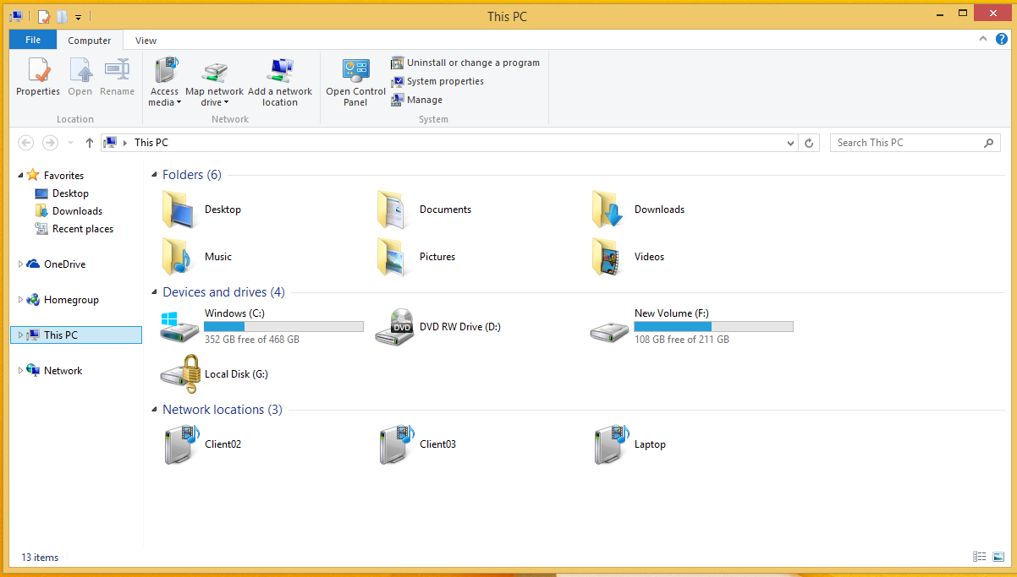
File Explorer

Slide 22
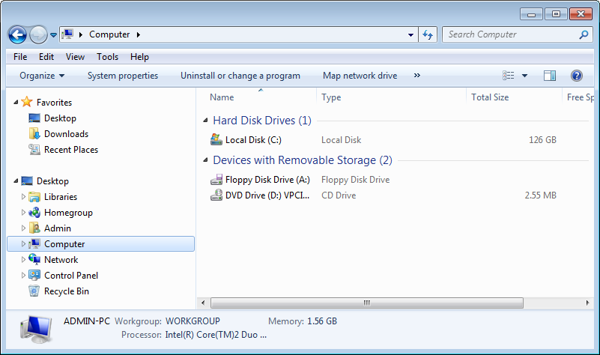
Computer in Windows 7

Slide 23
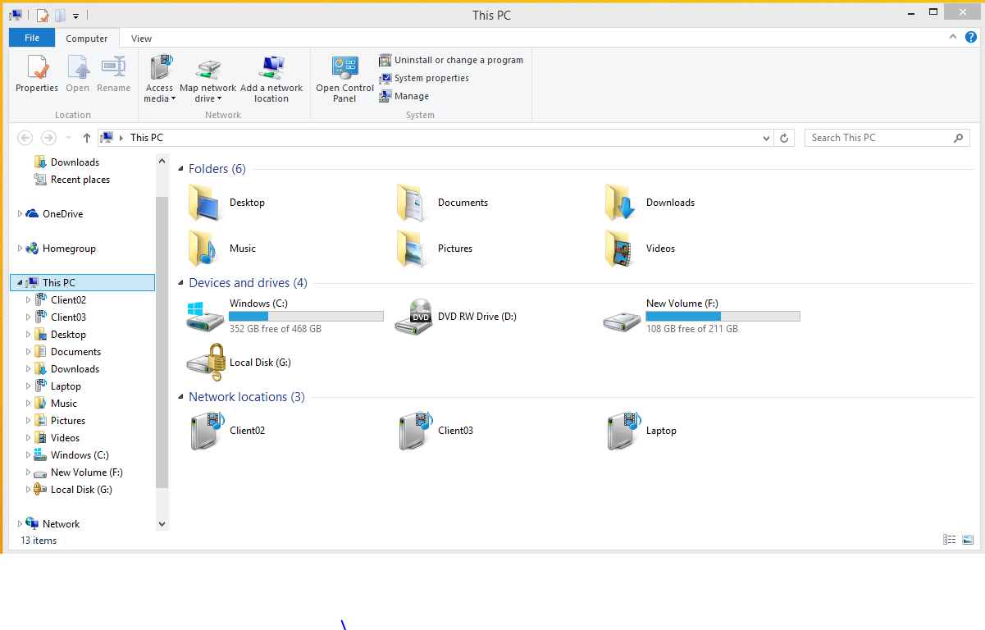
This PC in Windows 8.1

Slide 24
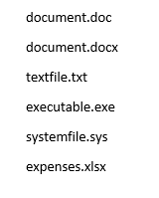
File Extensions
Differentiate between program files and data files.
For data files, can indicate which application can open and edit the files.
Usually three or four characters long.
Separated from file name by a period (.).
Changing an extension can change its behavior.
Does not display by default.

Slide 25
File Attributes
File Attribute | Description
Archive (A) | File has been backed up.
Hidden (H) | File is not displayed in file management tools.
Read-Only (R) | Users can read file contents or run an executable file, but cannot change the contents of the file.
System (S) | File is used by the OS and is automatically hidden by Windows.
Index (I) | In Windows, denotes that the file has been indexed to speed up searching.

Slide 26
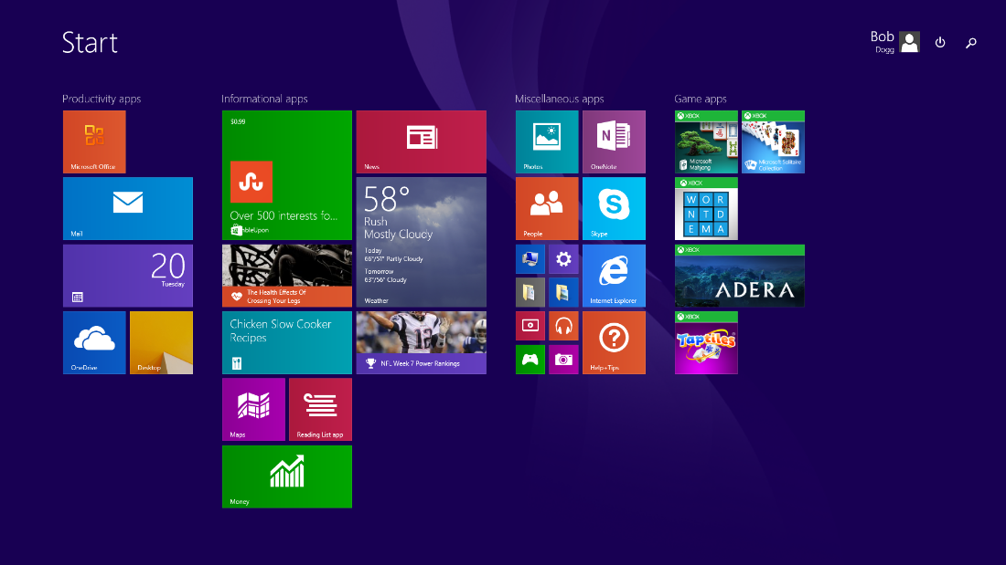
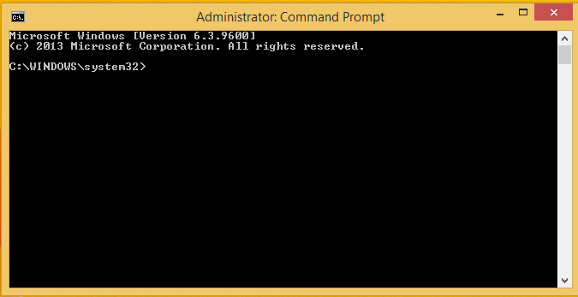
Types of User Interfaces
GUI
CLI

Slide 27

Windows Tools
Command line tools
  Command Prompt
  Windows PowerShell Console
GUI tools
  MMC
  Control Panel
  Windows PowerShell ISE
Methods for accessing tools

Slide 28

Linux Tools
Command line tools for most operations.
GUI tools depend on the distribution and GUI you are using.
Types of tools:
  Backup and restore
  Image recovery
  Disk maintenance
  Screen sharing
  Application management

Slide 29
OS X Tools
Most tools run from the GUI.
Command line tools are UNIX commands.
Types of tools:
  Backup and restore
  Image recovery
  Disk maintenance utilities
  Screen sharing
  Application management

Slide 30
Reflective Questions
1. With which type of operating system (mobile, desktop, or web-based) do you have the most experience? Which do you have the least experience using?
2. How will you remember which commands and tools are used with which operating systems? Why do you think this is important?

