Slide 1
Managing System Components
Identify Motherboard Components and Features
Install and Configure CPUs and Cooling Systems
Install Power Supplies
Troubleshoot System Components

Slide 2
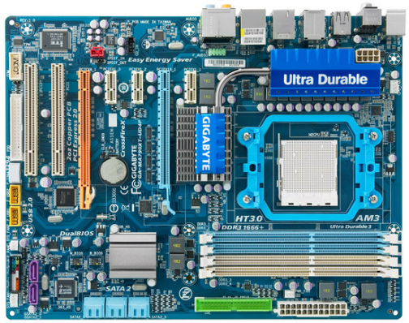
Motherboards

Slide 3
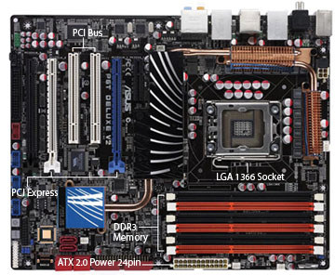
Motherboard Sizes/Form Factors
ATX is an older standard but has been revised several times
CPU close to cooling fan on power supply
Air flows into the case (original standard) or out of the case (later revisions)
Board rotated to allow access to entire motherboard
Can’t be used in Baby AT or LPX cases
Maximum size 12 x 9.6 or 12 x 10 inches
ATX

Slide 4
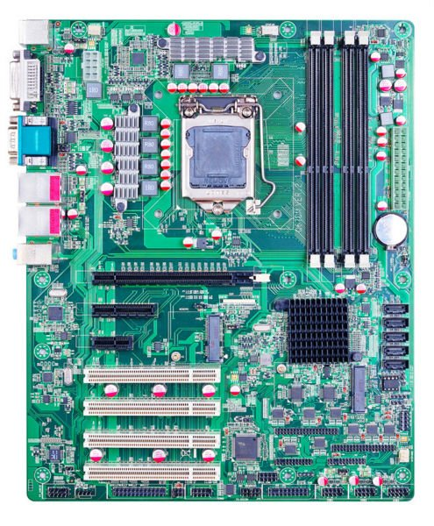
Motherboard Sizes/Form Factors (Cont.)
Same features as ATX
Maximum size 11.2 x 8.2 inches
Mini-ATX

Slide 5
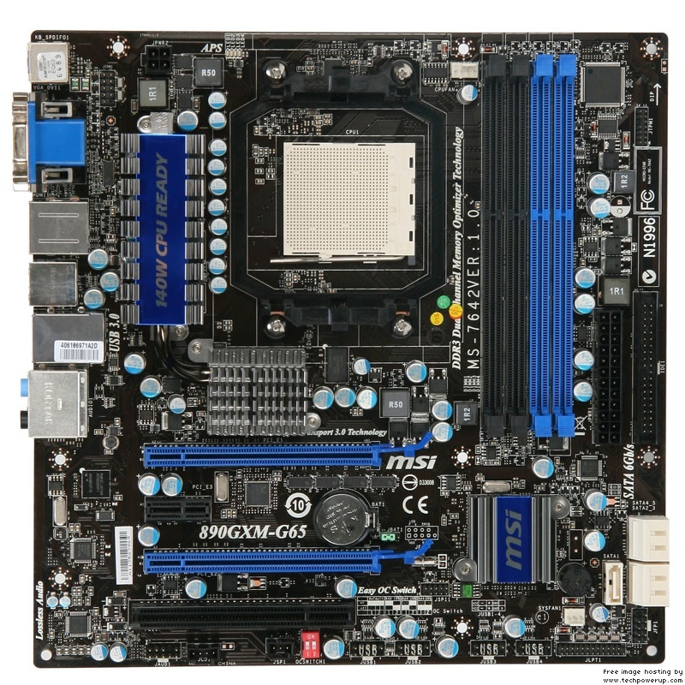
Motherboard Sizes/Form Factors (Cont.)
Integrated graphics
Backwards compatible with ATX
Fewer I/O ports than ATX
Maximum size 9.6 x 9.6 inches
MicroATX

Slide 6
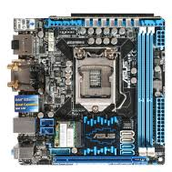
Motherboard Sizes/Form Factors (Cont.)
ITXs are small motherboard designed for industrial applications
Used in firewalls, home theater PCs, and embedded car computers
Mini-ITX maximum size 6.7 x 6.6 inches
Mini-ITX consumes less power
Mini-ITX

Slide 7
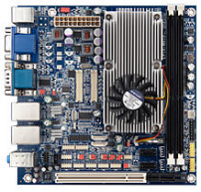
Identifying Motherboards, Step 1
6.7 inches
6.7 inches

Slide 8
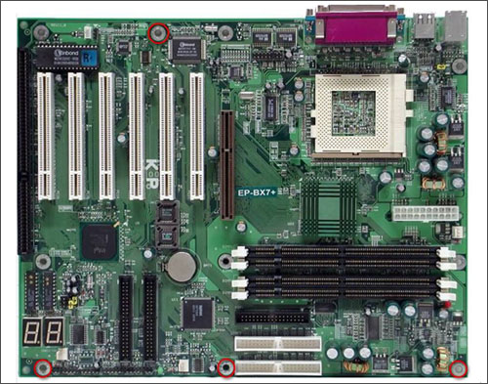
Identifying Motherboards, Step 2
10 inches
12 inches

Slide 9
Expansion Slots
PCI expansion slots
PCIe expansion slot

Slide 10
RAM Slots
RAM slots

Slide 11
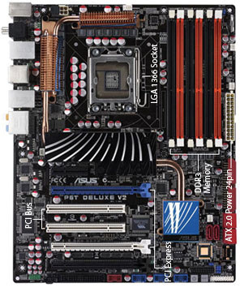
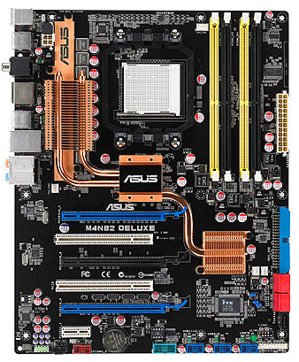
Chipsets
Chipset
Chipset

Slide 12
CPU Sockets
CPU socket
CPU socket

Slide 13
Bus Speeds
Determines how fast data is transmitted.
Speed varies based on bus.
Bus speed depends on installed components.

Slide 14
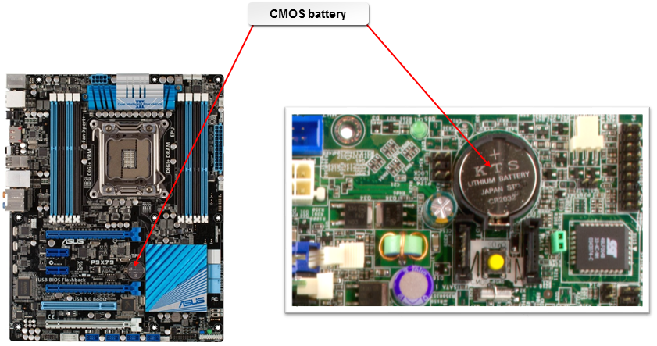
CMOS Batteries
CMOS battery

Slide 15
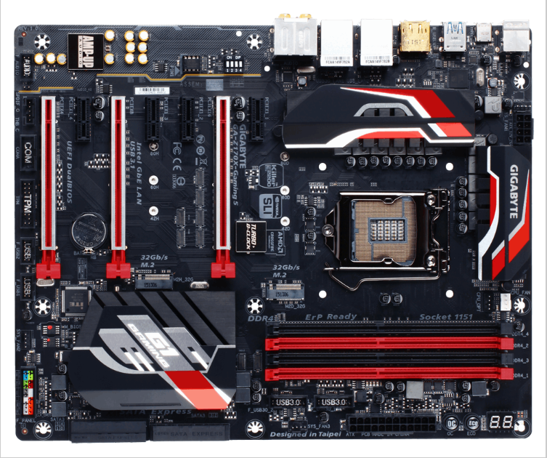
Power Connections
4/8-pin 12V (CPU) power connector
CPU fan connector
24-pin ATX (main) power connector

Slide 16
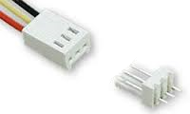
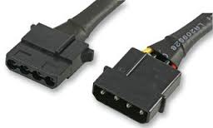
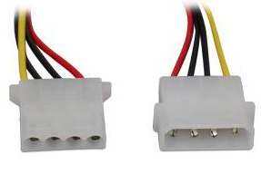
Fan Connectors
3-pin Molex KK fan connector
4-pin Molex KK fan connector
4-pin Molex direct fan connector

Slide 17
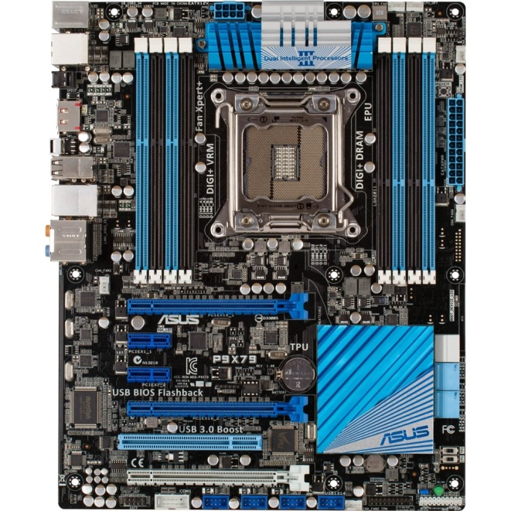

Front and Top Panel Connectors
Front USB header
Power button
Power LED
Reset button
HDD LED
Front panel header
Audio header
USB headers

Slide 18
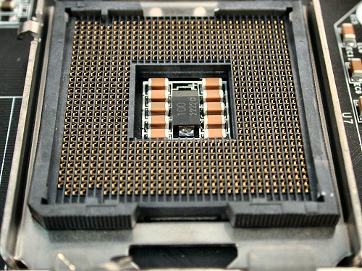
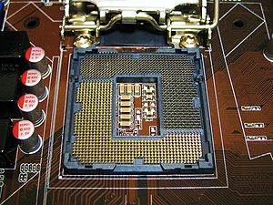
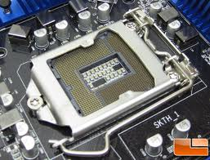
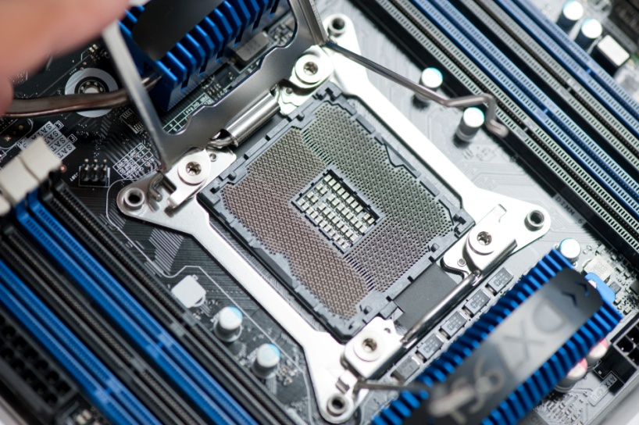
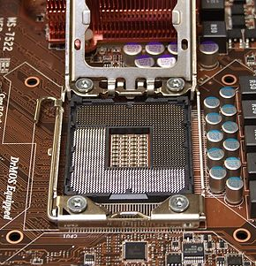
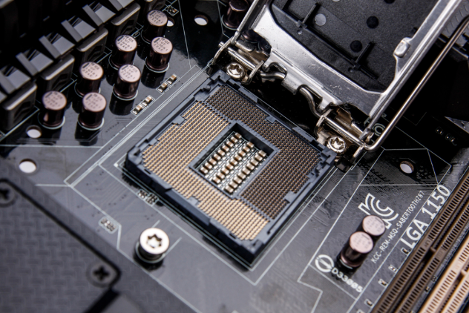
Intel CPU Socket Types
LGA 775
LGA 1156
LGA 1155
LGA 1150
LGA 1366
LGA 2011

Slide 19
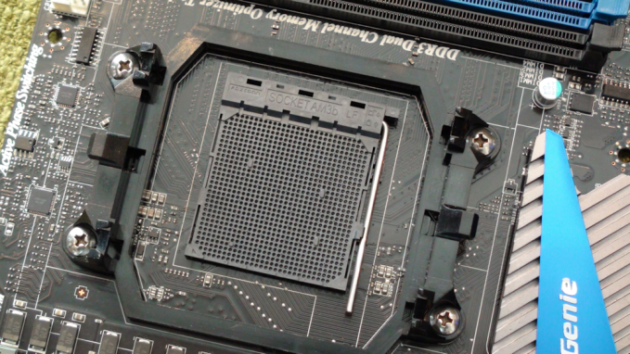
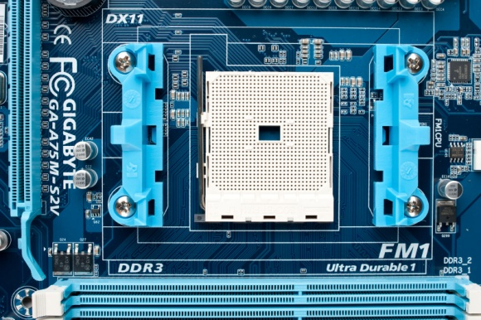
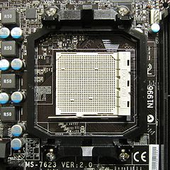
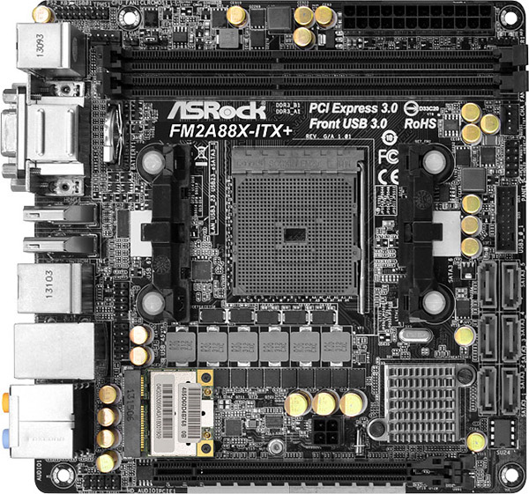
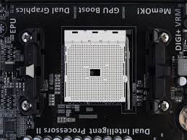
AMD CPU Socket Types
AM3
AM3+
FM1
FM2
FM2+

Slide 20
CPU Characteristics
Characteristic or Technology | Description
Architecture | A description of the width of the CPU’s front-side bus, which is either 32 or 64 bits.
Clock speed | The number of processing cycles a microprocessor can perform in one second. Also referred to as processor performance.
Overclocking | Configuring the CPU to run faster than it is rated to handle.
CPU speed | The overall rate at which instructions are processed. Factors that contribute are core clock speed and bus clock speed.
Throttling | Adjusting CPU speed to slow down during idle time or when hardware problems occur.
Hyperthreading | A feature of some Intel CPUs that enable one physical CPU to be recognized as two logical CPUs, increasing performance by up to 30%.

Slide 21
CPU Characteristics (Cont.)
Characteristic or Technology | Description
Integrated GPU | Graphics processing unit included on CPU die instead of dedicated graphics card.
Virtualization support | Virtualization software built into CPU’s chipset, enabling fast and efficient processing of instructions from multiple operating systems.
Cores | The computational heart of the PC. A CPU that contains multiple cores can be faster and more efficient than a single-core CPU.
Cache | Dedicated high-speed memory for storing recently used instructions and data.
VRM | Voltage regulator module, provides the CPU with the appropriate voltage.
MMX | Multimedia extensions, additional instructions that support sound, video, and graphics.
EDB | A hardware-based security feature that allows the processor to classify and separate memory areas where application code can and cannot run. Intel: XD bit; AMD: Enhanced Virus Protection. The OS must support the NX bit to use this feature.

Slide 22
CPU Cooling Methods
Cooling System | Description
Fans | Computer fans provide cooling by blowing regular air across heated components. It is common to see case fans, power supply fans, adapter card fans, and CPU fans.
Vents | Computer cases are designed with vents to facilitate airflow through the case and across all components. A common implementation is to include air vents near the bottom of the front of the case and to place a fan near the top of the rear of the case to pull cooler air through the system.
Heat sinks | A heat sink is designed to provide direct cooling to a system's CPU. Heat sinks have metal fins to increase their surface area to aid in heat dissipation. Cool air is blown past it by a fan, removing the heat from the processor.
Thermal paste | Thermal paste connects a heat sink to a CPU. At the microscopic level, when two solids touch, there are air gaps that act as insulation; the liquid thermally conductive compound gel fills these gaps to permit a more efficient transference of heat from the processor to the heat sink.
Fanless/passive | A fanless CPU cooler passively transfers heat through convection to the area surrounding the CPU. This ensures that hot air can move out of the CPU chassis without the assistance of loud, dust-accumulating fans. The fanless cooler is therefore more silent and efficient than traditional heat sinks.
Liquid-based | CPUs can also be kept cool by circulating a liquid or liquefied gas past the CPU. Like an air conditioner or car radiator, heat from the CPU is absorbed by the cooler liquid, and the heated liquid is circulated away from the CPU so it can disperse the heat into the air outside the computer. Also quieter than using fans. Not as prevalent as heat sinks in most desktop systems or low-end servers, but you might encounter them if your organization has deployed computers with hexa-core or octa-core processors.

Slide 23
Power Supply Specifications
Specification | Description
Size | AT ATX Micro ATX Proprietary
Connector style | Berg Molex SATA
Voltage | Power supply must provide voltages needed by system components Dual-voltage power supplies Single rail and dual rail Power needs calculations Voltage selector switch (115 V or 230 V)
Wattage | Old PCs: up to 200 W Modern PCs: 200 to 500 W High-end PCs: 500 W to 1 kW

Slide 24
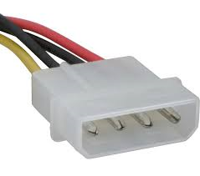
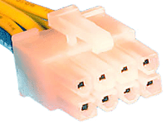
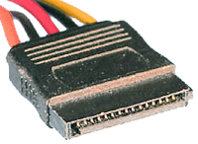
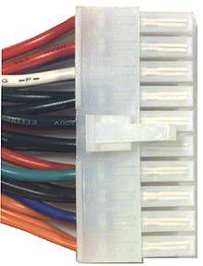
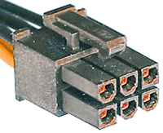
Power Connector Types
SATA power connector
Molex power connector
4/8-pin 12V power connector
PCIe 6/8-pin power connector
Main power connector

Slide 25
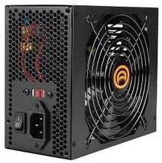
Power Supply Safety Recommendations
Check for UL certification.
Replace instead of repairing.
Keep the computer case closed during normal operation.
Protect the power supply.

Slide 26
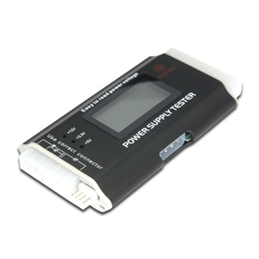
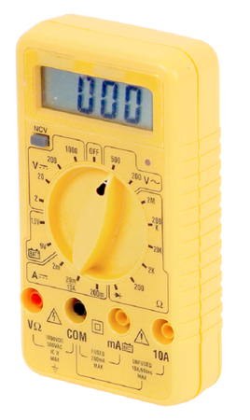
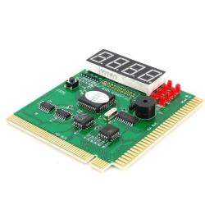
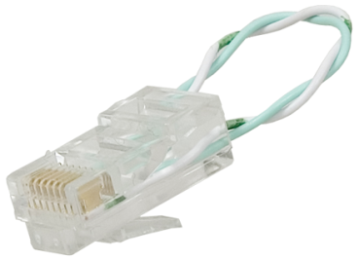
Common System Troubleshooting Tools
Power supply tester
Multimeter
Loopback plug
POST card

Slide 27
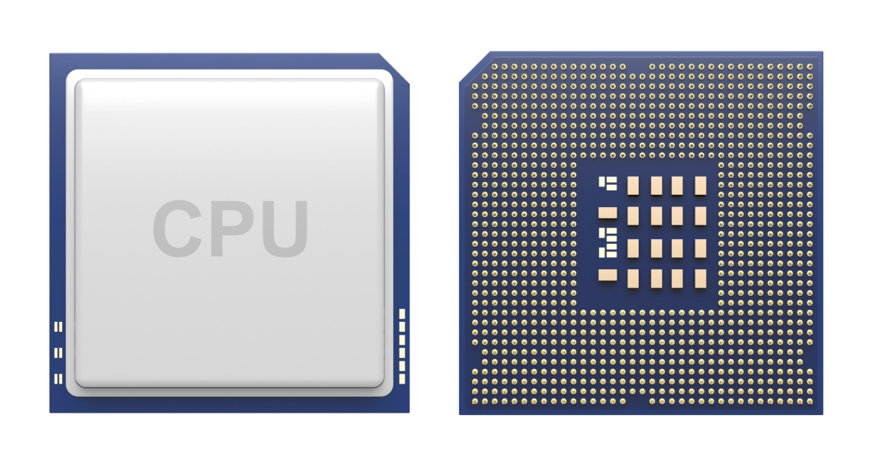
Common CPU Issues
Overheating and failure
Slot and socket compatibility
Cooling system issues
Excess power consumption

Slide 28
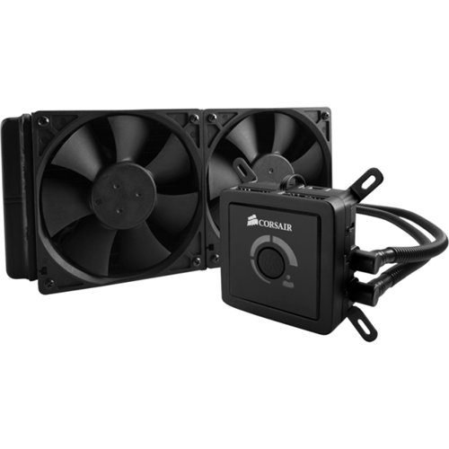
Common Cooling System Issues
Dust buildup
Poor airflow
Poor heat transfer

Slide 29
Common Motherboard Issues
Difficult to recognize and diagnose
Typical issues include:
  Computer will not boot
  Computer displays erratic behavior
  Intermittent device failure
Sources:
  Viruses
  Loose connections
  BIOS problems
  CMOS battery problems
  Heat or electrical damage
  Power surges
  Physical damage

Slide 30
Repair vs. Replace
Very few components on the board are individually repairable.
Most times when a motherboard fails, you will replace it.

Slide 31
Common External Power Source Problems
Power Problem | Possible Causes
Line noise | EMI. RFI. Lightning. Defective power supply.
Power sag | Several electrical systems starting at one time. Switching loads at the electric company utility. Electric company equipment failure. Inadequate power source.
Power undervoltage / brownout | Decreased line voltage. Demand exceeds power company supply. Utility reduced voltage to conserve energy.
Frequency variation | Supplying power via a generator and without a conditioner or inverter.
Overvoltage | Suddenly reduced loads. Equipment with high power consumption turns off. Power company switches loads between equipment. Lightning strikes.
Power failure | Lightning strikes. Power lines down. Overload of electrical power needs.

Slide 32
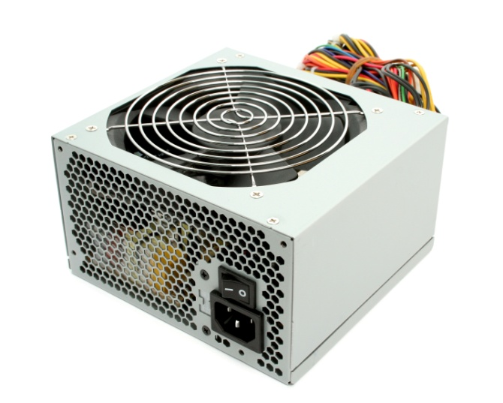
Common Power Supply Problems
Fans will not work.
No power.
Fans spin but no power to other devices.
Computer will not start or reboots after startup.
An odor or burning smell is coming from the power supply.
Smoke coming from the computer.
Loud noise is coming from the power supply.

Slide 33
Power Supply Troubleshooting Considerations
Verify how much power each system component requires.
Verify that the usage does not exceed the power supply capacity.
When replacing, consider the connection type and number of connectors.
Verify that the output voltages are within the range of what is expected.

Slide 34
Reflective Questions
In your current job role, what system components have you worked with the most? In future job roles as an A+ technician, what system components do you think you will be working with the most?
What types of cooling systems have you worked with? What would you recommend for the average user?

