Slide 1
Installing and Configuring Peripheral
Components
Install and Configure Input Devices
Install and Configure Output Devices
Install and Configure Input/Output Devices
Install and Configure Expansion Cards

Slide 2
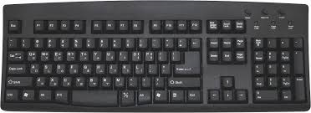
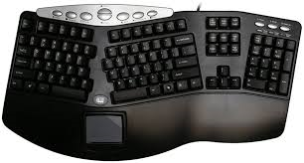
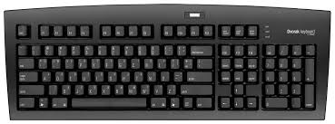
Keyboards
Standard (QWERTY) keyboard
Ergonomic keyboard
Dvorak keyboard

Slide 3
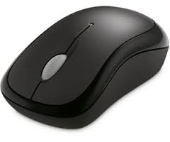
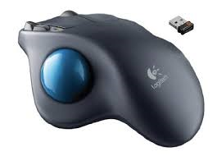
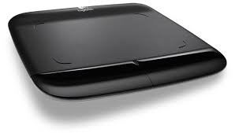
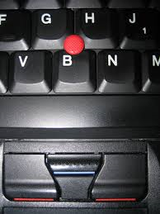
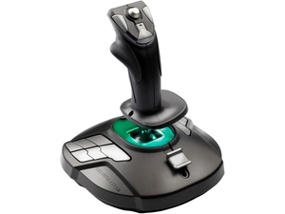
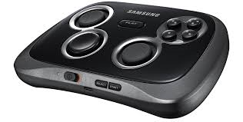
Pointing Devices
Mouse
Trackball
Touch pad
Trackpoint
Gamepad
Joystick

Slide 4
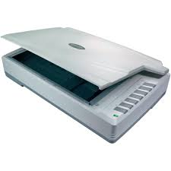
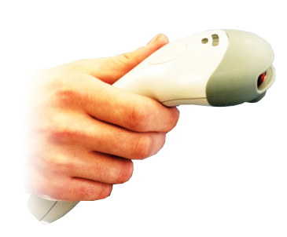
Optical Input Devices
Flatbed scanner
Barcode reader

Slide 5
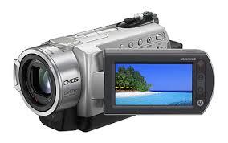
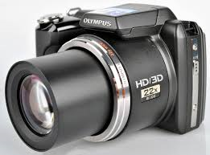
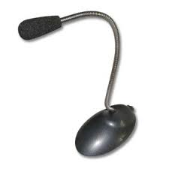
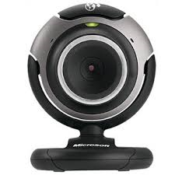
Multimedia Input Devices
Digital camera
Camcorder
Webcam
Microphone

Slide 6
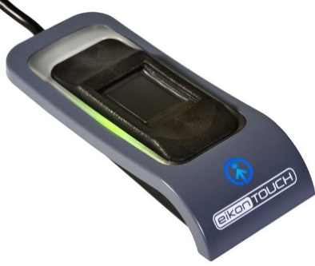
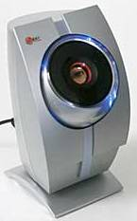
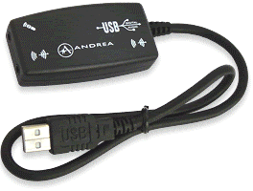
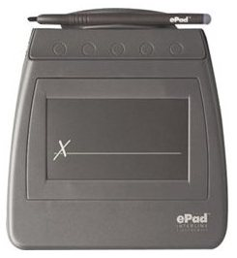
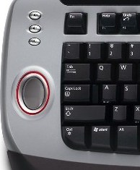
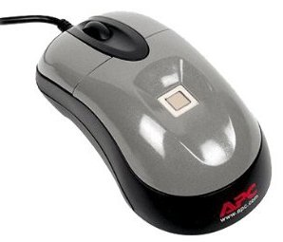
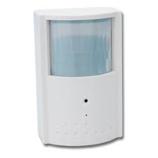
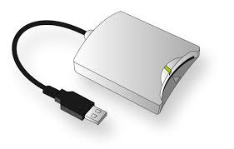
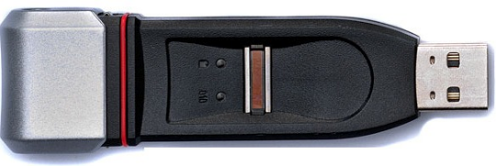
Security Input Devices
Fingerprint scanner/reader
Retina scanner
Voice recognition system
Signature recognition system
Biometric keyboard
Biometric mouse
Biometric storage devices
Motion sensor
Smart card reader

Slide 7
Guidelines for Installing Input Devices
Verify that you have the most current drivers for the device and for the PC’s OS.
Either let the PC find the driver, or restart and see if the device is recognized.
  If that does not work, you will need to find a driver for the device.
Review the manual or quick start guide that came with the device.

Slide 8
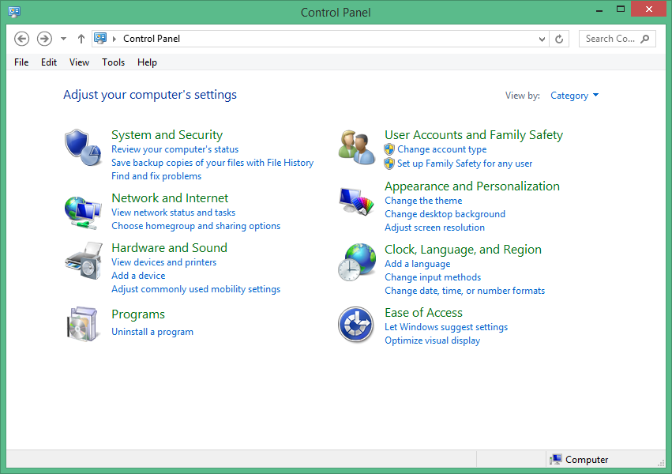
Windows Input Device Configuration Tools
Windows Control Panel or Windows 8 PC Settings
Sample configuration options:
  Mouse: Specify primary mouse button and double-click speed
  Keyboard: Adjust character repeat rate
  Touch pad: Specify input delay
  Touch screen: Calibrate for pen or touch and specify meaning of gestures
  Bluetooth: Specify whether Bluetooth is on or off

Slide 9


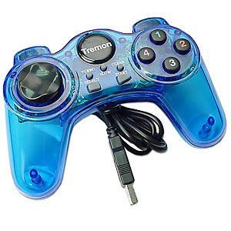

Third-Party Configuration Utilities for Input
Devices
Provide additional functionality beyond that of OS device drivers.
Sometimes need to install utilities before devices.

Slide 10
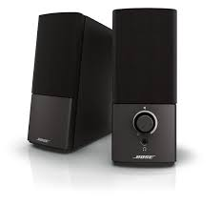
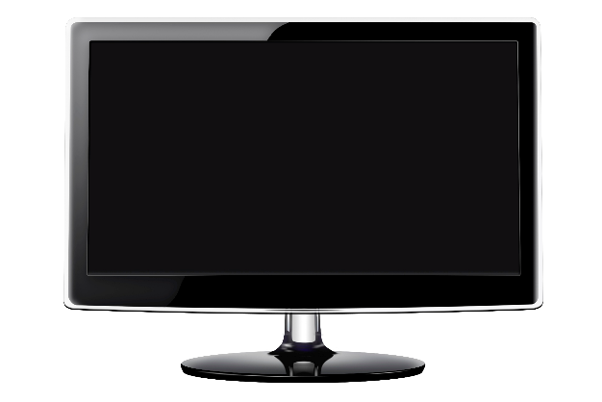
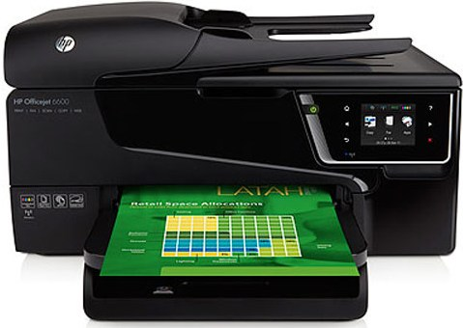
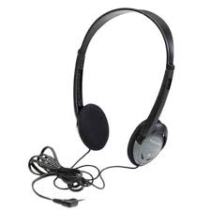
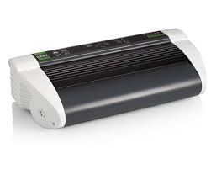
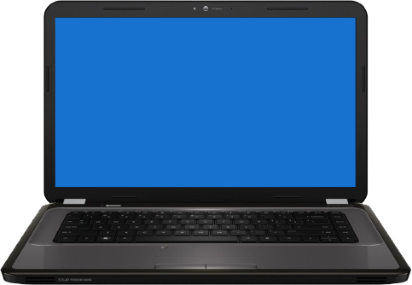

Output Devices
Display devices
Printers
Speakers
Headphones
Braille printer
Screen reader

Slide 11

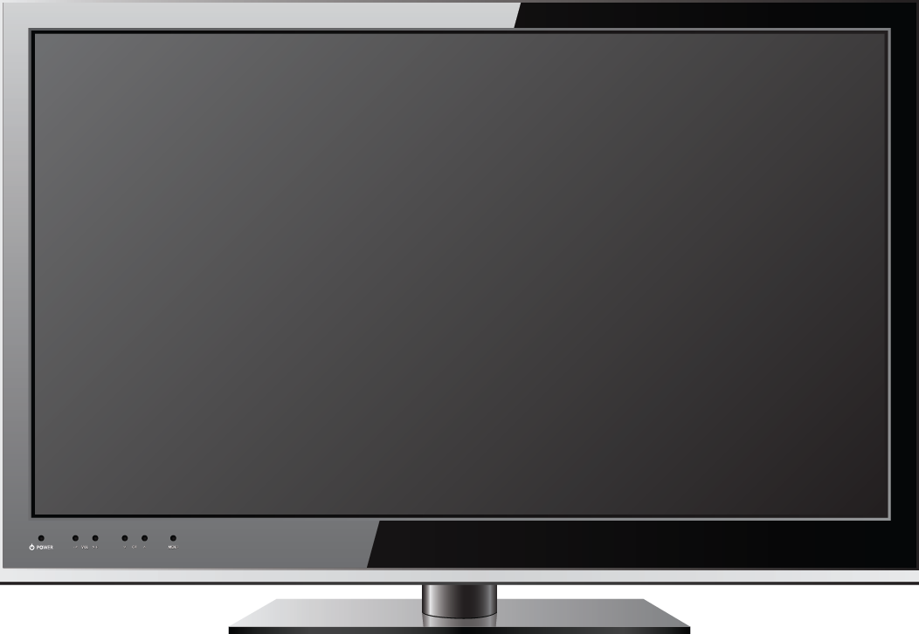
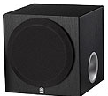


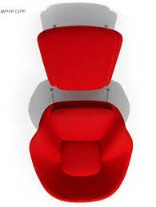

Surround Sound
Front center
Subwoofer
Front left
Front right
Surround left
Surround right
Surround back left
Surround back right

Slide 12
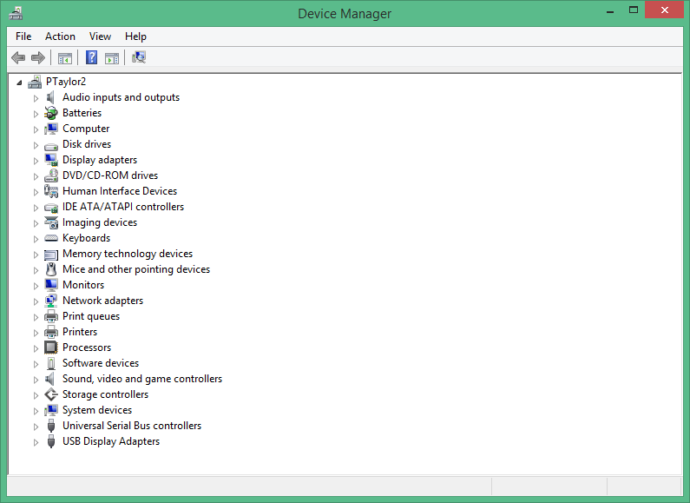
Device Manager
My PC

Slide 13
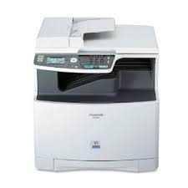
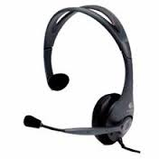
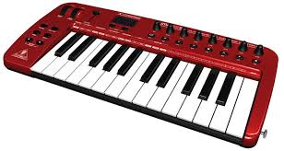
Input/Output Devices
MIDI-enabled device
Multifunction printer
Headset

Slide 14
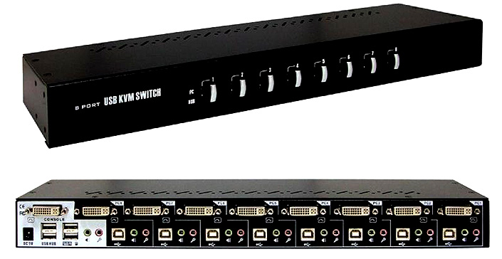
KVM Switches

Slide 15
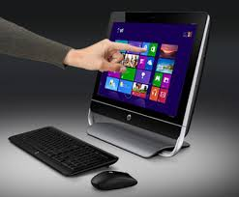
Touch Screens

Slide 16
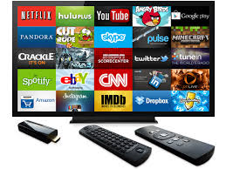
Smart TVs

Slide 17
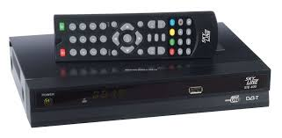
Set-Top Boxes

Slide 18
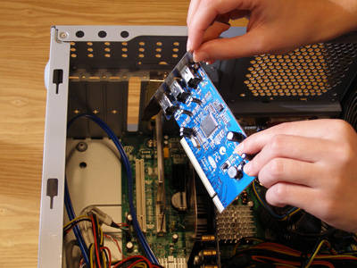
Expansion Card Types
Sound cards
Video cards
Network cards
USB cards
FireWire cards
Thunderbolt cards
Storage cards
Modem cards
Wireless/cellular cards
TV tuner cards
Video capture cards
Riser cards

Slide 19
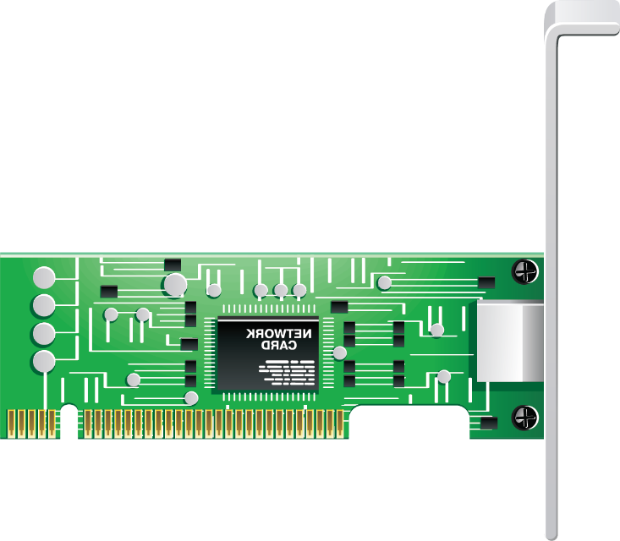

Expansion Card Configuration
Plug and Play installation
  Add Hardware Wizard.
  Scan for new hardware.
  Select driver or accept default driver.
Manual installation
  When Plug and Play installation is not successful.
  Download driver from manufacturer website.
  Use Device Manager to manually install driver.
  Manufacturer installation utility.

Slide 20
Reflective Questions
1. What types of peripheral components do you anticipate having to install and configure most often in your current job role?
2. Will there be any specialty input devices that you will need to install or configure at your workplace? How might this affect your day-to-day activities as an IT professional?

